Slide 1

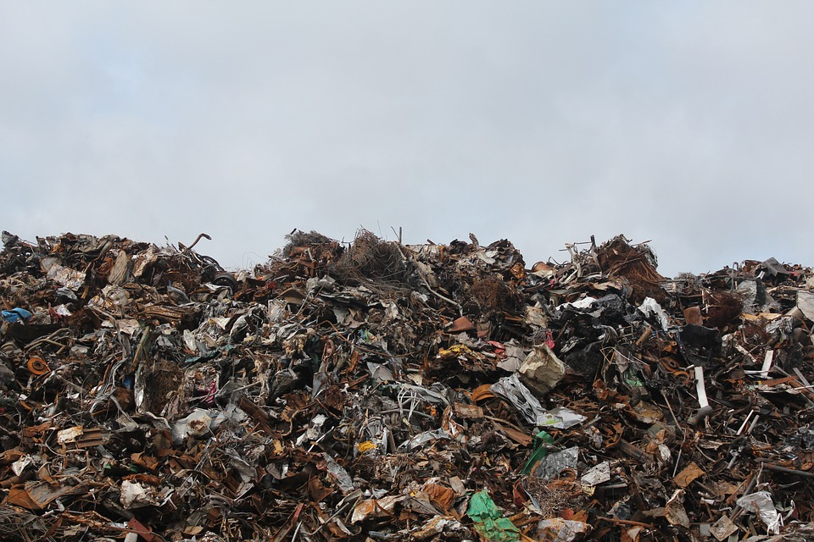
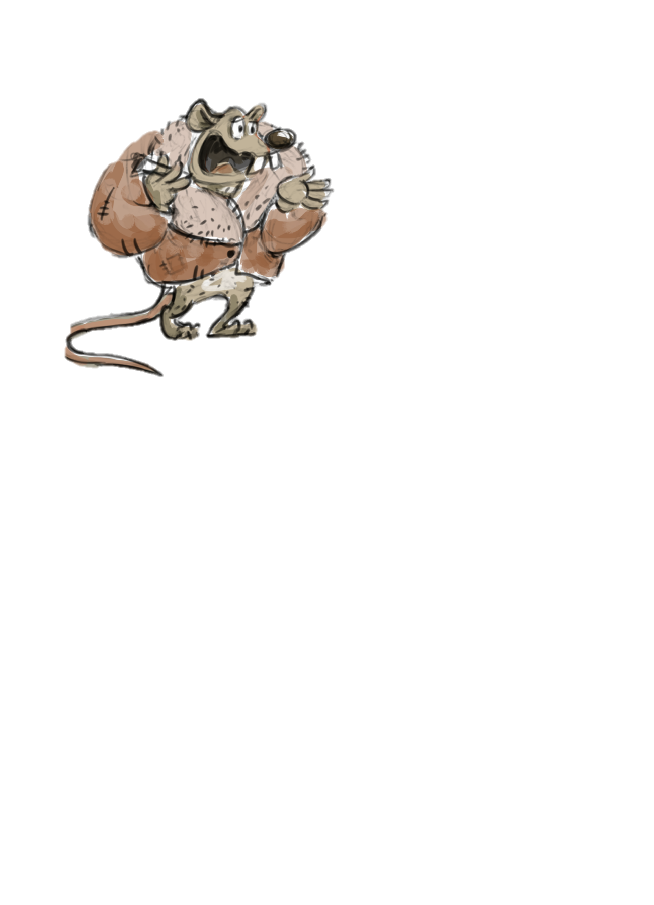
The Dirty Game
Development of a Card Game to Promote Sustainable Waste Management
Dan Podjed

Slide 2




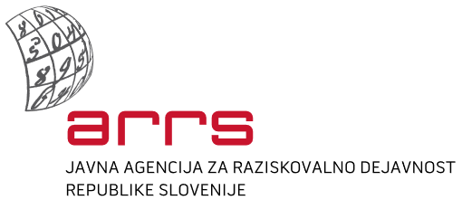
www.lifeofwaste.eu
“Show me your garbage, and I will tell you who you are. Show me how much waste you produce, and I will tell you what kind of society you live in.”
-Thomas Hylland Eriksen, 2011
Project partners
Financing
Notes:
Lepo pozdravljeni!
V naslednje pol ure vam bom v povzetku predstavila zaključke svoje doktorske naloge, kjer smo preučevali vlogo socialnih dejavnikov pri razvoju okoljske ozaveščenosti in spreminjanju okoljskega vedenja. Naj povem, da bo predstavitev nekoliko slikovno obarvana. Kot glavni lik nastopajo ovčke v najrazličnejših vlogah. Če se bo kdo slučajno v katerem izmed likov prepoznal je pa to zgolj naključje.

Slide 3
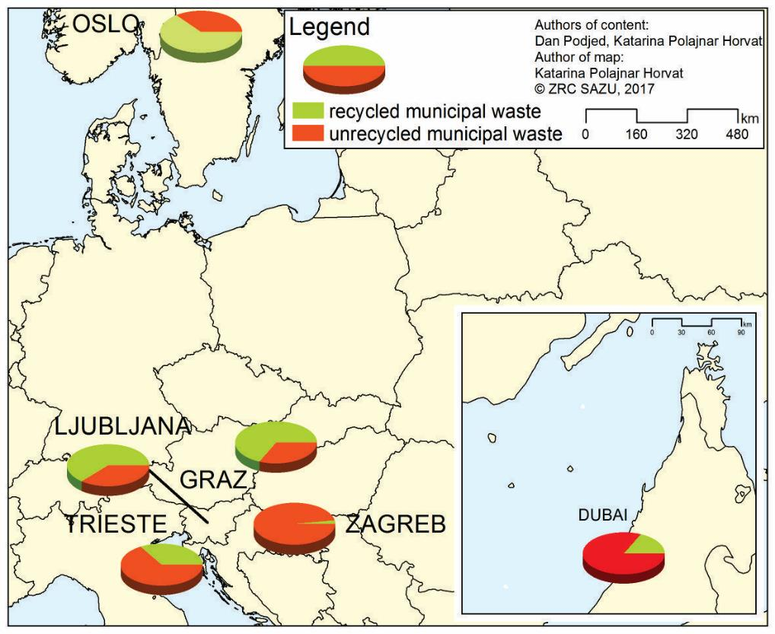
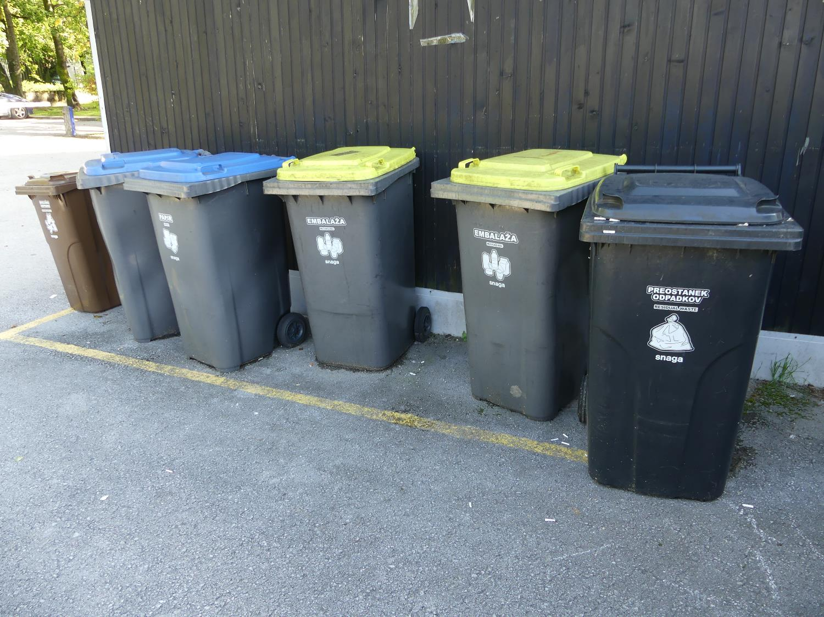
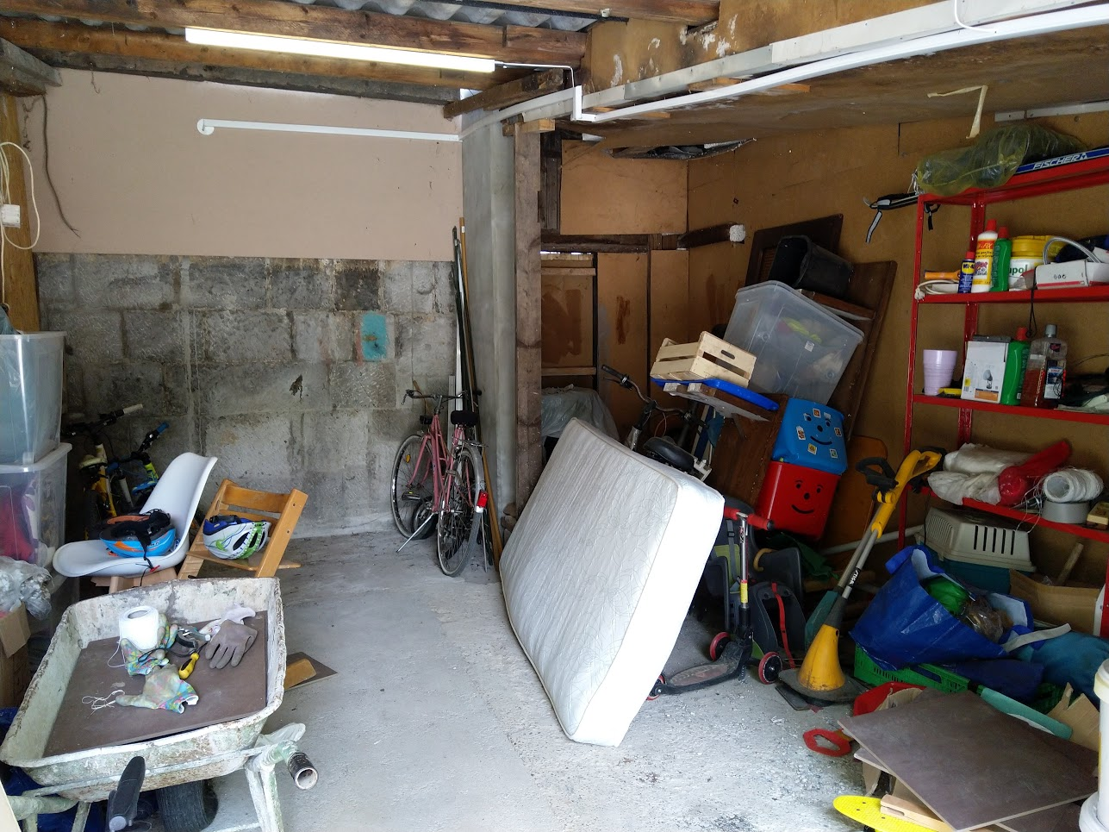

Slide 4



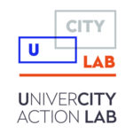

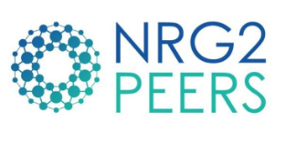




4 STEPS OF THE PEOPLE-CENTRED DEVELOPMENT
OFTEN LEFT OUT
STEP 4:
TESTING
Why does it matter to the people?
STEP 3:
INTERPRETATION
What and how will we create to serve their needs?
STEP 2:
ANALYSIS
What do people want?
STEP 1: IDENTIFICATION
Who are we solving for – and with?
improvements
design and development
Identification and analysis methods:
interviews, focus groups, participant observation, questionnaires, etc.
Interpretation and testing methods:
prototyping, scenarios, card sorting, think aloud, etc.

Slide 5
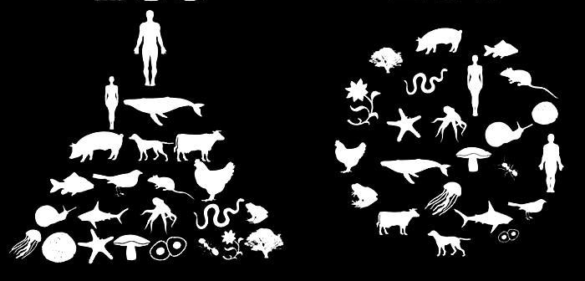
EGO
ECO
expert
development
people-centred
development
planet-centred
development
PARADIGM SHIFT

Slide 6
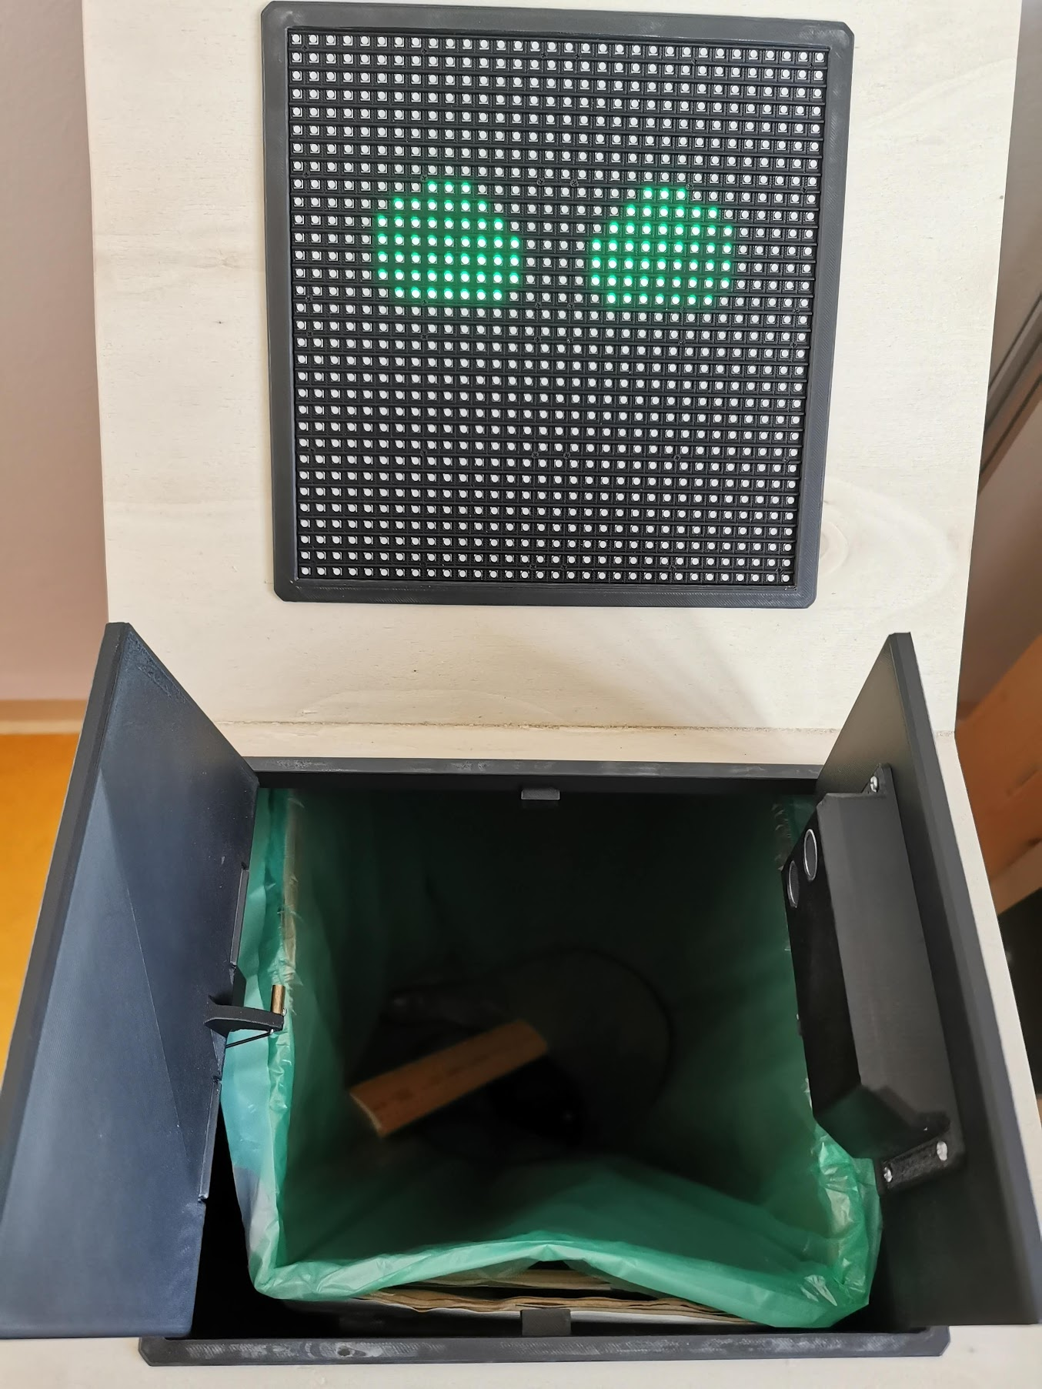
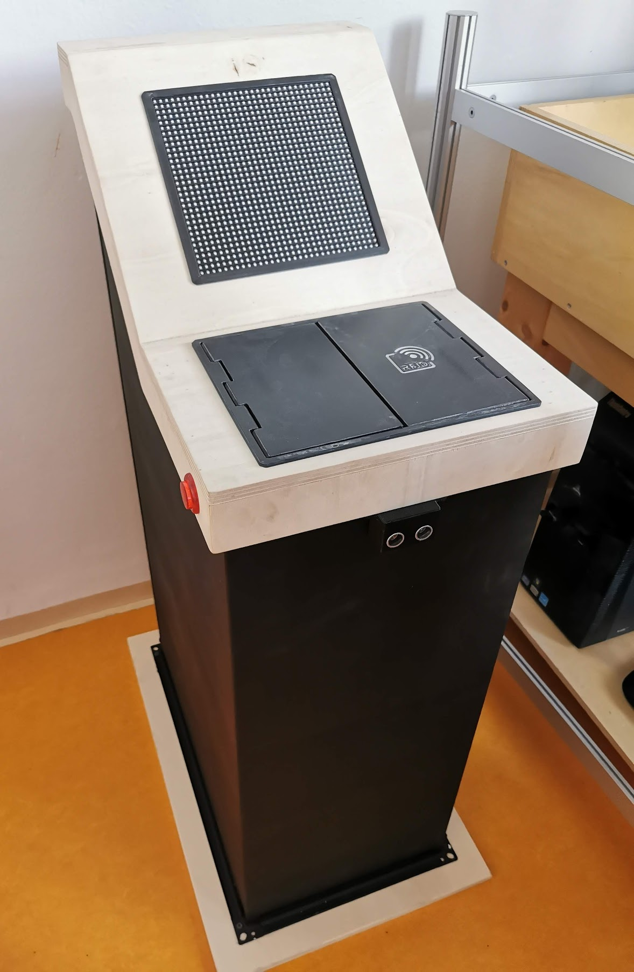

Slide 7
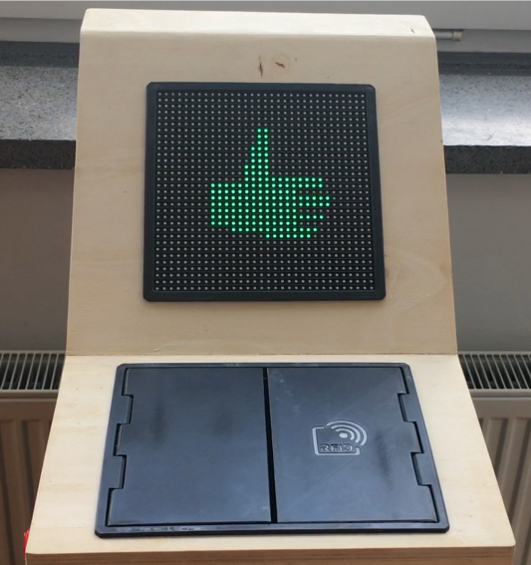
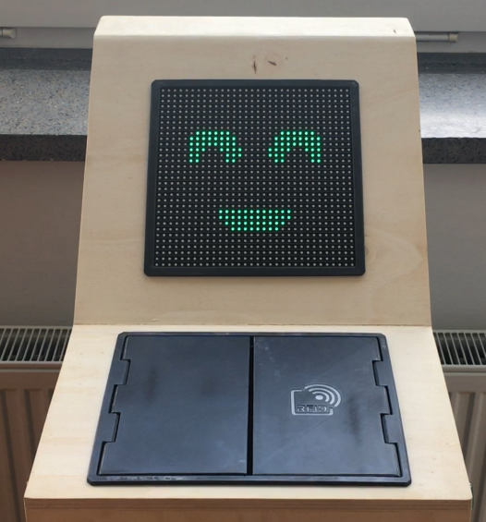
Guna, Jože, Katarina Polajnar Horvat & Dan Podjed. 2022. People-centred Development of a Smart Waste Bin. Sensors 3 (1288): 1-14.

Slide 8
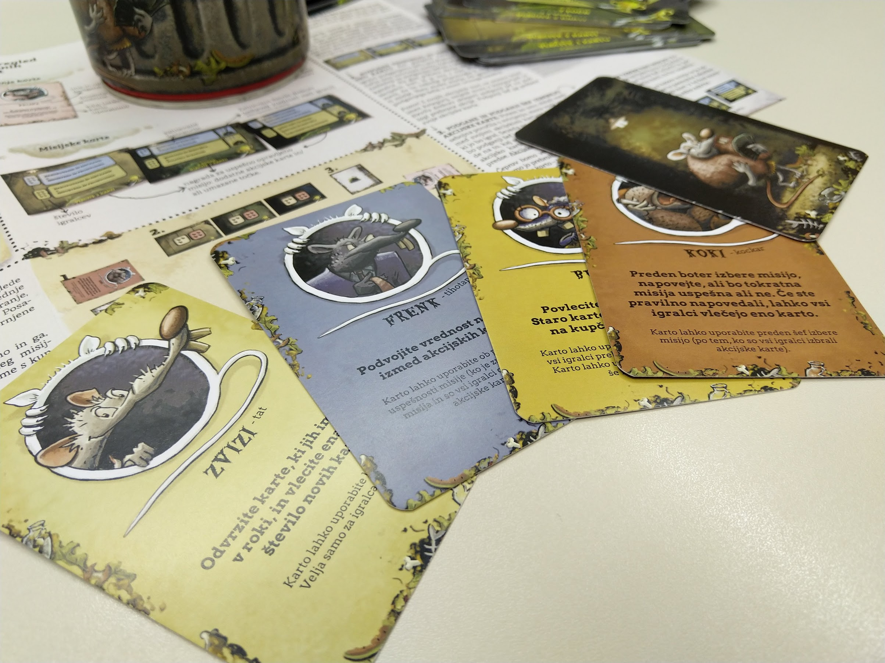

Slide 9
