Slide 1
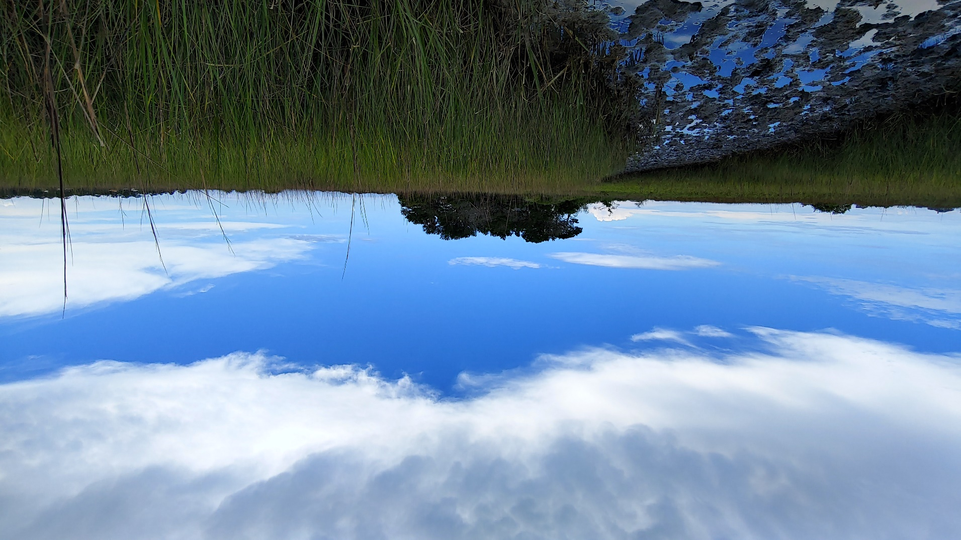
The Archaeology of Colonialism at Fort Mose: Forging Freedom through Practice (1752-1763)
Lori Lee
Flagler College

Slide 2
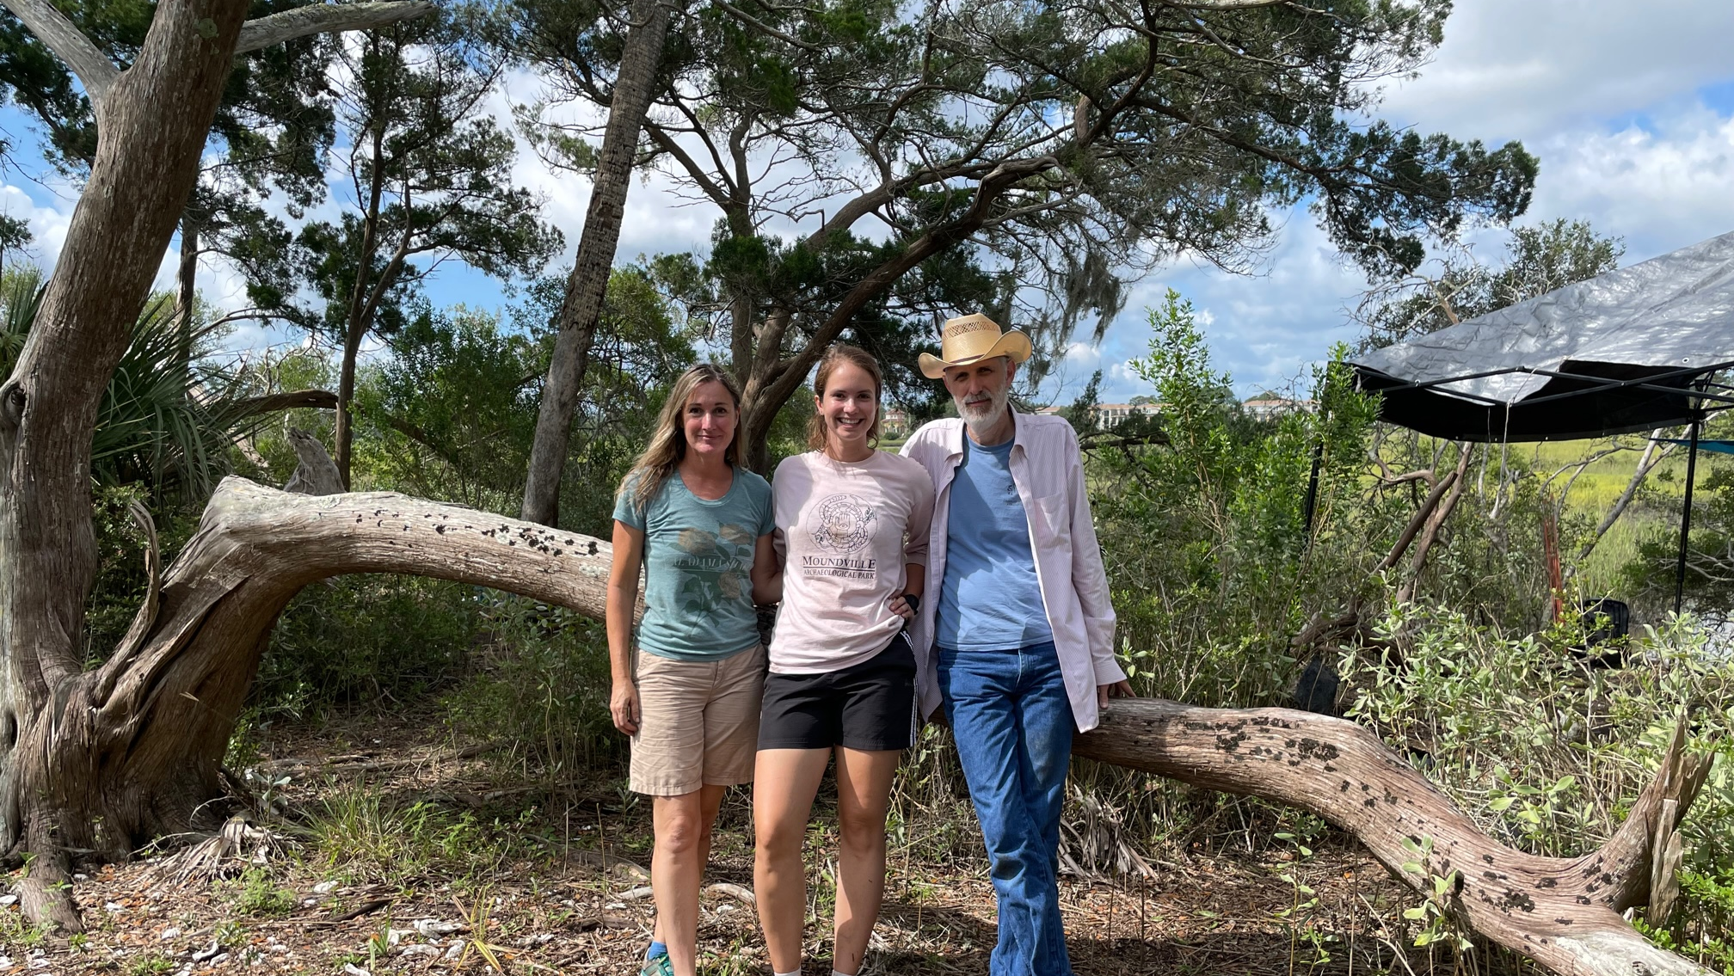

Slide 3
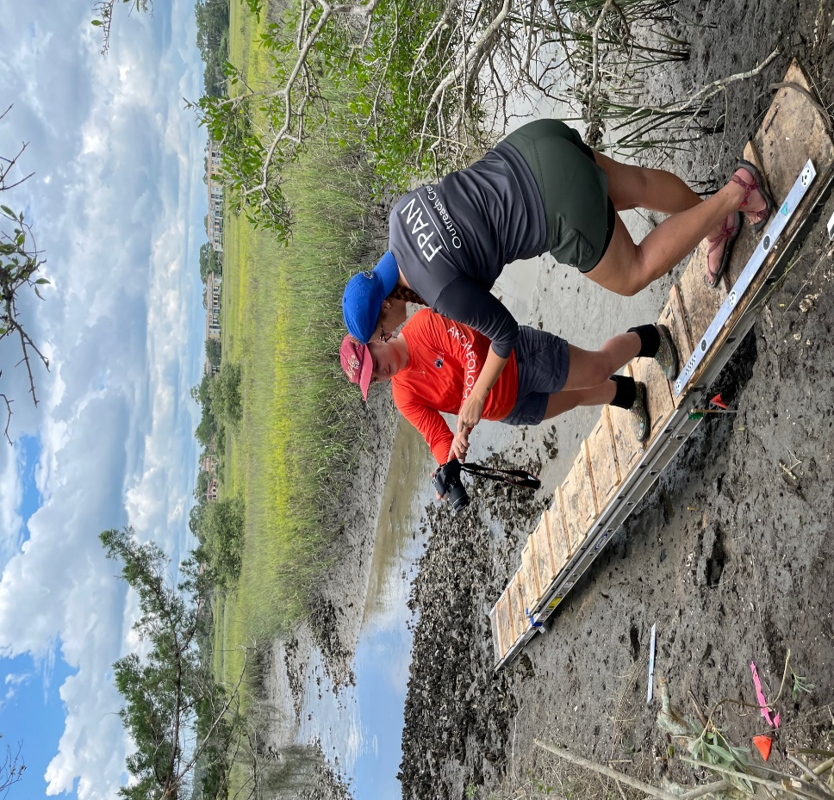
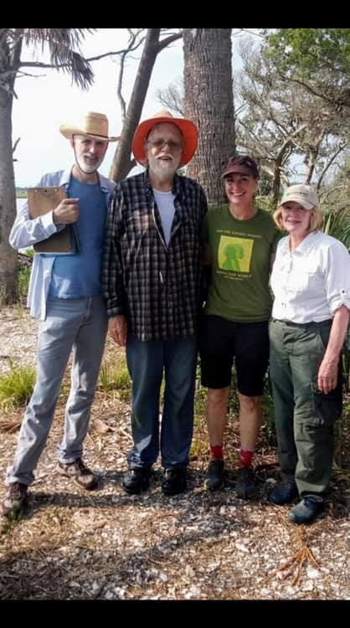
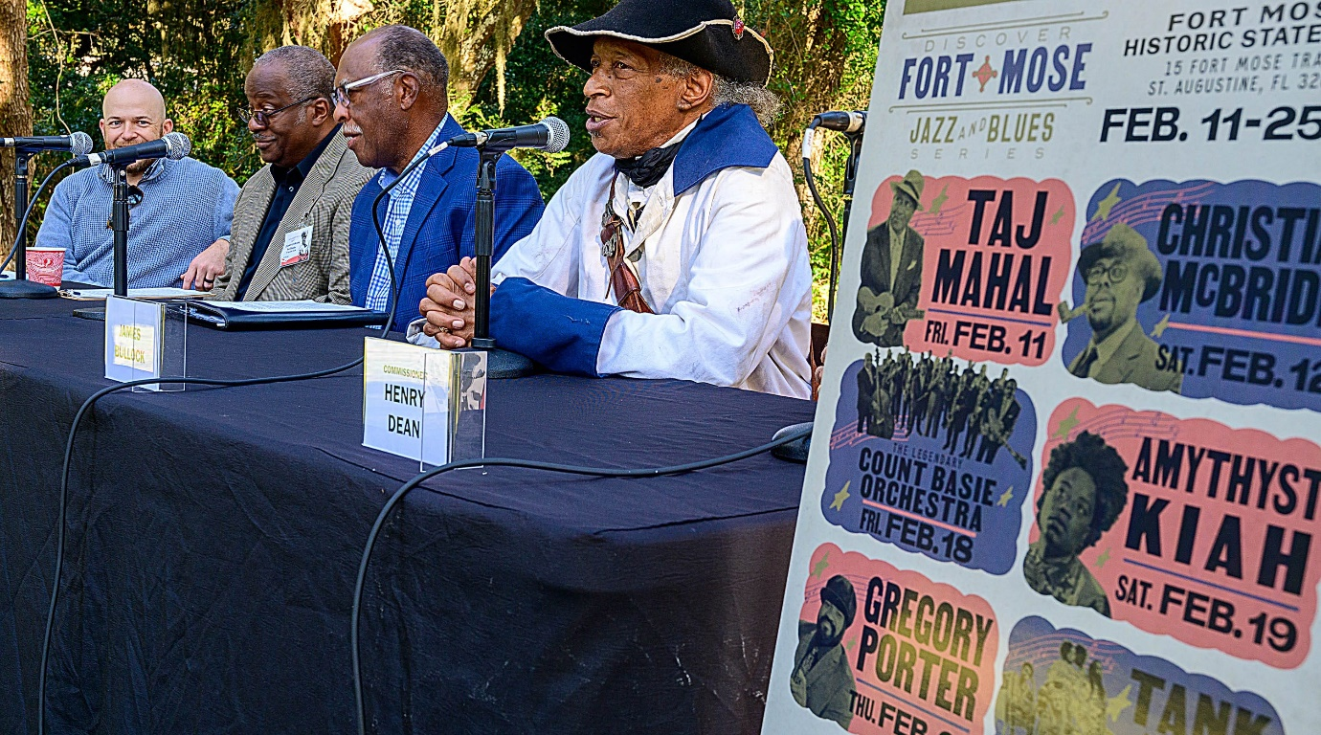
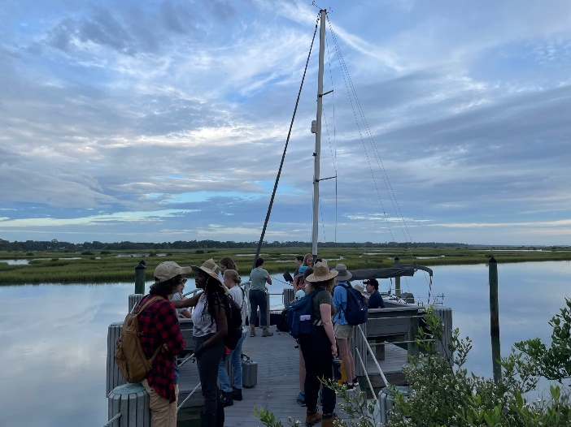
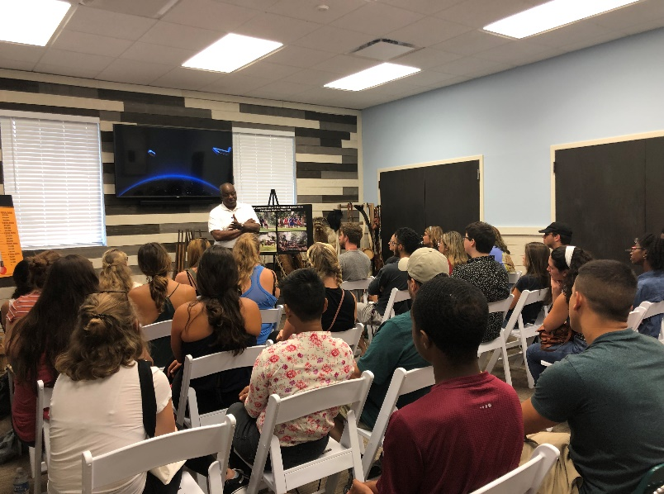
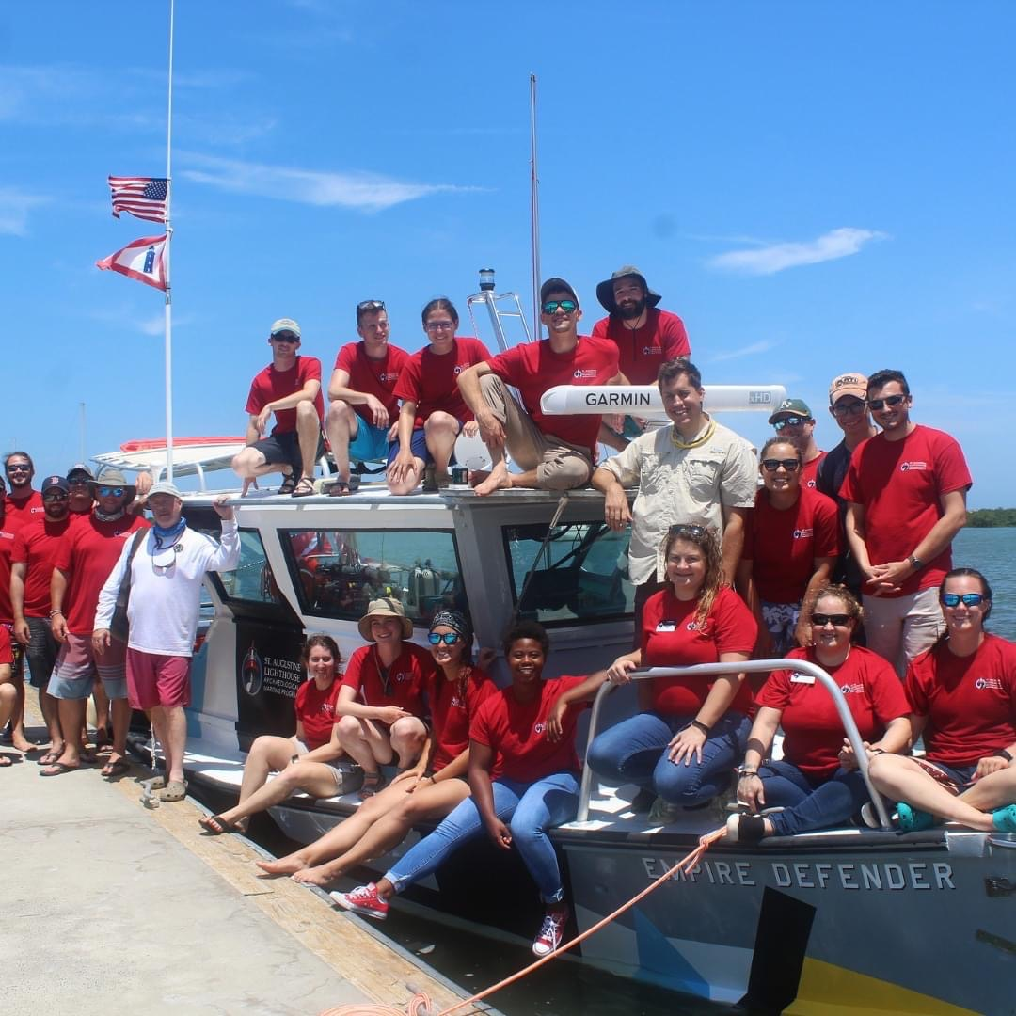
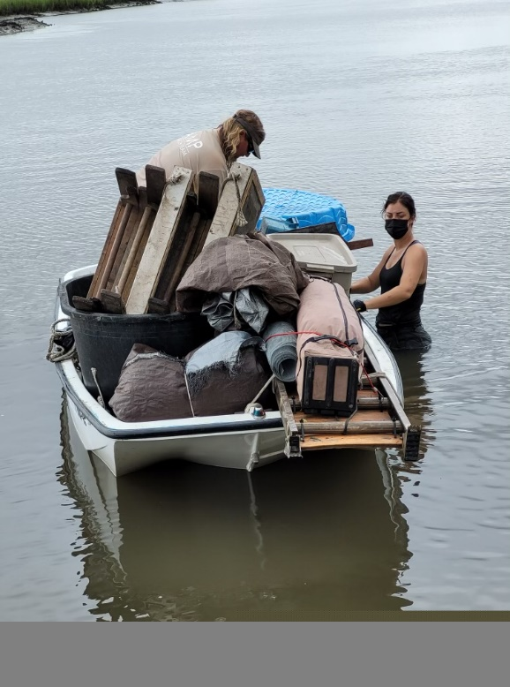
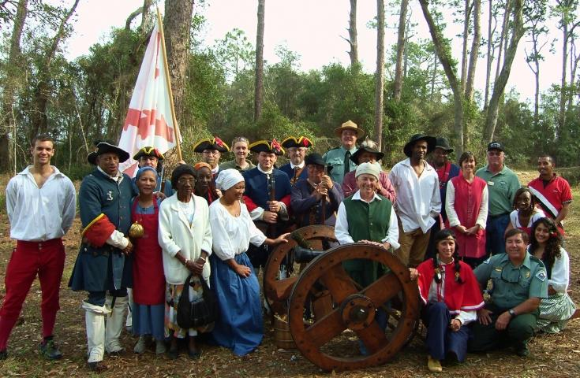

Slide 4
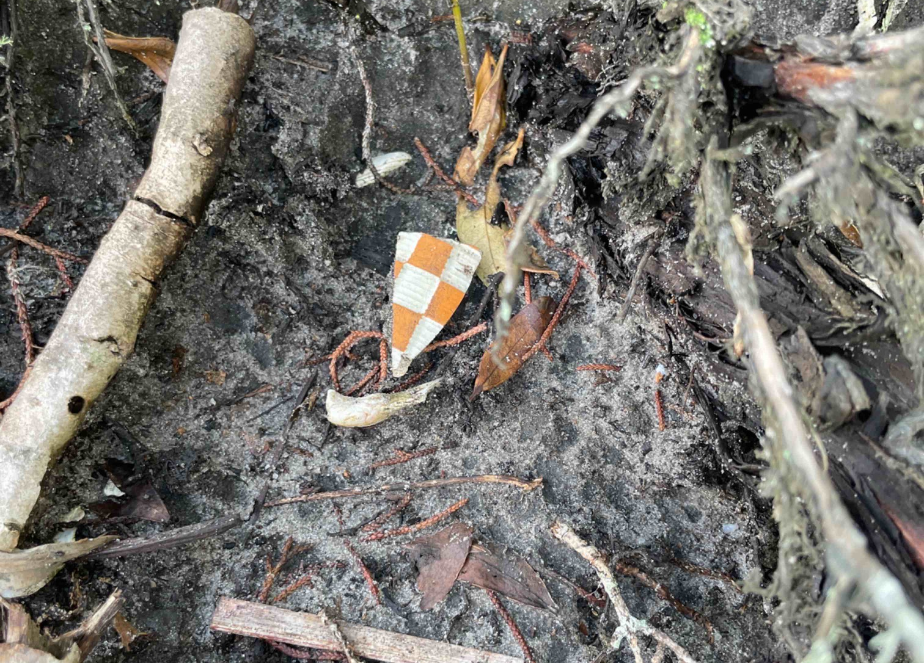
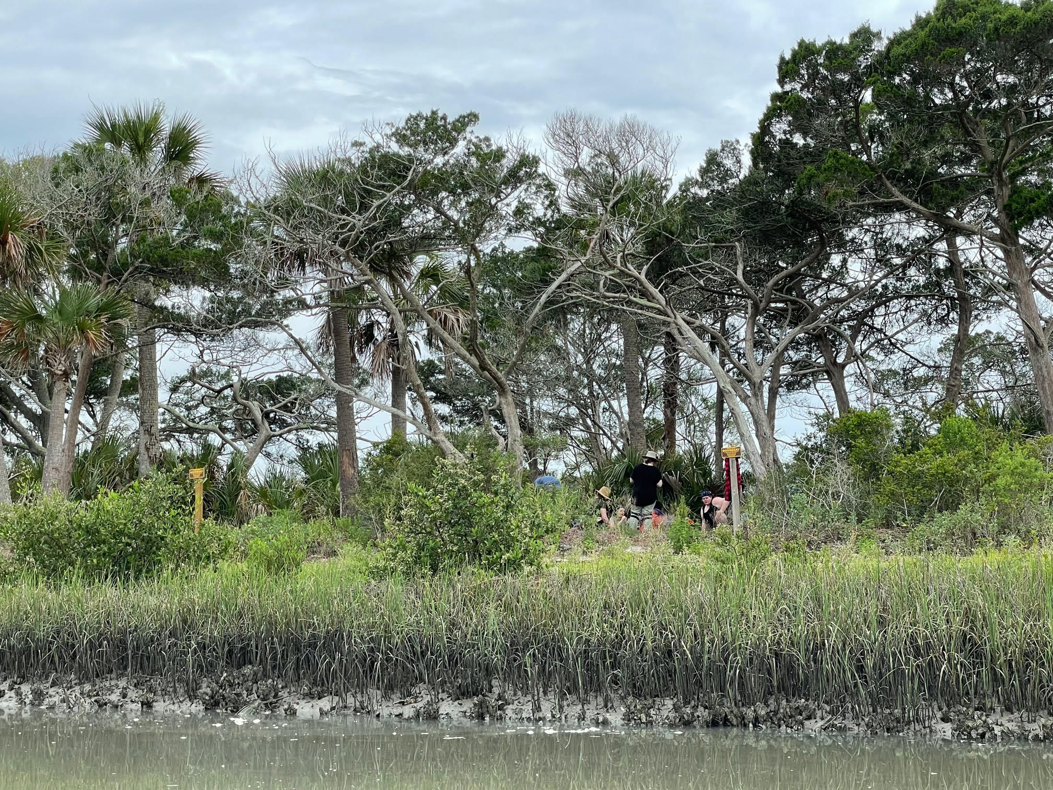

Slide 6
Dr. Kathleen Deagan with Dr. Charles Fairbanks 1979 St. Simons Island

Slide 7
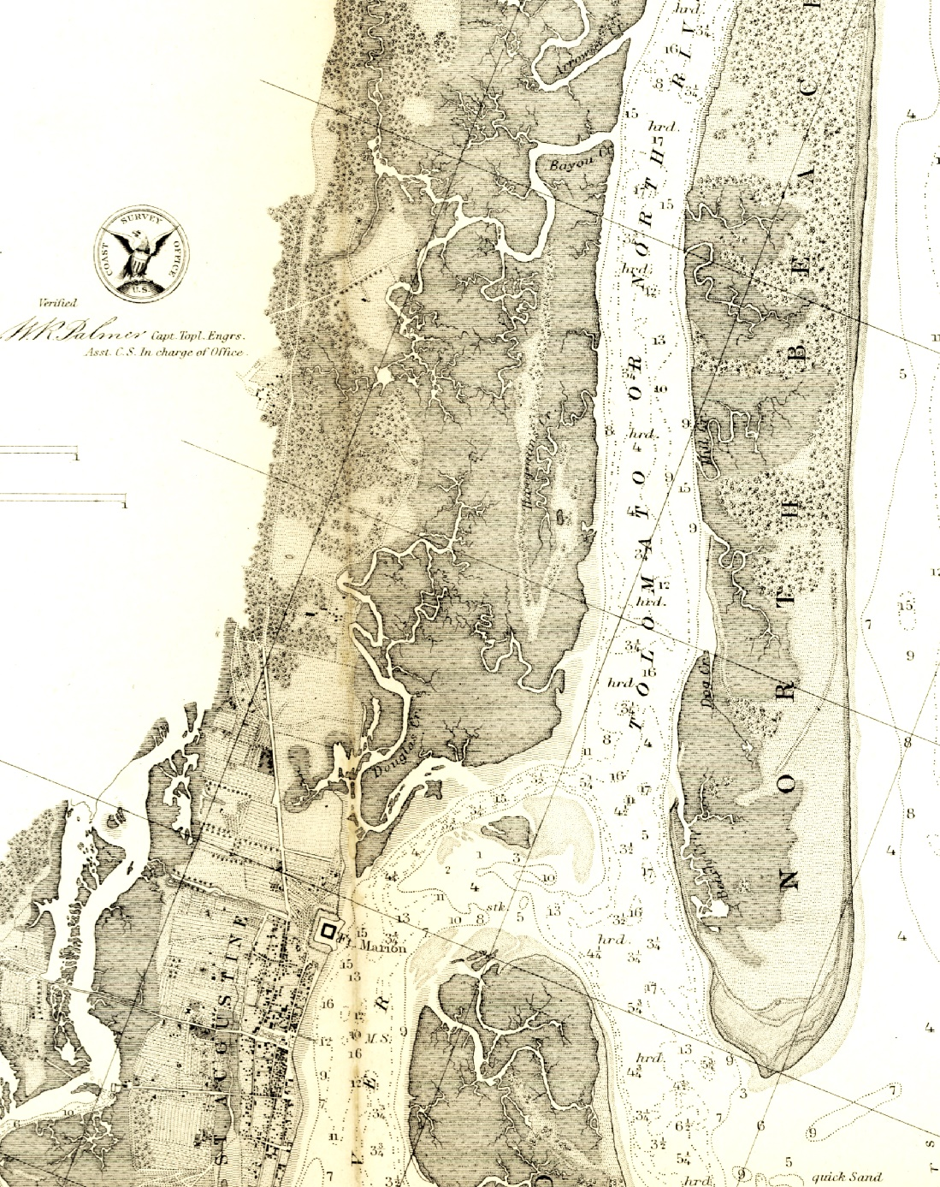
The original Fort Mose (1738-1740) (red circle)
1739 – 38 men, some of with families, were in residence
The original fort was attacked by British forces in 1740 during the War of Jenkins’ Ear
The British briefly held the fort, but a counterattack by the Spanish drove them out
The second Fort Mose (1752-1763)
(blue circle)

Slide 8
Location of second Fort Mose (1752-1763)

Slide 9
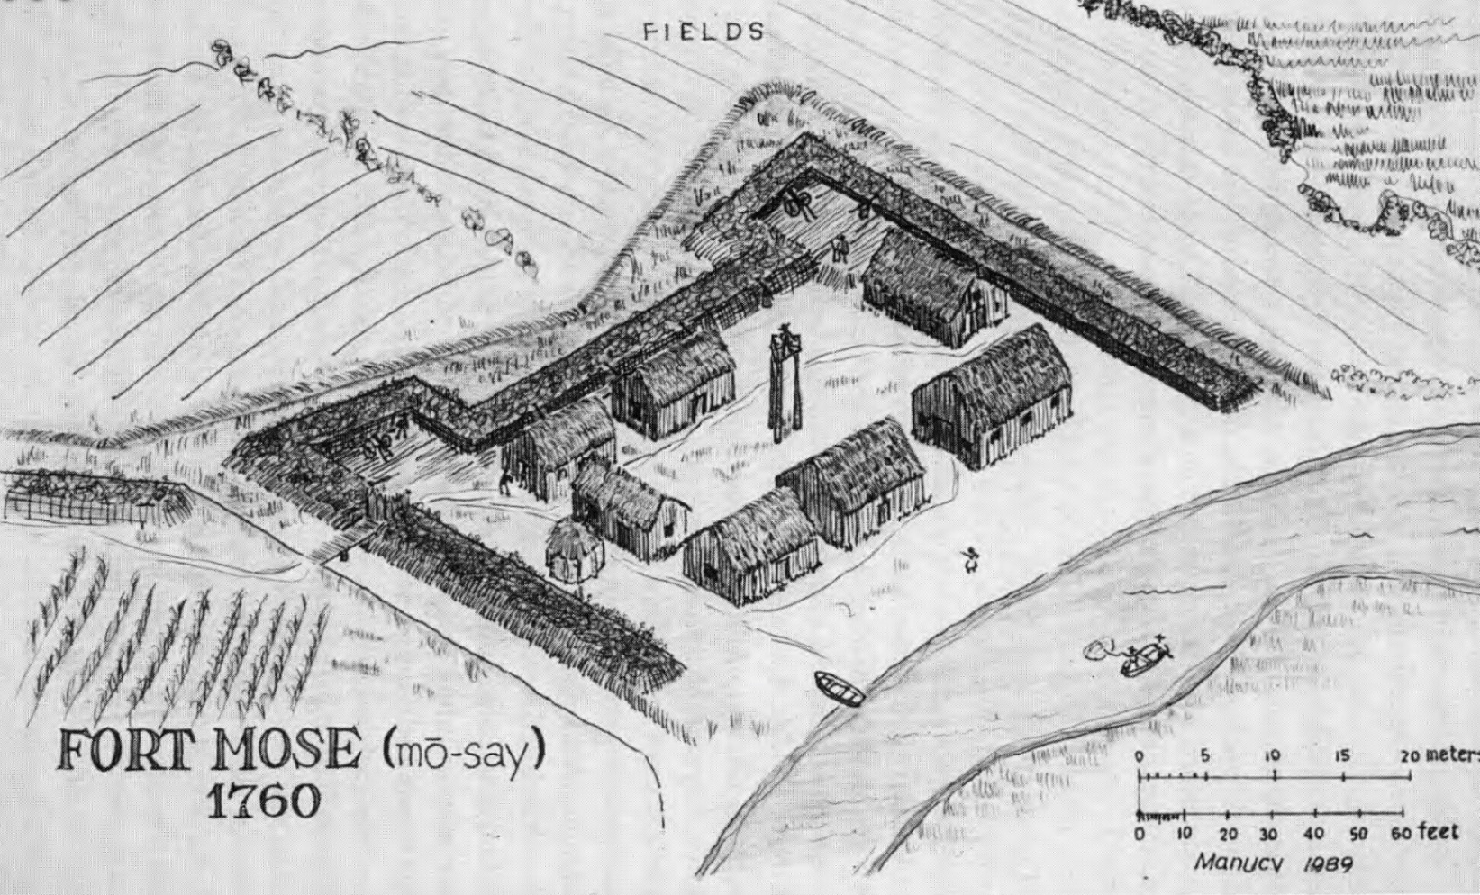
Second Fort Mose (1752-1763)
Hypothetical reconstruction of the 1752 fort by Albert Manucy, based on period sources

Slide 10
At high tide, the main channel surrounding the island was approximately four feet deep

Slide 11
Shell lens dating to the First Spanish Period (1565-1763)

Slide 12
Shell lens in profile

Slide 13
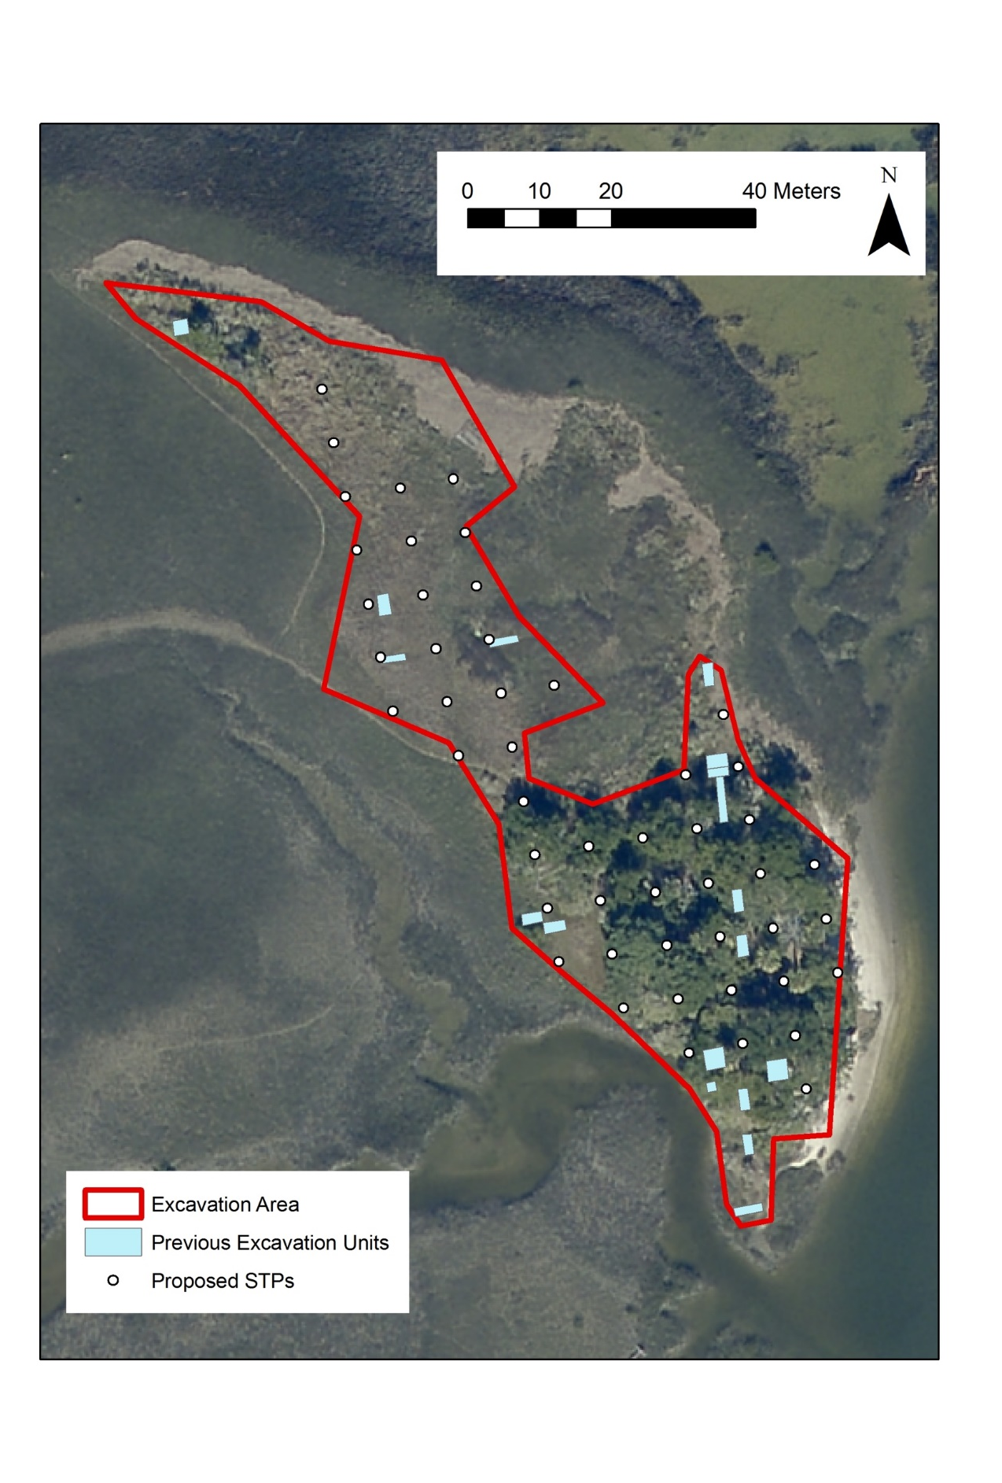
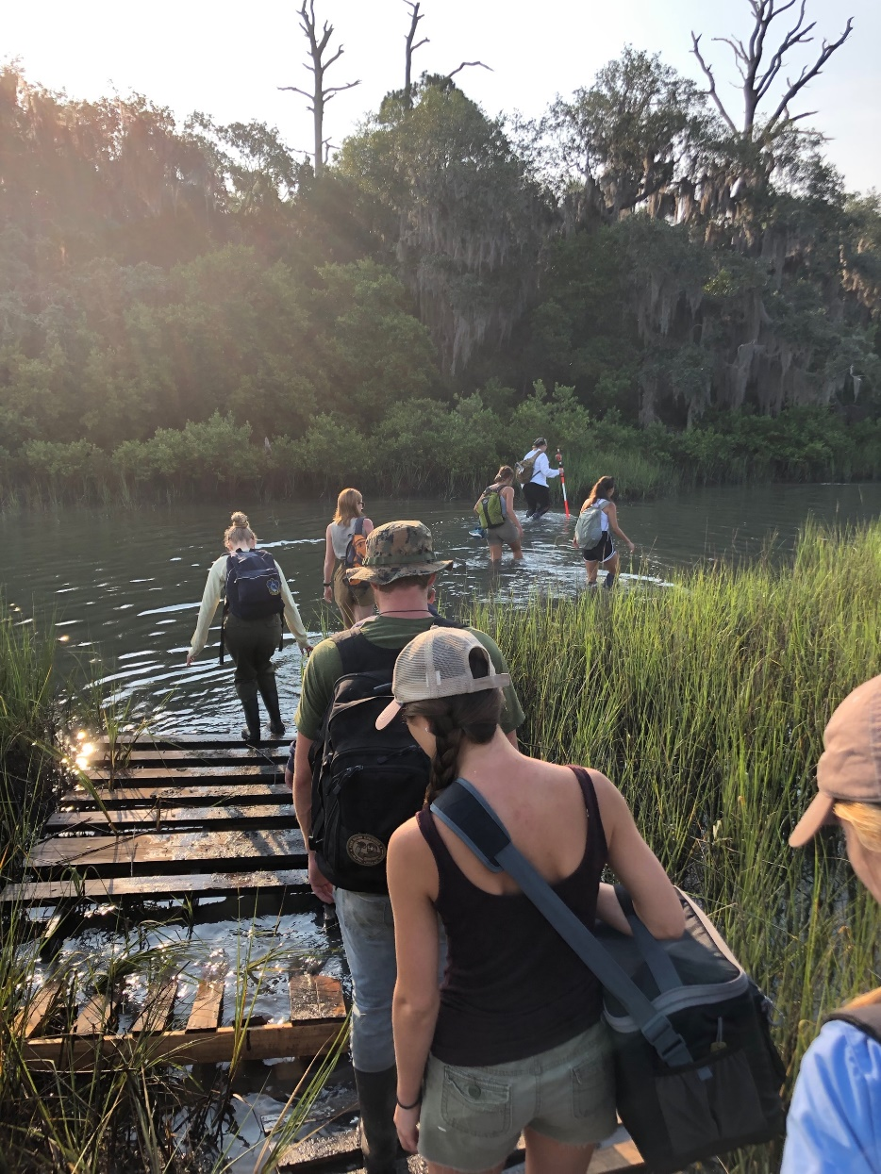
Fort Mose 2019 Research Design
Map created by Eric Proebsting

Slide 14
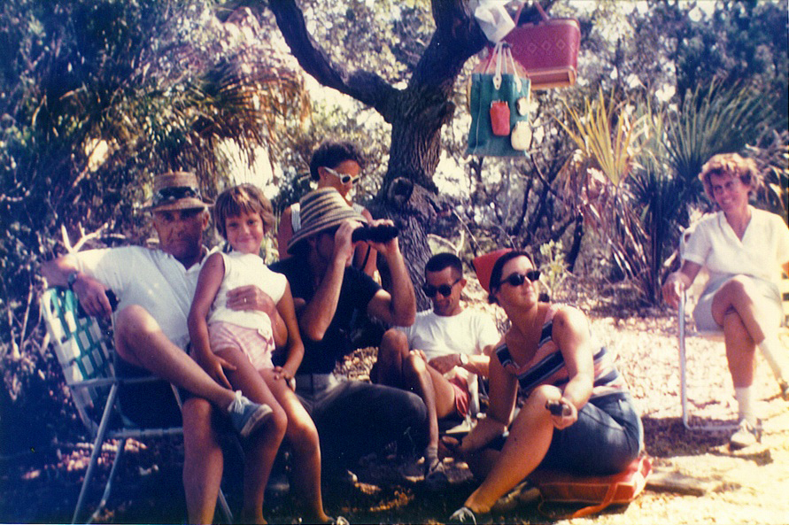
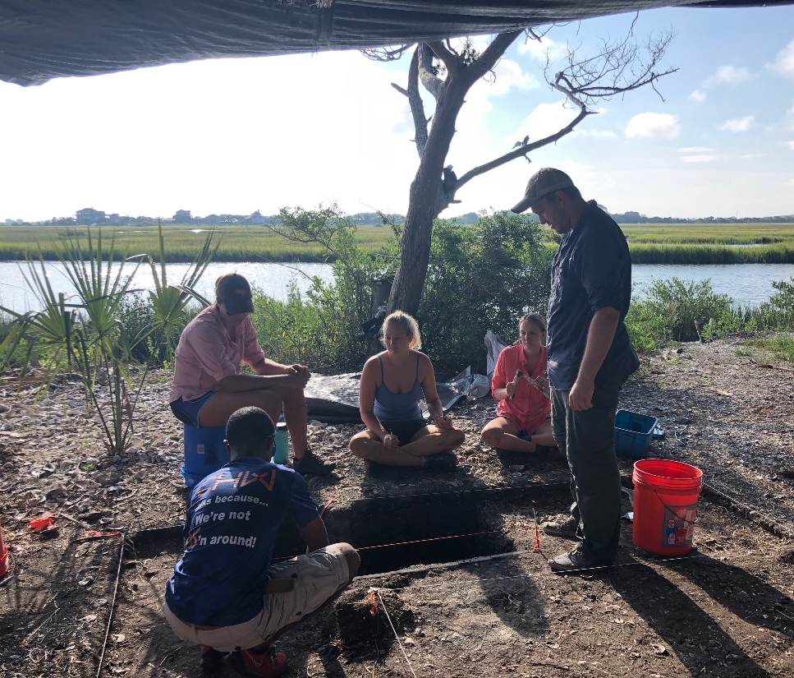
More recent history at Fort Mose

Slide 15
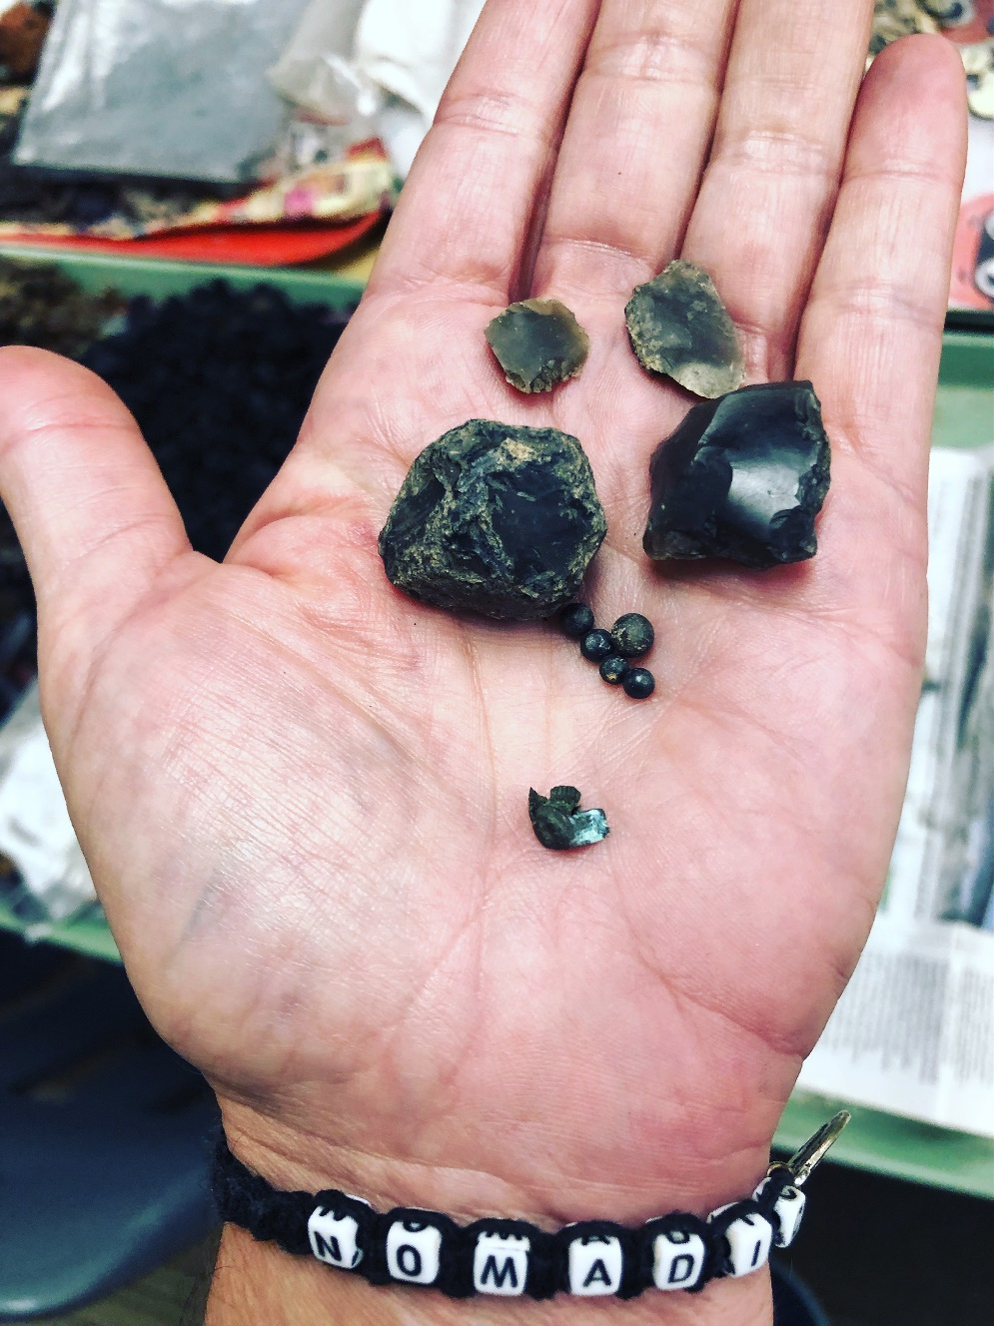
Gun flints and chert

Slide 16
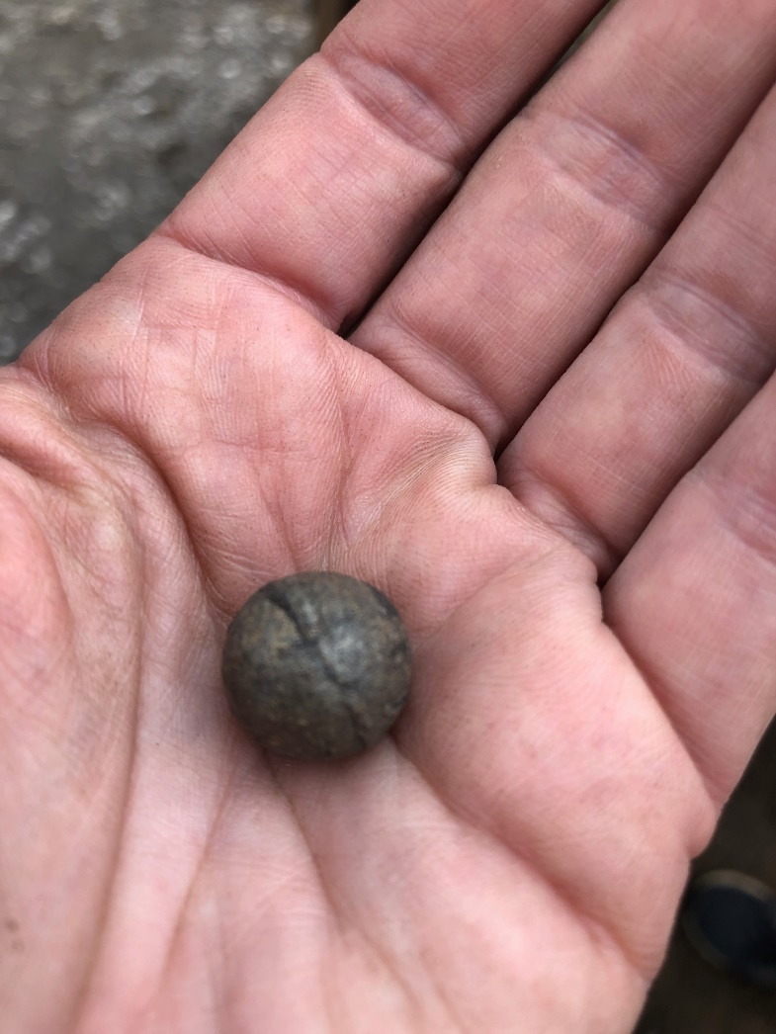
Gun flint and lead shot

Slide 17
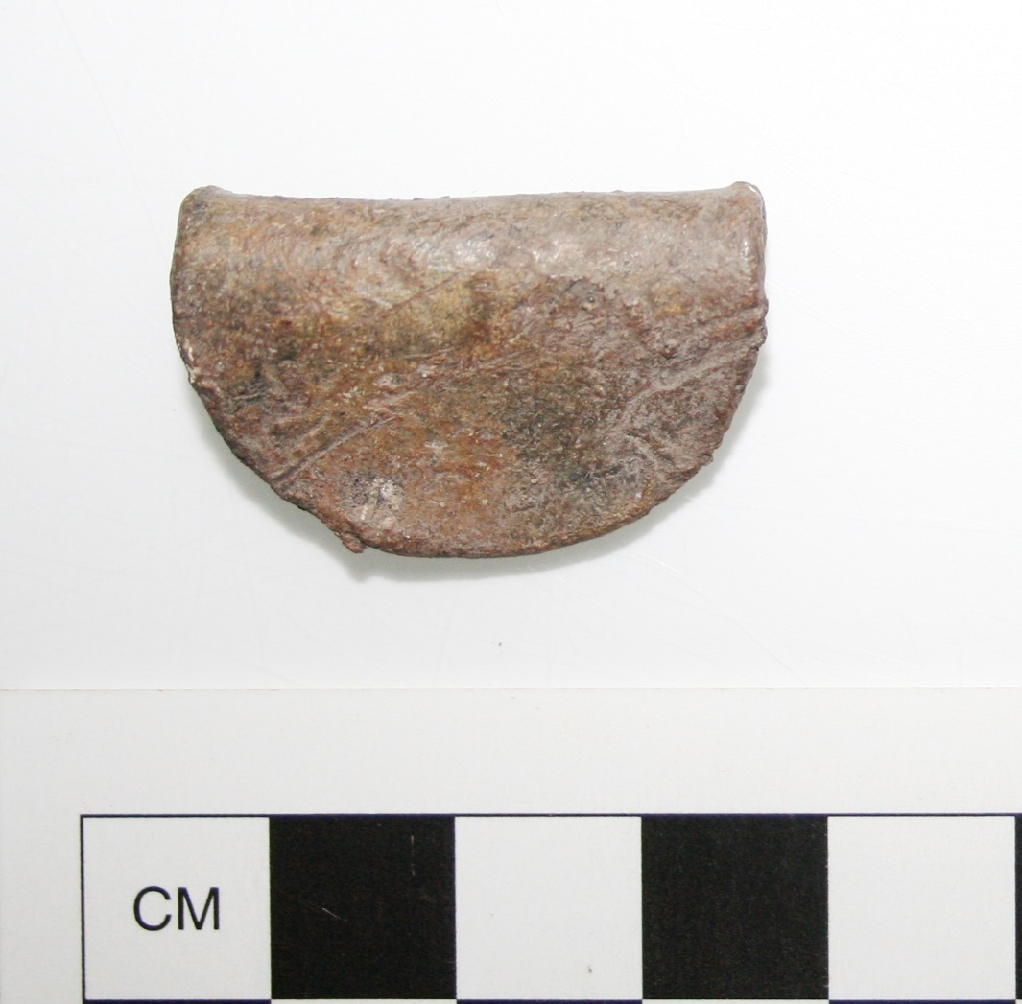
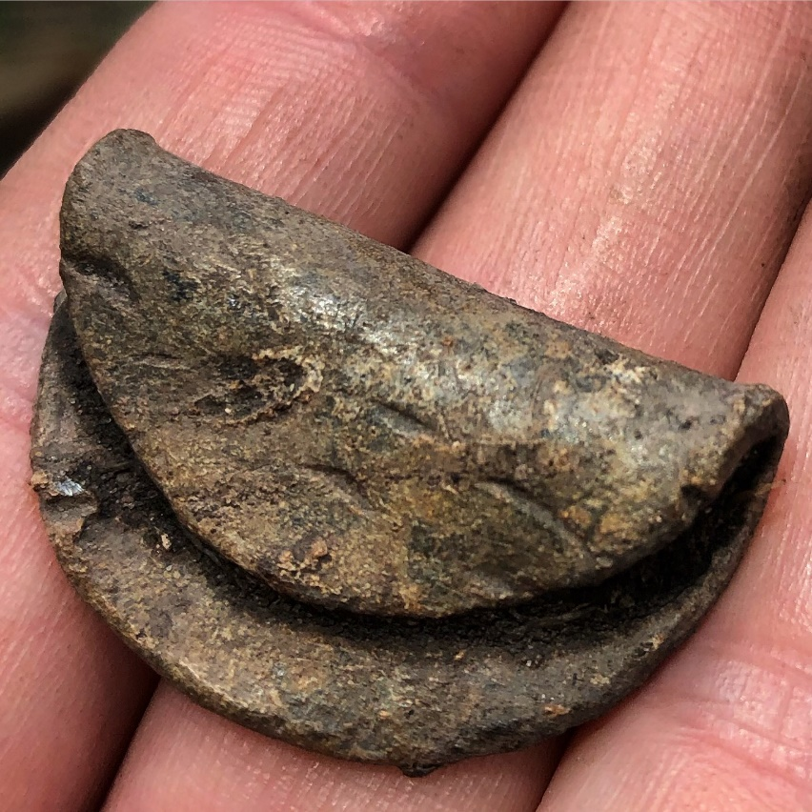
Lead gunflint clamps for muskets

Slide 18
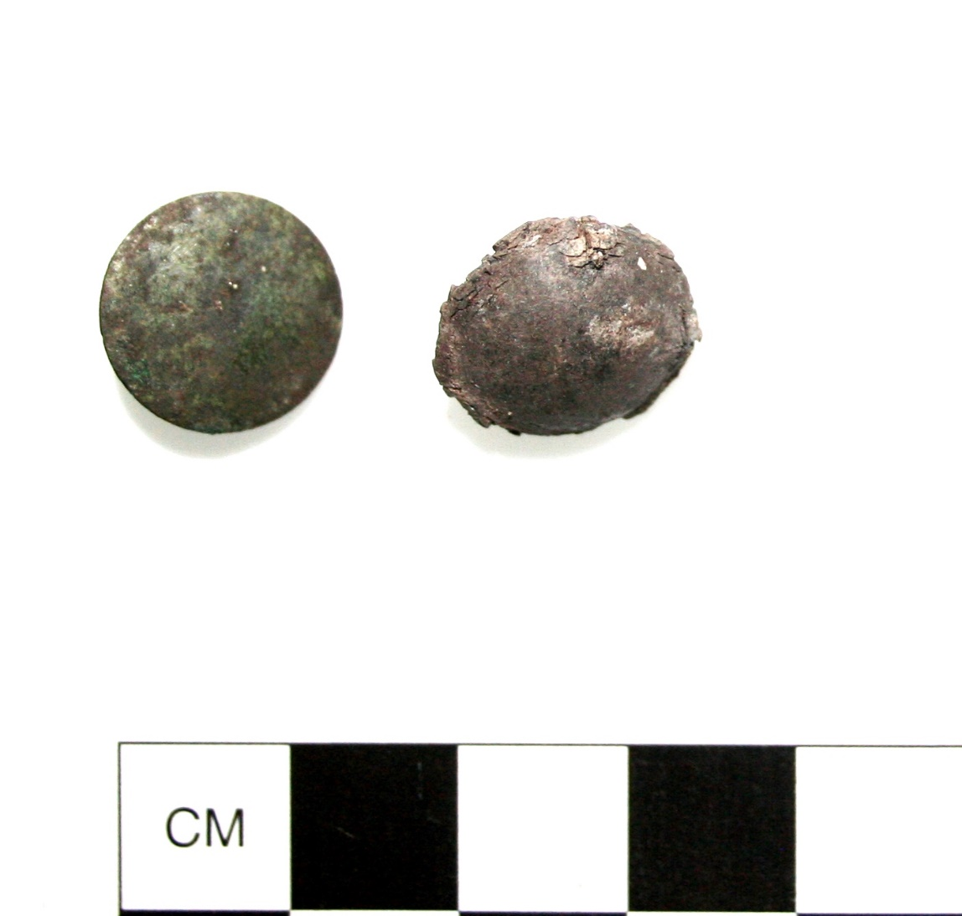
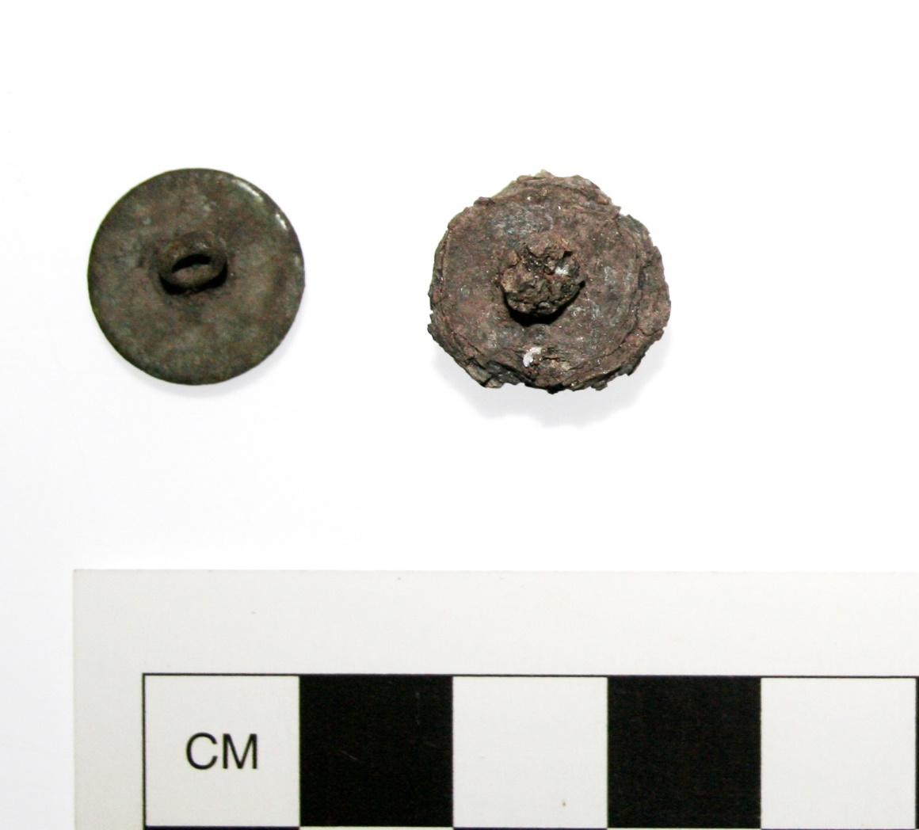
Buttons

Slide 19
Brass Shoe Buckle and Brass Hook

Slide 20
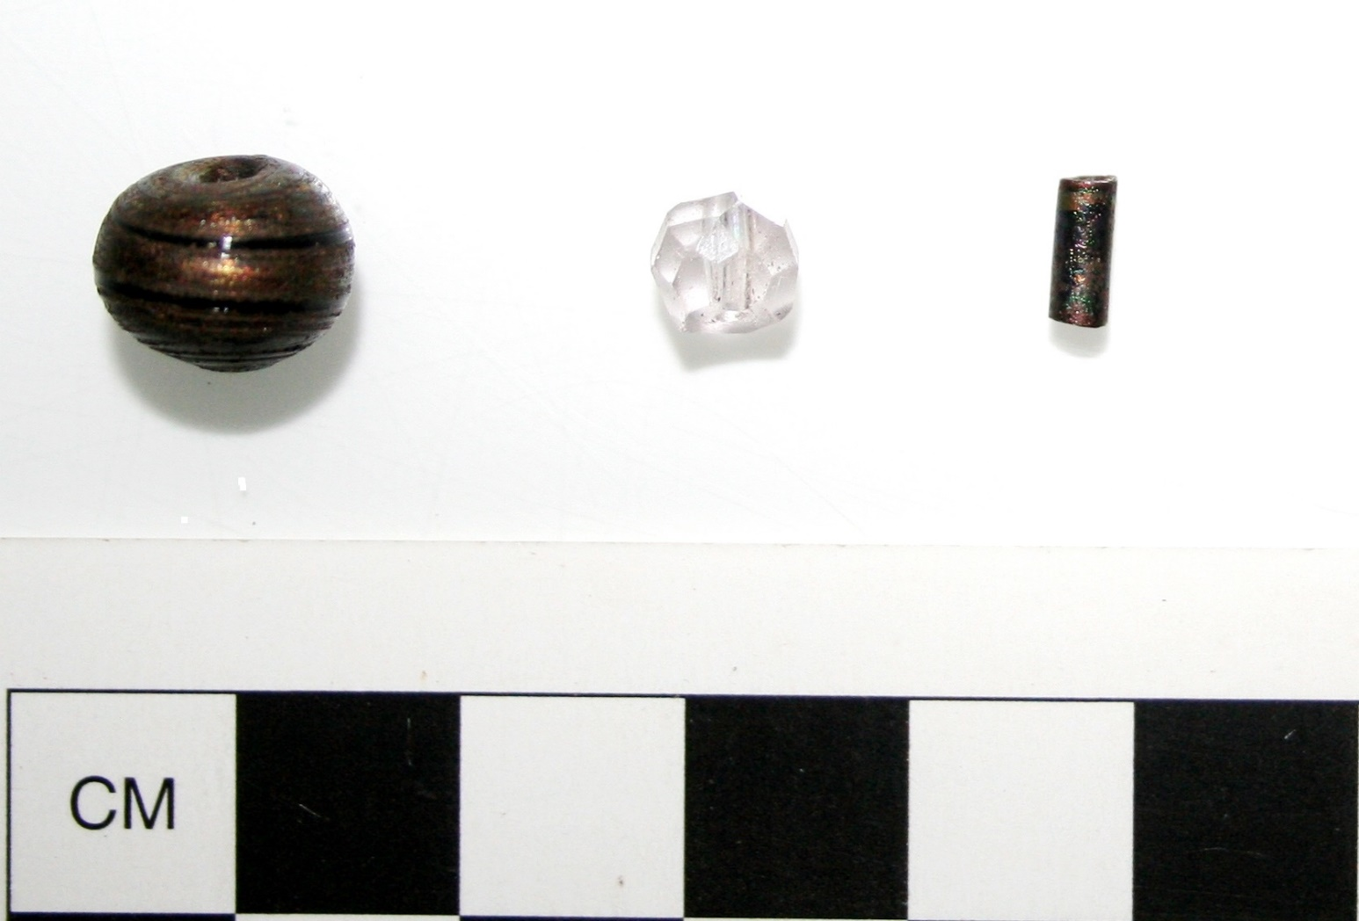
Glass beads (n=3)

Slide 21
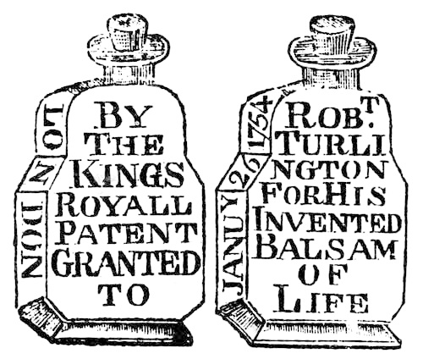
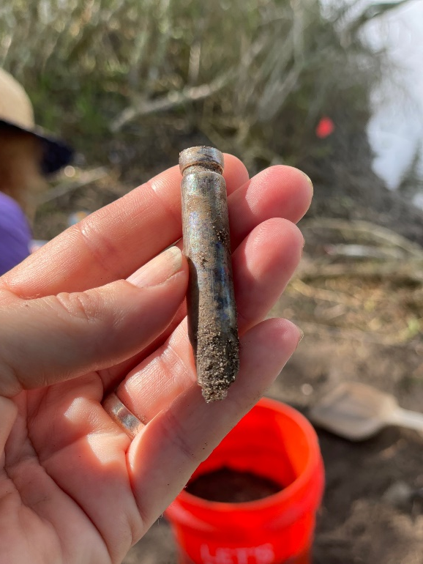
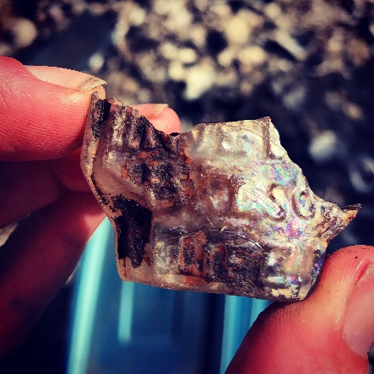
Robert Turlington’s Balsom of Life Bottle
(version patented in 1754)

Slide 23
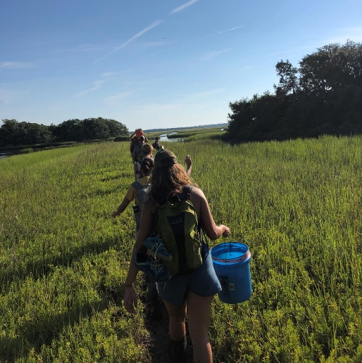
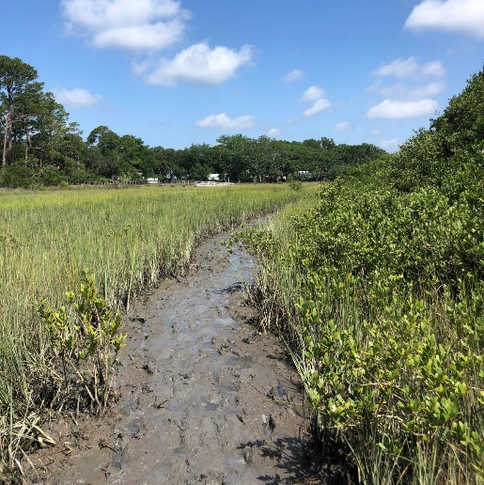
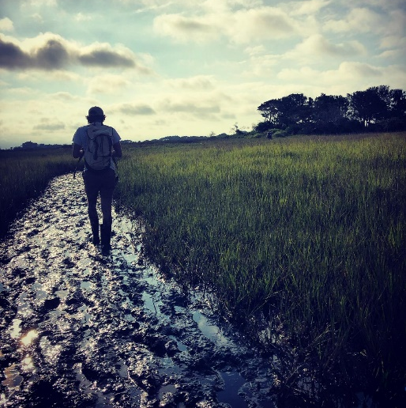
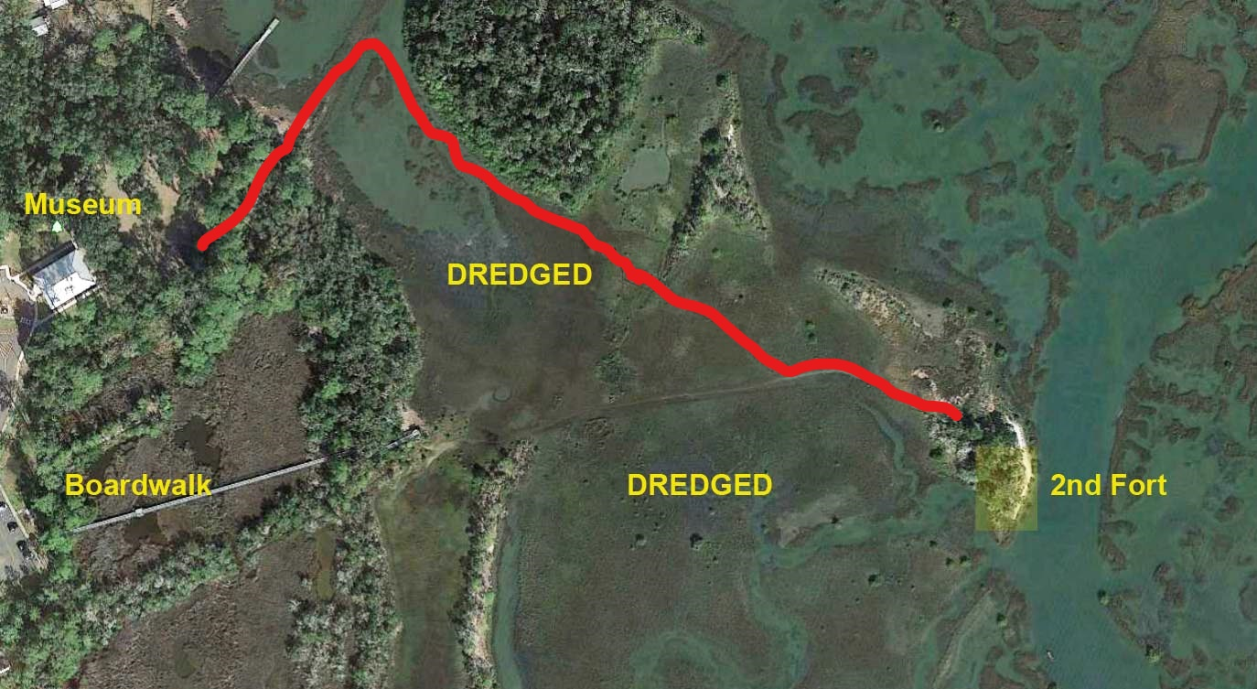
2019 Path to Fort Mose: Finding Our Way

Slide 24
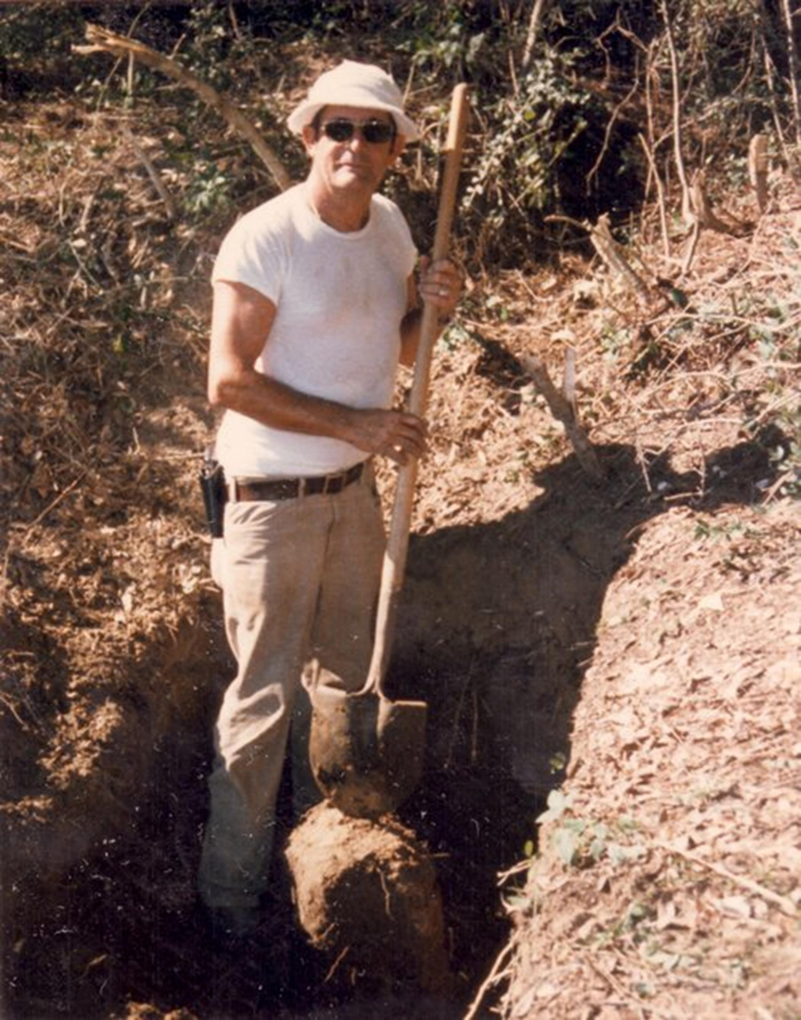
Jack Williams

Slide 25
Markland House

Slide 26
1885 Henry Wellge map
Markland House
Maria Sanchez Creek

Slide 27
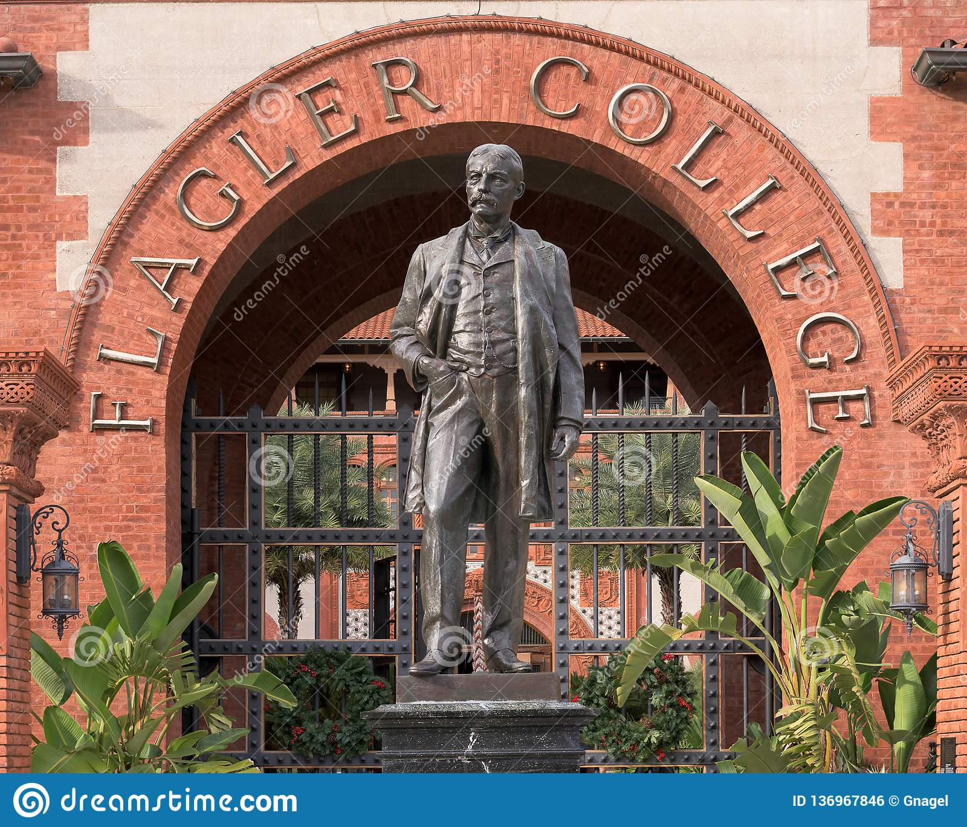
Ponce de Leon Hotel 1897
1968

Slide 28
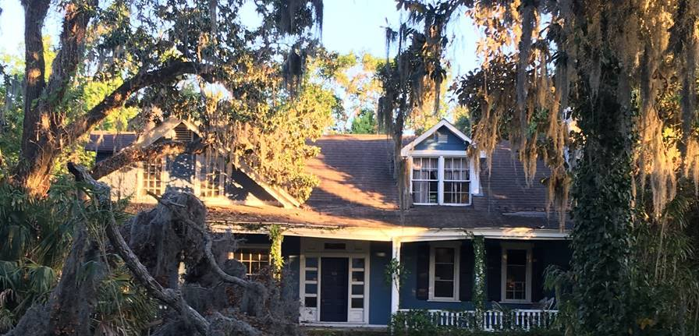
Yallaha and Esperanza Plantations

Slide 30
1885 Henry Wellge map
Markland House
Maria Sanchez Creek

Slide 31
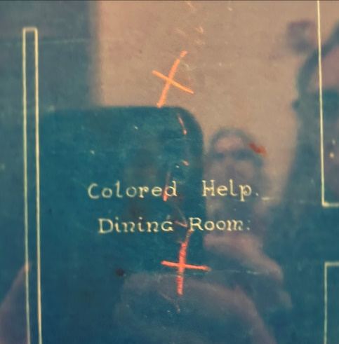
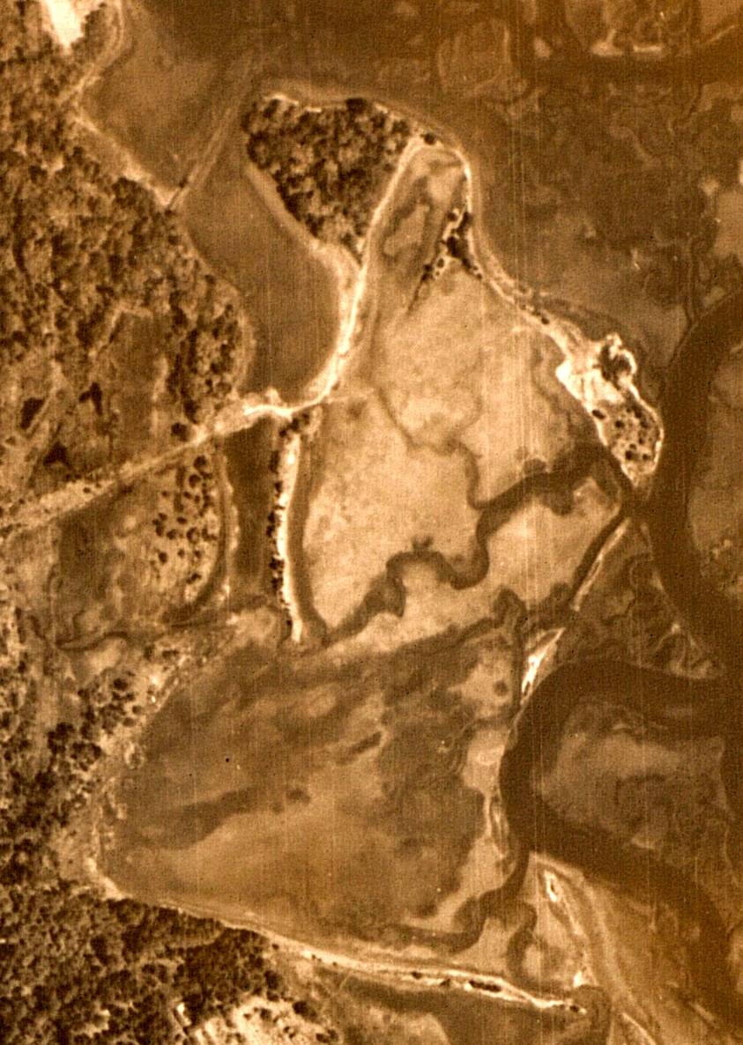
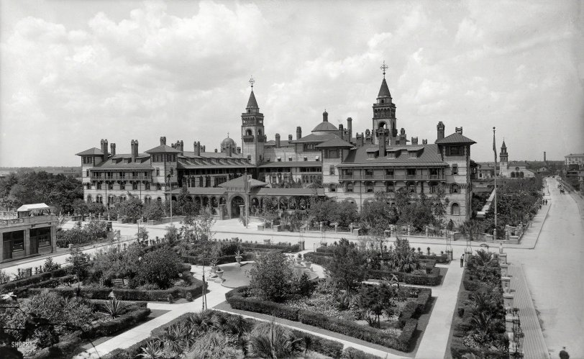
1968
Aerial Map
1943
Fort Mose
Ponce de Leon Hotel Blueprint
1897 Ponce de Leon Hotel

Slide 32
Community-based research at Fort Mose 1987

Slide 35
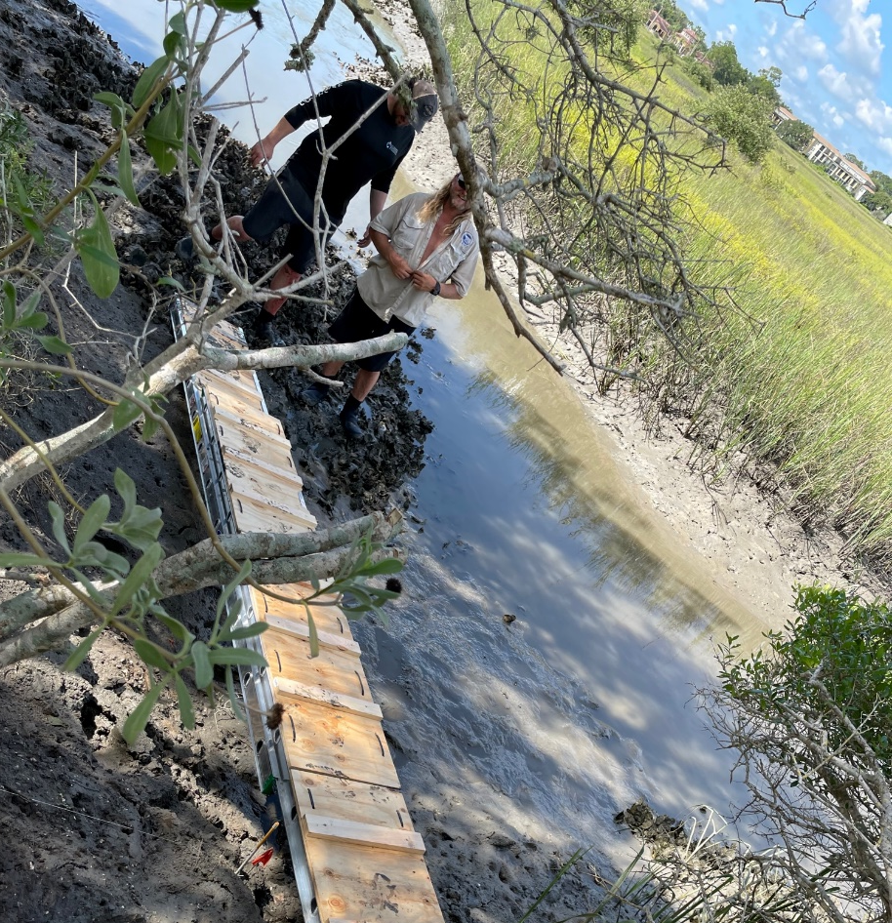
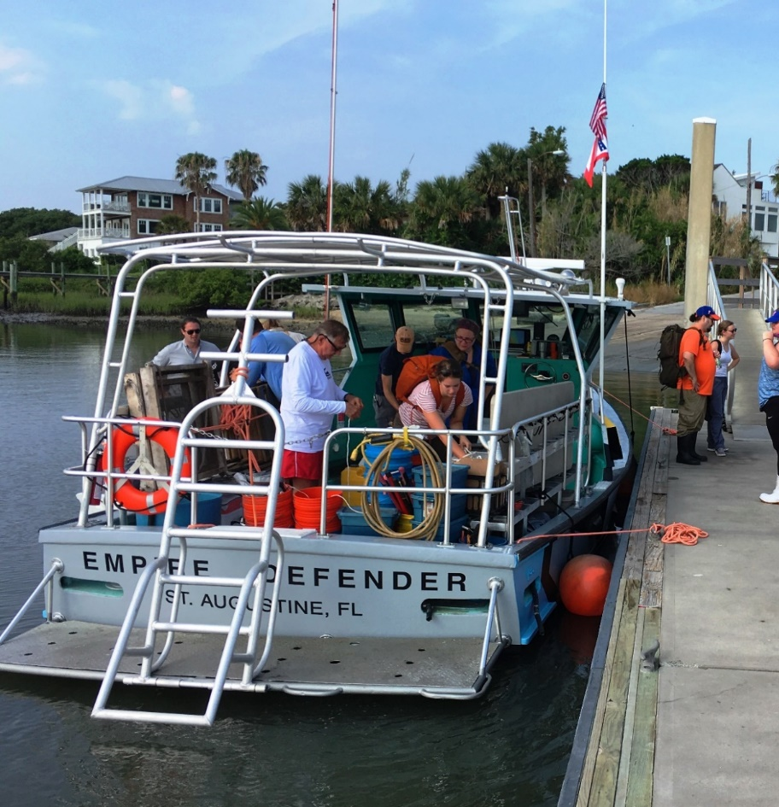
The St. Augustine Lighthouse Archaeological Maritime Program (LAMP)

Slide 36
At high tide, the main channel surrounding the island was approximately four feet deep

Slide 37
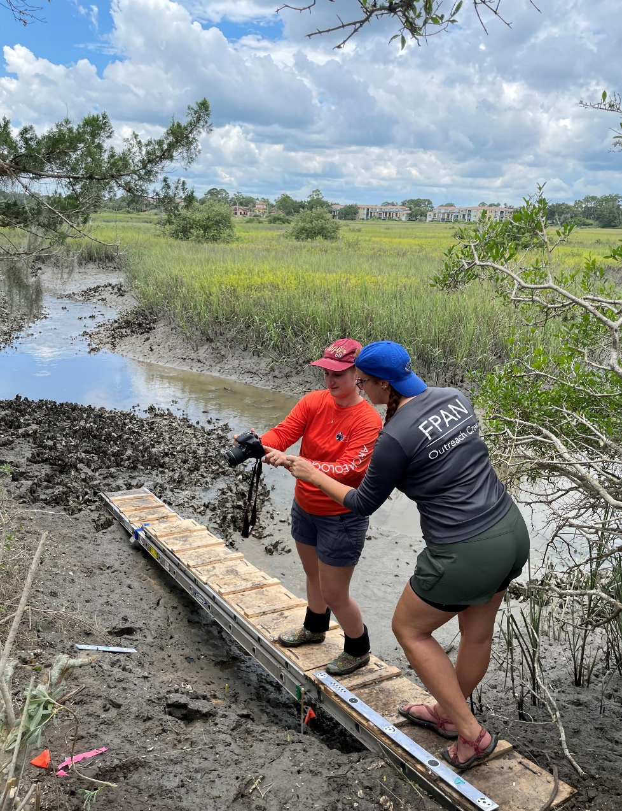
Partnering with FPAN

Slide 38
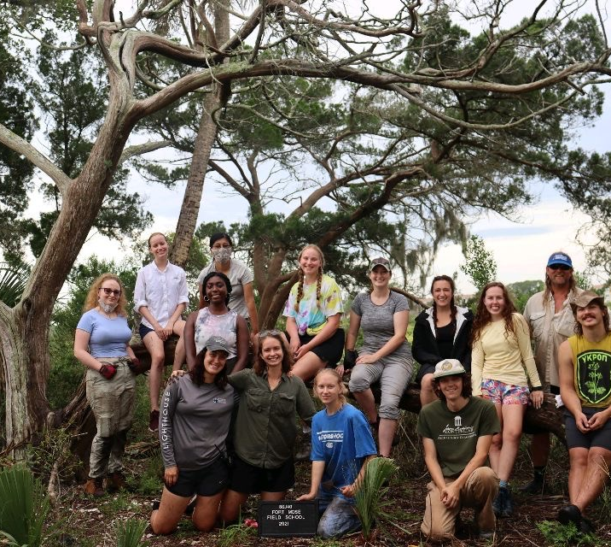
Flagler College – University of Florida Field Schools 2019-2021

Slide 39
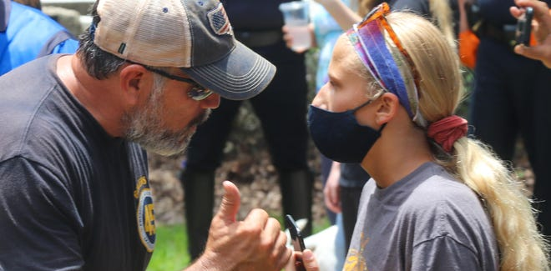
Flagler Student Protests 2020 on Cordova Street (former Maria Sanchez Creek) at the edge of Lincolnville

Slide 40
