Slide 1
How Employers' Cybervetting Practices Affect Jobseekers’ Social Media Impression Management Intentions And Their Subsequent Application Process
24TH INTERNATIONAL CONFERENCE ON KNOWLEDGE, CULTURE AND CHANGE IN ORGANIZATIONS, JULY 3-5, UNIVERSITY OF LUSIADA, LISBON, PORTUGAL
Presented by
Pratyush Banerjee, PhD.
Associate Professor, International Management Institute Bhubaneswar, India, Post-doc scholar at Center for Applied Research in Management and Economics (CARME), Politecnico de Leiria, Portugal.
and
Prof. Neuza Ribeiro, PhD.
Professor, School of Technology and Management, Polytechnic University of Leiria, Researcher at Center for Applied Research in Management and Economics (CARME), Politecnico de Leiria, Portugal.

Slide 2
Flow of Presentation
Rationale
Introducing study constructs
Theoretical framework
Research Method
Data Analysis
Findings
Implications
Limitations and future directions

Slide 3
FROM WHERE DID THE STUDY MOTIVATION COME?
The rise of social media has resulted in organizations investigating the social media profiles of candidates at the time of recruitment for detecting candidates’ character flaws (Drake et al., 2016).
This phenomenon has become popularly known as Cybervetting which may be defined as “a process of internet surveillance, social media background checks, social media screening, online screening, social media profiling, or Facebook fired” (Berkelaar & Harrison 2017, p. 1).
A report by job recruitment website CareerBuilder states that the practice of Cybervetting has increased from 10 % to 70% by 2018.
The information collected about applicants may include inappropriate comments or texts, group memberships, education, professional affiliations, lifestyle choices, and interests (Kluemper, 2013).
Importantly, cybervetting brings the bias and moral judgments of HR professionals into hiring decisions (McDonald et al., 2021).
This has resulted in growing concern in the mind of jobseekers about such violation of private information and rising anxiety towards possible discrimination in hiring practices (Jacobson & Gruzd, 2020; Fernandez, 2022).

Slide 4
Lit Review - Cybervetting
A jobseeker’s social media profile can be a decisive factor in the hiring process, including being a disqualifying factor (Melton et al., 2018)
Jacobson and Gruzd (2020) have stated that Cybervetting is the new normal
A study by Walrave et al. (2022) substantiates this claim through a qualitative inquiry with HR professionals
Roulin and Liu (2023) have conducted a study with Chinese jobseekers which shows that there is negative attitude towards all three dimensions of cyber-vetting among jobseekers

Slide 5
ATTITUDE TOWARDS CYBERVETTING
Invasiveness
Justice / Fairness
PERCEPTION TOWARDS CYBERVETTING
Face validity / Trust
Adapted from: Cook, R., Jones‐Chick, R., Roulin, N., & O'Rourke, K. (2020). Job seekers' attitudes toward cybervetting: Scale development, validation, and platform comparison. International Journal of Selection and Assessment, 28(4), 383-398.

Slide 6
Lit Review – Cyber-faking / Social Media Impression Management (SMIM)
Social Media inspection has led to candidates being eliminated from further job consideration or disqualified from interviewing (Bennett, 2013).
Faking is a defensive strategy where jobseekers attempt to misrepresent themselves during the personnel selection process.
It is a deceptive form of impression management, or an intentional distortion of the responses or information provided to create a favorable impression (Levashina & Campion, 2006).
Faking corresponds to a job- or organization-specific response distortion strategy with the objective of intentionally and artificially increasing one’s scores or perceived performance at selection
Faking through online social media may be referred to as cyber-faking (Myers et al., 2021)
Studies linking the phenomenon of SMIM with online social networking and career-related outcomes are scarce (Al-Shatti & Ohana, 2021)

Slide 7
Tactics of Social Media Impression Management
SMIM TACTICS
DEFENSIVE
ASSERTIVE HONEST
ASSERTIVE DECEPTIVE
Sources:
Myers, V., Price, J. P., Roulin, N., Duval, A., & Sobhani, S. (2021). Job seekers’ impression management on Facebook: Scale development, antecedents, and outcomes. Personnel Assessment and Decisions, 7(1), 10.
Roulin, N., & Bourdage, J. S. (2017). Once an impression manager, always an impression manager? Antecedents of honest and deceptive impression management use and variability across multiple job interviews. Frontiers in Psychology, 8, Article 29. https://doi.org/10.3389/fpsyg.2017.00029

Slide 8
Study 1
How do Indian jobseekers react towards the practice of Cybervetting and what are their opinion about Cyberfaking their Social Media profiles as a reaction to cybervetting?

Slide 9
Study 1 Research Methodology
Research design – Qualitative
Sampling strategy and sample size – Purposive sampling (Robinson, 2014)
Target population – Active and passive jobseekers who have been subject to Cybervetting identified through Snowballing
Sample Size = 32
Data Collection – Through open ended unstructured interview
Duration – 60 Mins (Avg), transcribed verbatim
Data analysis method – Thematic Analysis (Braun & Clarke) conducted through QDAMINER Lite (Cuva, 2014; Fernandez et al., 2023)

Slide 10
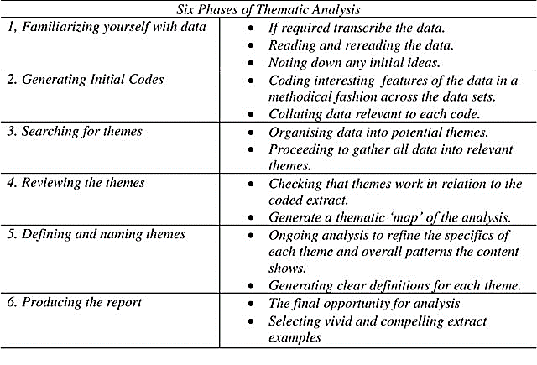
Thematic Analysis Process
Source: Adopted from Braun, V., & Clarke, V. (2006). Using thematic analysis in psychology. Qualitative research in psychology, 3(2), 77-101.

Slide 11
Data Analysis
The responses were transcribed verbatim by the first author and then fed into QDAMiner Lite (Lewis and Maas, 2007).
QDAMiner has been accepted as a very good CAQDAS tool when the agenda is reflective thematic analysis (Derobertmasure and Robertson 2014)
The initial set of codes was created by the first author based on existing literature as per recommendations by Dean and Sharp (2006)
The overall thematic analysis was performed based on Braun and Clarke’s (2005) template

Slide 12
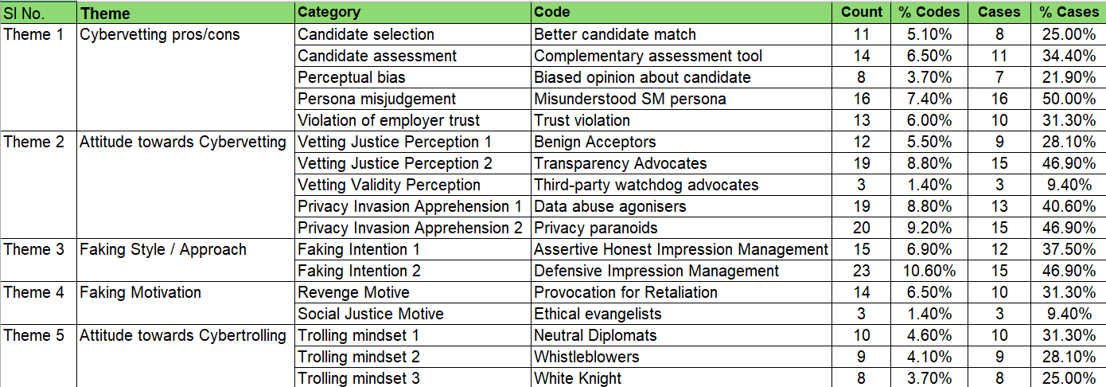
Initial Code Identification

Slide 13
Theme 1: Cybervetting Virtues
Sub-theme 1a: Holistic Candidate Assessment
"Cyber vetting to some extent is fine, but not always, even if it is used ethically. There are high chances that the job seekers/people willing to apply for that position have manipulated their information over their social media. But sometimes it can also help/save the organisation from on boarding people who are into things which is not excepted by the law of our country.in such cases, cyber is beneficial for organisation to assess the candidate….."

Slide 14
Theme 1 (Contd…)
Sub-theme 1b: Revealing Hidden (Fit) Candidate Persona
…..Its is good to do cyber-vetting as candidate must show interest in company' trends, practices otherwise candidate may not join only, it also helps in understanding what the candidate is about beyond their CVs, helps to bring out skeletons from the closet…….
…Some benefits like certificate, skills, experience that might not highlighted in resume may get on social media platforms. It also provide candidates area of interest values which indicate good fit for the company.

Slide 15
Theme 2: Dark Side of Cybervetting
Sub-theme 2a: Misunderstood SM Persona
"Firstly, professional and personal life should be kept separate. It is not necessary that a person who enjoys a lot or is more active and social media is not responsible enough in their professional life. Similarly, a person who is not much active over social media is an introvert or lack creativity, hence personal information to decide someone selection should not be advisable ."

Slide 16
Theme 2: Dark Side of Cybervetting
Sub-theme 2b: Biased Candidate Impression
….it raises concerns about privacy invasion and potential bias, as online personas may not fully reflect a person's true self or circumstances….. The ethical grey area in cyber-vetting during recruitment lies in the potential for bias, invasion of privacy, and misinterpretation of online activity…..
…… forcing someone to make their personal profiles desirable is forcing people to pretend as a desired person, it’s indirectly forcing someone to behave and act fake. Which is not correct and may indirectly lead to personality problems…

Slide 17
Theme 3: Attitude towards Cybervetting
Subtheme 3a: Vetting Justice
…It is generally perceived neutral as it is a widely accepted process in recruitment in the current era of social media…. I am ok with it as thats what the trend is right now….
…… This practice has been seen to increase in the past two decades as internet became accessible to all. My perception about this practice is that its a very crucial step to complete before any employee is actually onboarded and forms an essential component for the ‘background check’ step overall……

Slide 18
Theme 3: Attitude towards Cybervetting
Subtheme 3b: Privacy Invasion
Qs: 4. Should employers disclose to candidates beforehand that their social media profile will be accessed by the recruitment team as a part of the recruitment process? Or, is it justified to conduct Cybervetting in a stealthy manner? Kindly share your thoughts in this regard.
"Using Cyber-vetting in recruitment raises ethical concerns because it involves delving into candidates' personal online activities, which may infringe on their privacy. It's important to balance the need for thorough evaluation with respect for individuals' digital autonomy and rights.“
"I believe cyber vetting is a wrong given the fact that a person's personal life and professional life are completely different, hence making a professional decision based on someone's personal time to is not acceptable."

Slide 19
Theme 3: Attitude towards Cybervetting
Subtheme 3c: Validity of Vetting
….This can be outsourced to an agency and can be probably done in a very professional way…..A lot of candidates might not be comfortable with the process if only the employer is involved in the Cybervetting process…..

Slide 20
Theme 4: Cyberfaking Style / Approach
Sub-theme 4a: Defensive Cyberfaking Intention
Qs: If employers can resort to Cybervetting, then it is justified for jobseekers to fake their online profiles. Share your views on this statement.
….Might be helpful in the hiring process by the HR, but a candidate might falsify their own information and the info gathered from social media may not be very reliable……
…..this forces me to over sell myself on LinkedIn and there is too much pressure to have LinkedIn profile and expectations of sharing all my professional success and this creates too much stress on my mind…

Slide 21
Theme 4 (contd…)
Sub-theme 4b: Assertive Honest Cyberfaking Intention
Qs: Cyber-vetting is forcing candidates to sugarcoat their social media profiles to present themselves as more desirable to employers. Have you resorted to any such strategy? If yes, kindly share your experience discretely and also elaborate on how are you may have benefited in your job search from such activities?
“No. In fact, I try to be as honest as possible because if something I don't know, I should not highlight that. Else that can show unprofessionalism and boasty personality which are not desired in the corporate world. "

Slide 22
Findings from Study 1
Cybervetting is accepted as a current trend among jobseekers
Jobseekers mostly worried about the issue of privacy violation
Also concerned about potential biased assessment of candidates
Several respondents stated that they may resort to defensive or honest impression management tactics

Slide 23
Study 2
Impact of Cybervetting on applicant intention to fake their social media information and the subsequent impact on job search outcomes

Slide 24
Impact of Cybervetting on Job Search Self-efficacy
Cybervetting often happens without the consent of jobseekers.
In certain situations, when companies seek permission for Cybervetting from jobseekers, applicants may not be able to refuse requests to share access details with an employer to their social media.
In other words, applicants may feel forced to comply if they want to have the position they apply for.
As a result, employers have a distinct advantage of exploiting private social media information of jobseekers (Greenwood and De Cieri, 2007).
This may reduce the self-belief in jobseekers regarding their chances of getting placement since they may fear that Cybervetting will lead to unwanted information leak of information making their profiles less desirable to be shortlisted.

Slide 25
Job-search Self Efficacy
Job search self-efficacy (JSSE) refers to the belief that one can successfully perform specific job search behaviors and obtain employment (Saks & Ashforth, 1999).
Studies have found that JSSE predicts job search behavior and job search outcomes (e.g., Brown et al., 2006, Côté et al., 2006, Saks, 2006, Saks and Ashforth, 1999, Saks and Ashforth, 2000, Wanberg et al., 2005).
JSSE have been reported to predict job search intention, and job search intention is the main determinant of job search behavior (Zikic and Saks, 2009).
The reason JSSE is considered such an important precursor of job search intention and job search success can be clarified from Theory of Planned Behavior (Ajzen, 1991)

Slide 26
THEORY OF PLANNED BEHAVIOR
According to the TPB, an individual's intention to engage in a behavior is the main predictor of the behavior in question,
One's intention to engage in a specific behavior is a function of one's attitude toward the behavior (the extent to which a person has a positive or negative evaluation of the behavior eg: Cybervetting), subjective norm (perceived social pressure to perform or not to perform the behavior, i.e., cyberfaking), and perceived behavioral control which is usually operationalized as self-efficacy or one's confidence to perform the behavior (Ajzen, 1991).
Therefore, it is proposed that
H1: Attitudes towards Cybervetting (justice, invasion, validity) reduces the job-search self-efficacy of jobseekers

Slide 27
THEORETICAL BACKGROUND
The reason for jobseekers adopting cyber-faking in response to rising concern of Cybervetting may be explained through Protection Motivation Theory (Rogers, 1975)
Protection Motivation Theory was developed to explain how fear-arousing communications, or fear appeals, motivate behaviour by influencing cognition, attitude, intention, and behaviour (Rogers, 1975, 1983).
A fear appeal originates from a relevant threat and induces a response to mitigate the threat (Witte, 1992).
The underlying premise is that a relevant and substantial threat drives one to perform any retaliatory action against the fear appeal to prevent unwanted outcomes.

Slide 28
Components of Fear Appeal
THE THREAT MAY HAVE DETRIMENTAL CONSEQUENCES
FEAR APPEAL
AN INDIVIDUAL IS SUSCEPTIBLE TO THE THREAT
THERE IS A WAY TO AVOID THE THREAT
THREAT MAY BE AVOIDED BY FOLLOWING THE RECOMMENDATION AGAINST THE FEAR APPEAL
Source: Rogers, R. (1975). A protection motivation theory of fear appeals and attitude change. Journal of Psychology, 91(1), 93–114.

Slide 29
Impact of Cybervetting on Cyberfaking
Cybervetting threatens job seekers and their ability to control both the access and the use of their SM content (Bélanger et al., 2002)
Wakefield and Wakefield (2024) have found that out of fear of Cybervetting, jobseekers tend to post less provocative content in their social media pages, hence, the likelihood of Cyberfaking increases
Hence it is proposed that
H2: Jobseeker’s Cybervetting attitudes (justice, invasion, validity) leads to heightened intention towards Cyberfaking (Defensive, Deceptive).

Slide 30
Impact of Cyberfaking on Job search self-efficacy
Barrick et al. (2009) found that IM tactics used during interviews were positively related to interviewer ratings.
Rosenberg and Egbert (2011) have highlighted the importance of IM in online social networks for self-promotion purposes related to establishing one’s job marketabilty
Harrison and Budworth (2015) found a positive impact of IM tactics on hiring and salary recommendations in social media platforms
In another notable study in this context, Paliszkiewicz and Madra-Sawicka (2016) illustrate the importance of online IM on LinkedIn to benefit from the platform features and gain job opportunities.
Bourdage et al. (2018) found a positive relationship between IM used in job interviews (particularly honest self-promotion and ingratiation) and job offers received.
Similar impact has been observed by Myers and colleagues (2021)
Hence it is proposed that:
H3: Cyberfaking tactics (Defensive, Deceptive) lead to higher job search self-efficacy

Slide 31
Mediating impact of Cyberfaking on Cybervetting - Job search self-efficacy relationship
Access fear arising out of perceived loss of control of personal information due to Cybervetting may lead to reduced self-efficacy among jobseekers (Witte, 1992; Wakefield & Wakefield, 2024)
At the same time, optimism in job-search progress has been found to be positively affecting job-search self-efficacy (Liu et al., 2014), which can be achieved through certain SMIM practices by jobseekers.
Hence it is proposed that:
H4: Cyberfaking (defensive, deceptive) will mediate the relationship between Cybervetting perceptions (justice, invasion, validity) and Job search self-efficacy

Slide 32
THEORETICAL BACKGROUND –PRINCIPLES OF SIGNALLING (SPENCE, 1973)
Principle 1: Competition
The signalling framework proposes that applicants’ behaviours are (in part) adaptive responses to what organizations expect from them (Bangerter et al., 2012). Applicants have little incentives to provide accurate information about themselves to organizations unless it is to their advantage (i.e., it helps them get the job).
Principle 2: Escalation
This principle states that applicants try to react to the degree of organizational effort to reduce faking costs and if they sense that firms are also investing in some kind of unfair means to gauge their candidature, then candidates also feel they have the license to resort to impression management to enhance their chances of employment
Principle 3: Mind Reading
Applicants try to mind-read organizations to identify the selection criteria that organizations use, to adapt their behaviour adequately and increase their chances of getting hired.

Slide 33
Moderating effect of jobseekers’ ability to fake
Jobseekers’ faking behaviour is defined as intentional or motivated distortions of responses (Robie, Brown and Beaty, 2007)
Individual differences such as prior knowledge about the target job and company (Frei, 1997), self-monitoring (McFarland & Ryan, 2000), personality traits (Raymark & Tafero, 2009) and impression motivation (Jansen, Konig, Kleinmann, & Melchers, 2012) may influence jobseekers‘ ability to fake information in their social media channels
Hence jobseekers will be willing to fake certain undesirable information in their social media channel since the context is related with career and job opportunities, which is a serious issue for jobseekers.
Hence it is proposed that:
H5: Jobseekers’ ability to fake will moderate the relationship between Cybervetting attitudes (justice, invasion, validity) and Cyberfaking (defensive, deceptive)

Slide 34
Study 2 Research Questions
How Attitude towards Cybervetting impacts applicant’s Cyberfaking intentions
How such intentions influence job-seekers’ job-search self-efficacy?
What role do ability to fake SM profile play in this context?

Slide 35
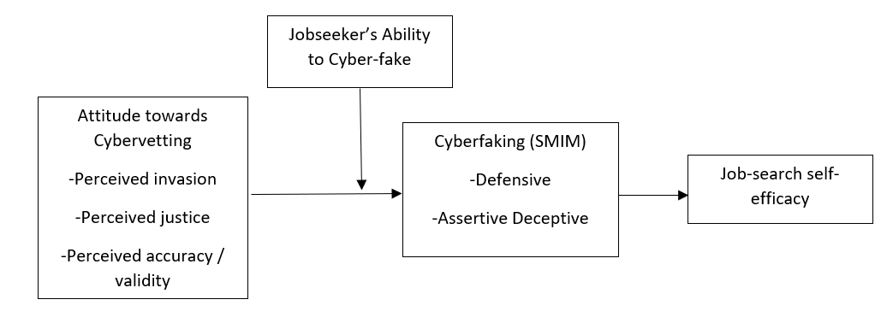
RESEARCH FRAMEWORK

Slide 36
Research Methodology
Research design – Multivariate statistical analysis
Research Technique – Conditional indirect effect test
Sampling strategy and sample size – Purposive sampling
Target population – Active and passive jobseekers
Measures – Attitude towards Cybervetting (Cook et al., 2020), Cyberfaking through a scale on measuring SM IM Tactics (Myers et al., 2021), Job search self-efficacy through Saks and colleagues’ scale (2015), Ability to fake SMIM profiles was measured with a scale developed by Grieve and colleagues (2020)
Data analysis method – To empirically test the conceptual model, the conditional indirect effects will be tested through PROCESS Macro in SPSS Version 20.

Slide 37
Pilot Study
The questionnaire was shared with 135 working professionals who were contacted through personal contacts and snowball sampling
The criteria for selection was a initial filer question which asked participants to confirm whether they have experienced Cybervetting in any of their job search experience.
93 responded in affirmative and 90 participants agreed to fill up the survey

Slide 38
Scale Reliability Testing (Cronbach’s Alpha)
Name of Variable | Cronbach’s Alpha | Item dropped due to reliability issue
Perceived Justice | 0.712 | One (I believe that screening my SM profile is an effective tool for an employer to use in the hiring process)
Perceived Invasion | 0.701 | One (I would still be able to post things freely if I knew a potential employer was going to screen my social media profile [R].
Perceived validity | 0.790 | Nil
Defensive SM Impression Management | 0.903 | Nil
Deceptive SM Impression Management | 0.841 | Nil
Job Search Self Efficacy | 0.728 | Nil
Ability to fake | 0.727 | One (I have the ability to control the way I come across to people through online social media, depending on the impression I wish to give them)

Slide 39
ONGOING WORK
Survey floated with 246 active jobseekers having active SM profiles who have been identified from final year graduate and post-graduate programme students in India
113 responses received till date, expecting for survey completion by August 2024.
Conduct model fit verification and hypothesis testing

Slide 40
Expected Research Implications
MANAGERIAL IMPLICATIONS
Study should throw light on how jobseekers view Cybervetting as a recruitment practice
Study may highlight actions that jobseekers are taking to counter such employer-level interventions
Study may further throw light on how jobseekers are coping with such disruptions to maintain a positive job-search attitude

Slide 41
Expected Research Implications
B) THEORETICAL IMPLICATIONS
Study is expected to help in validating Rogers’ Protection Motivation theory
Spence’s signalling theory may receive further validation in this study
Ajzen’s TPB also may receive support from this study

Slide 42
Expected Research Implications
C) SOCIETAL IMPLICATIONS
Practitioners may be made cognizant about the thin line between ethical data mining and unethical data hacking in the context of Cybervetting
Study may help in understanding more about the rising phenomenon of cyberfaking

Slide 43
OBRIGADO
OPEN FOR QUESTIONS

