Slide 1
Edible Learning: School Food Service Programming and Experiential Learning That Promote Sustainable Agriculture and Better Nutritional Health
A Themed Paper Presentation
13th International Conference on Food Studies
University of Guadalajara, Jalisco, Mexico
Kristina Grasty, Ed.D.
San José State University, California
October 2023

Slide 2
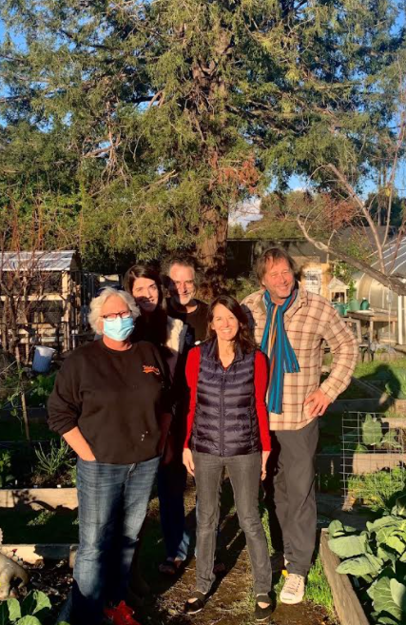
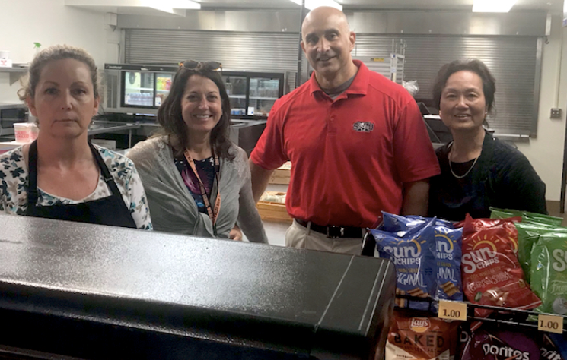
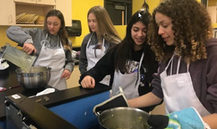
My Story
▪ Family background in food service
▪ Childhood experiences in 4H
▪ Culinary teaching experience ▪ As principal, led farm-to-table initiatives
“Things don’t change on their own, things don’t change by waiting for them to change; they change through actions of good people.”
Dr. Martin Luther King, Jr.
Problem of Practice Where I’ve Worked for 27 Years
Culinary Class
Agroecology Class
Former cafeteria manager, me, Chef Paul, worker, Fall 2019
Family Food Service
USDA-supported youth development program

Slide 4
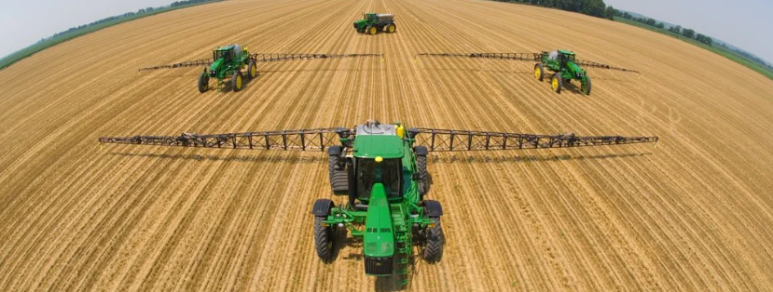
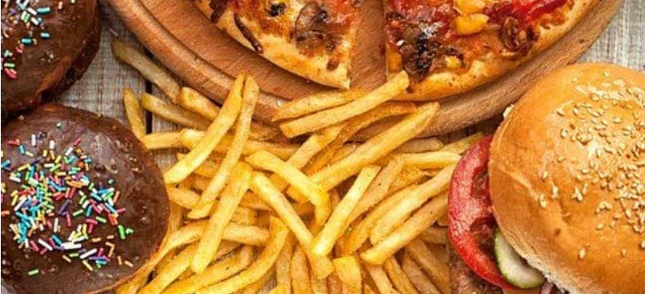
Sociocultural Context of the Problem
Since the 1970s, corporate agribusiness and the fast food industry have transformed the U.S. economy, culture, and diet—and have adversely impacted human health.
(Schlosser, Fast Food Nation, 2002)

Slide 5
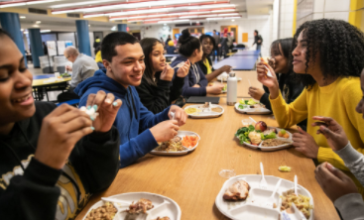
Nutritional Health Statistics
A Western-style diet, including a high intake of sodium and processed meat products and low intake of fruits and vegetables, has been associated with 45.5% of all cardio-metabolic deaths
(Kahleova et al., 2017).
92 percent of school breakfasts and 69 percent of school lunches in the U.S. contain 10 percent or more of calories from added sugars.
(USDA’s Food and Nutrition Service, 2022)

Slide 6
Contextual Relevance to Schools
“More than 95% of American youth attend school and consume as much as 35%-40% of their daily caloric intake there” (Nollen et al., 2007).
Over 30 million American students eat one or two meals a day at the public schools they attend (Bean et al., 2019, Poppendieck, 2010; USDA, 2019).
Poor children are the ones “most likely to participate” in U.S. school meal programs and “consume both breakfast and lunch at school”
(Bean et al., 2019).

Slide 7
California Universal Meals
RECENT LEGISLATION AFFECTING CALIFORNIA SCHOOLS
In August 2022, California became the first state to implement a statewide Universal Meals Program for school children. Schools must provide up to two meals (breakfast and lunch) free of charge during each school day to all TK-12 students requesting a meal, regardless of free or reduced-price meal eligibility.
(CDE, 2022)
Following California, eight more states have passed Universal Meals programs: Maine, Colorado, Minnesota, New Mexico, Vermont, Michigan, Massachusetts, and Illinois, with likely more in the future.
Notes:
Starting in SY 2022–23, California public school districts, county offices of education, and charter schools have to provide during each school day up to two meals (breakfast and lunch) free of charge to all students in grades TK-12 requesting a meal, regardless of their free or reduced-price meal eligibility.

Slide 8
The Problem is Dual-Pronged
Over 14 million American students face compromised health due to malnutrition, which includes type 2 diabetes and other health harms
(Fryar, et al., 2021; Hales et al., 2017; Nollen et al., 2007; Ogden et al., 2014).
2. Nutrition services & nutrition-related education have not been
consistently placed as high educational priorities by U.S. schools.
This domain has been overlooked in educational research.
(Colombo et al., 2020; Crawford et al., 2011; Joyce et al., 2018, Poppendieck, 2010; Weaver-Hightower, 2011).
Notes:
The two variables (participation in school lunch and childhood obesity) have a statistically significant correlation; my argument is that since these issues have a relationship, they reflect a problem of concern that should be addressed. The literature I reviewed suggests that there are improvement steps that can be taken with more deliberateness to improve the quality of nutrition and nutrition education that schools provide so that students’ health and well-being are more positively impacted. Some educational research considers food in its studies but often in limited ways that avoid the totality of complex effects food service has in schools. Many articles come from health and nutrition journals but not educational journals.

Slide 9
Purpose of Study Context for Addressing the Problem
Schools are an appropriate setting for students
To receive healthy, nutritious meals on a consistent basis
To learn & develop healthy food habits that can last into adulthood
(Colombo et al., 2020; Crawford et al., 2011)

Slide 10
Research Question
What are impactful ways to address significant health problems facing a large number of children and adolescents through nutrition programs & related education in public schools?

Slide 11
Research Methodology
Documentary Film:
An exploratory, qualitative research method
to collect and analyze pertinent descriptive research data
to illuminate current systemic challenges as well as strategies to address health injustices facing students through improved school nutrition programming and experiential education about sustainable agriculture

Slide 12
Research Settings: Three California Public Schools Viable Contexts for Exploring the Issues
Los Gatos High School (suburban)
Lowell High School (urban)
Cambria Grammar School (rural/coastal)

Slide 13
Participant Selection Purposeful Sampling (Patton, 2002; Suri, 2011)
43 individuals interviewed
Los Gatos High School (39) - administrators, teachers, cafeteria workers, chef/consultants, parents, students (in Agroecology class and school cafeteria)
Lowell High School (2) – teachers of AP Environmental Class in the school garden and the cooperative, community-based agriculture program
Cambria Grammar School (2) - administrator, garden learning teacher, food bank
Notes:
The logic and power of purposeful sampling lie in selecting information-rich cases for study in depth. Information-rich cases are those from which one can learn a great deal about issues of central importance to the purpose of the inquiry, thus the term purposeful sampling. Studying information-rich cases yields insights and in‐depth understanding rather than empirical generalizations (Patton, 2002)

Slide 14
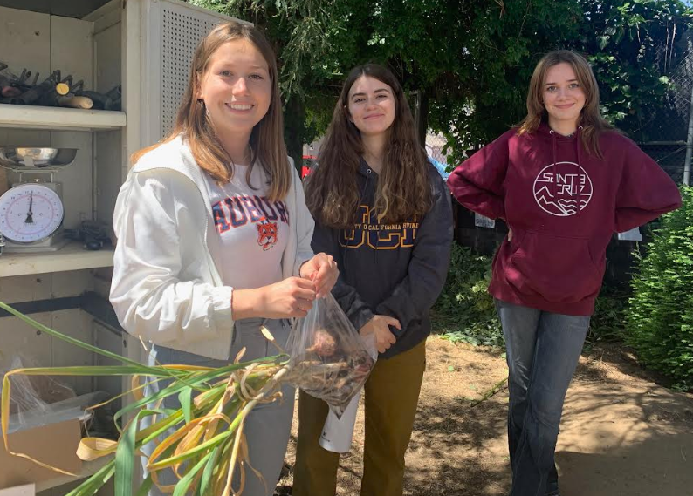
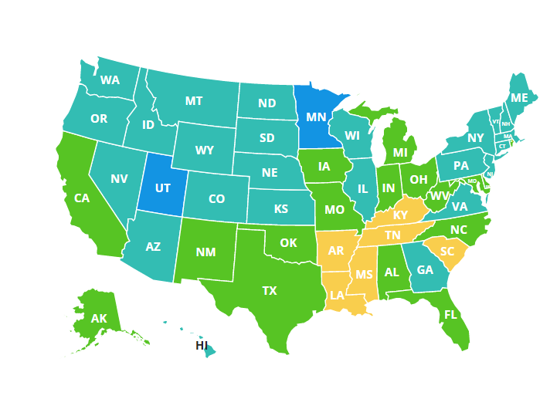
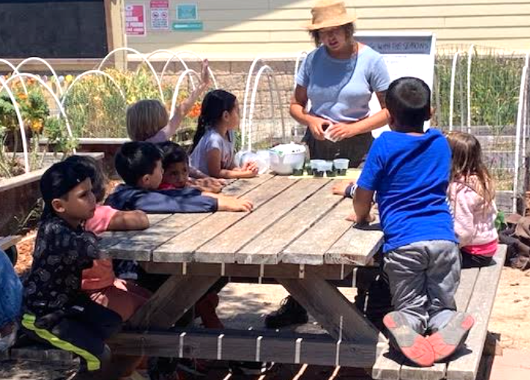
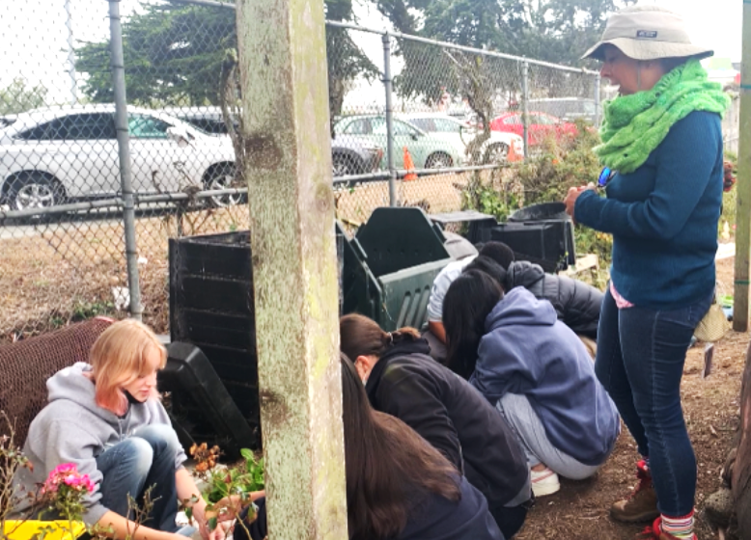
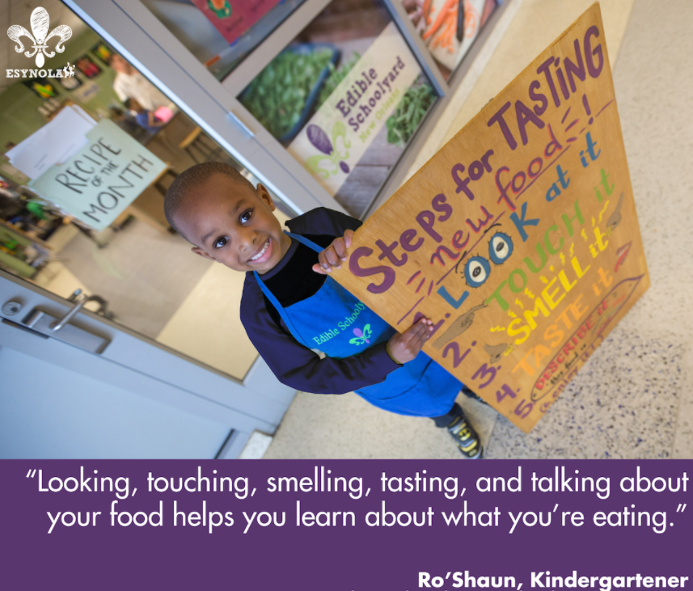
Limitations of the Study: Data Collection
Applying Descriptive Data from Three CA Schools to Where Students are Heavily Impacted
Los Gatos High School (suburban)
Lowell High School (urban)
Cambria Elementary School (rural)
New Orleans, Louisiana

Slide 15
Data Analysis
Journaling - Process Notes
Transcribing Interviews - Linguistic & Thematic Analysis
Poring Over Video Footage - Avoiding Redundancy
Preserving Authenticity - Inclusion vs. Omission
Triangulation of Themes - Telling the Story
Sequencing Footage & Adding Supplemental Footage

Slide 16
Findings & Recommendations
Key Themes
Implications
Recommended Perspectives
Ideas for Improved Practice & Future Research

Slide 17
Findings - Key Themes
Belief in Promoting Good Nutrition & Environmental Sustainability
Challenges: Costs, Procurement, Staffing, Low Reimbursement Rates, Waste, Increased Student Demand, Long Lines, Upscaling
Operating Like A Family Restaurant: Training & Support Needed
Active vs. Passive Learning: Active is Better
Belief in Interconnectedness
Value of School-Community Partnerships

Slide 18
Implications of Findings
Leading Change with an Ecological Systems Perspective
Critical Role of Schools to Address Health Harms Faced by Youth
Importance of Training Staff about Healthy Cooking & Nutrition
Need for Action Learning about Environmental Nutrition

Slide 19
Recommendations - Perspectives to Adopt
An Ecocritical Approach to Forming Partnerships
Establishing Supportive Partnerships to Catalyze Change
Pushing Against Institutional Rigidity Toward Openness
Leveraging Change and Transferability to Other Schools

Slide 20
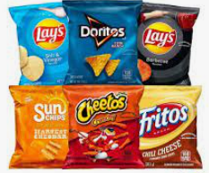
Recommendations for Improved Practice
Procure locally-sourced, fresh ingredients; use a greater proportion of plant-based foods
Eliminate or reduce competitive foods to adhere to nutritious offerings
Provide ongoing training & support for school food service personnel
Improve cafeteria spaces to be well designed, aesthetically pleasing, culturally inclusive
Expand school garden programs; incorporate sustainable food system topics in core curricula starting at young ages

Slide 21
Recommendations for Future Research
Conduct systematic research about the impacts of the Universal Meals policy
Conduct more research in a wide range of urban and rural schools
Conduct research on longer-term impacts of school garden learning programs
Explore how schools can reduce food waste and plastic usage in school food service
Research further how a school cafeteria might promote a more inclusive culture and climate

Slide 23
Recent Developments Tied to My Research
Media Attention: Stories by SJ Mercury News, NBC, CBS TV affiliates
Other Schools Expressed Interest: Contacted & visited by other districts (e.g., students, teachers, parents, a food service director)
Awarded $180,018 from CDE’s School Food Best Practice funding program & the USDA’s Healthy Meals Incentives for Schools
Won 2023 California Golden Bell Award from the California School Boards Association for Student Services

Slide 24
Thank you for listening!
Do you have any questions?
Kristina Grasty
kristi.grasty@sjsu.edu

Slide 25
References
Bean, M. K., Theriault, E., Grigsby, T., Stewart, M. D., & LaRose, J. G. (2019). A cafeteria personnel intervention to improve the school food
environment. American Journal of Health Behavior, 43(1), 158-167. https://doi:10.5993/AJHB.43.1.13
California Department of Education (2022). California Universal Meals. California Department of Education School Nutrition. School Nutrition.
Retrieved December 10, 2022, from https://www.cde.ca.gov/ls/nu/sn/cauniversalmeals.asp
Colombo, P. E., Patterson, E., Lindroos, A. K., Parlesak, A., & Elinder, L. S. (2020). Sustainable and acceptable school meals through
optimization analysis: An intervention study. Nutrition Journal. 19(61), 1-15.
Crawford, P. B., Gosliner, W., & Kayman, H. (2011). The ethical basis for promoting nutritional health in public schools in the United States,
Preventing Chronic Disease, 8(5), 1-6. https://www.ncbi.nlm.nih.gov/pmc/articles/PMC3181198/pdf/PCD85A98.pdf
The Edible Schoolyard Project (2021). Edible schoolyard Berkeley. https://edibleschoolyard.org/berkeley
Fryar, C. D., Carroll, M. D., & Afful, J. (2021). Prevalence of overweight, obesity, and severe obesity among children and adolescents aged 2-19
years: United States, 1963-1965 through 2017-2018. National Center for Health Statistics Health E-Stats, 1-7.
Hales, C. M., Carroll, M. D., Fryar, C. D., & Ogden, C. L. (2017). Prevalence of obesity among adults and youth: United States, 2015–2016.
National Center for Health Statistics Data Brief, 288(1), 1-8. https://stacks.cdc.gov/view/cdc/49223

Slide 26
References (continued)
Joyce, J. M., Rosenkranz, R. R., & Rosenkranz, S. K. (2018). Variation in nutritional quality of school lunches with implementation of National
School Lunch Program guidelines. Journal of School Health, 88(9), 636-643. https://doi.org/10.1111/josh.12665
Kahleova, H., Levin, S., & Barnard, N. (2017). Cardio-metabolic benefits of plant-based diets. Nutrients, 9(8), 1-13.
https://doi.org/10.3390/nu9080848
Khalifa, M. (2019). Culturally responsive school leadership. Harvard University Press.
Lalonde, C. (2014). Raising critique about unhealthy food access among marginalized youth in communities and schools. In J. Hall (Ed.)
Underprivileged Schoolchildren and the Assault on Dignity: Policy Challenges and Resistance, (1st ed., pp. 157-172). Routledge.
Lupinacci, J., Happel-Parkins, A., & Turner, R. (2019). Ecocritical pedagogies for teacher education. In M. A. Peters (Ed.), Encyclopedia of
Teacher Education (1st ed., p. 2). Springer Nature.
McVety, P. J. (2009). Essential Competencies for Delivering Quality Culinary Arts Programs in United States High Schools (Publication No.
305160444) [Doctoral dissertation, Johnson & Wales University]. ProQuest Dissertations & Theses Global. http://search.proquest.com.libaccess.sjlibrary.org/dissertations-theses/essential-competencies-delivering-quality/docview/305160444/se-2?accountid=10361

Slide 27
References (continued)
Molteni, R. Barnard, R., Ying, Z., Roberts, C., & Gómez-Pinilla, F. (2002). A high-fat, refined sugar diet reduces hippocampal brain-derived
neurotrophic factor, neuronal plasticity, and learning. Neuroscience, 112(4), 803–814. https://doi.org/10.1016/S0306-4522(02)00123-9
Munoz, I., Colacino, J. A., Lewis, R. C., Arthur, A. E., Meeker, J. D., & Ferguson, K. K. (2018). Associations between school lunch
consumption and urinary phthalate metabolite concentrations in US children and adolescents: Results from NHANES 2003-2014. Environment International, 121(1), 287-295.
Neely, E., Walton, M., & Stephens, C. (2015). Building school connectedness through shared lunches. Health Education, 115(6), 554–569.
https://doi.org/10.1108/HE-08-2014-0085
Nestle, M. (2013). Food politics: How the food industry influences nutrition and health (3rd ed.). University of California Press.
Nollen, N. L., Befort, C. A., Snow, P., Daley, C. M., Ellerbeck, E., & Ahluwalia, J. S. (2007). The school food environment and adolescent
obesity: Qualitative insights from high school principals and food service personnel. International Journal of Behavioral Nutrition and Physical Activity, 4(18), 1-12. https://doi:10.1186/1479-5868-4-18
Ogden, C. L., Carroll, M. D., Kit, B. K., & Flegal, K. M. (2014). Prevalence of childhood and adult obesity in the United States, 2011–2012.
JAMA, 311(8), 806–814. https://doi.org/10.1001/jama.2014.732
Patton, M. Q. (2002). Qualitative research and evaluation methods (3rd ed.). Sage.

Slide 28
References (continued)
Poppendieck, J. (2010). Free for all: Fixing school food in America. University of California Press.
Russell, C. G., Worsley, A., Liem, D. G. (2014). Parents’ food choice motives and their associations with children’s food preferences. Public
Health Nutrition, 18(6), 1018-1027.
Schlosser, E. (2002). Fast food nation (2nd ed.). HarperCollins.
Selznick, P. (1943). An approach to a theory of bureaucracy. American Sociological Review, 8(1), 47-54. https://doi.org/10.2307/2085448
Sharma, A., Moon, J., Baig, J. I., Choi, J., Seo, K., Donatone, L. C. (2015). Cost–benefit framework for K-12 foodservice outsourcing
decisions. International Journal of Hospitality Management, 45(1), 69-72. https://doi.org/10.1016/j.ijhm.2014.11.008
Silva, C. (2020, September 27). Food insecurity in the U.S. by the numbers. NPR,
https://www.npr.org/2020/09/27/912486921/food-insecurity-in-the-u-s-by-the-numbers
Strauss, R. S. and Pollack, H. A. (2003). Social marginalization of overweight children. Archives of Pediatric and Adolescent Medicine, 157(1), 746-752.
Suri, H. (2011). Purposeful sampling in qualitative research synthesis. Qualitative Research Journal, 11(2), 63+.

Slide 29
References (continued)
Taber, D. R., Chriqui, J. F., & Chaloupka, F. J. (2012). Differences in nutrient intake associated with state laws regarding fat, sugar, and caloric
content of competitive foods. Archives of Pediatrics & Adolescent Medicine, 166(5), 452-458.
Trasande, L. and Attina, T. M. (2015). Association of exposure to di-2-ethylhexylphthalate replacements with increased blood pressure in
children and adolescents. Hypertension. 66(2), 301-308.
U.S. Department of Agriculture (2019). The national school lunch program: fact sheet. USDA Food and Nutrition Service. Retrieved April 18,
2021, from https://www.fns.usda.gov/
U.S. Department of Agriculture (2022). Added sugars in school meals and competitive foods. USDA Food and Nutrition Service. Retrieved
February 12, 2023, from https://fns-prod.azureedge.us/sites/default/files/resource-files/AddedSugarsinSchoolMeals.pdf

