Slide 1
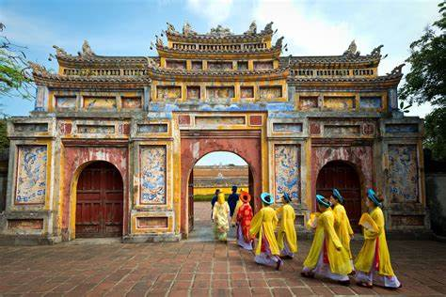
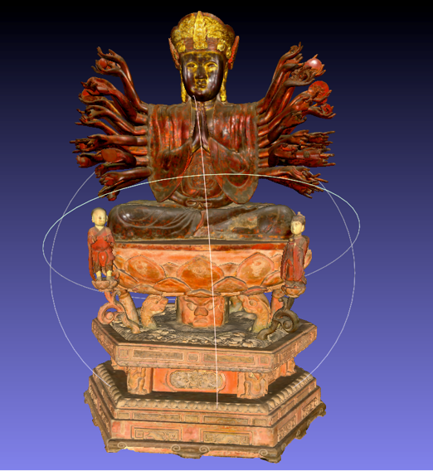
Creating Ethical and Sustainable Digital Museums in the Global South:
Applying Needs and Suggestions of Vietnamese Museum Professionals
and Audiences to Digitize Cultural Heritage
Dr. Emma Duester
Institute of Cultural and Creative industries, Shanghai Jiao Tong University

Slide 2
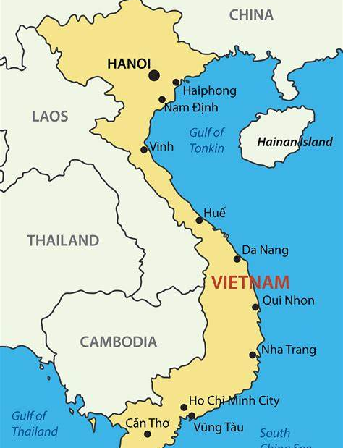

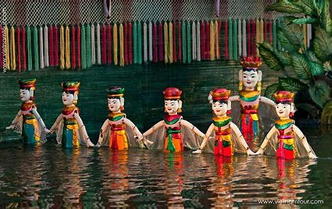
Vietnamese BUILT, TANGIBLE, and INTANGIBLE cultural heritage
Notes:
Museums are currently going through rapid digital transformation. However, museums in the Global South lack sufficient technical, human, and financial resources to ensure timeliness and high-quality digital cultural content creation. Yet, there are many built, tangible, and intangible cultural heritage in Vietnam that requires digitization and making access to in order to ensure its preservation but also to showcase a more comprehensive picture of Vietnamese culture.
This means that Vietnamese museums’ route and approach to digitizing collections requires specific digital solutions. These solutions need to be feasible while still being ethical and sustainable. This paper draws on the process of and results from a co-designed digitization project, including interviews, consultations, visits, an audience survey, and the digitization of cultural heritage artefacts at the Vietnamese Women’s Museum (VWM), The Vietnamese National Museum of Fine Arts (VNMFA), and Vietnamese National Museum of History (VNMH) between 2020 and 2023. This project applied museum professionals’ and local audiences’ needs and desires for digital developments in digitization projects, as they aptly shared what they wanted to be digitized and how they wanted it to be digitally presented online – while respecting the local context. This approach can ensure more sustainable and ethical digitization practices and creation of digital museums.

Slide 3
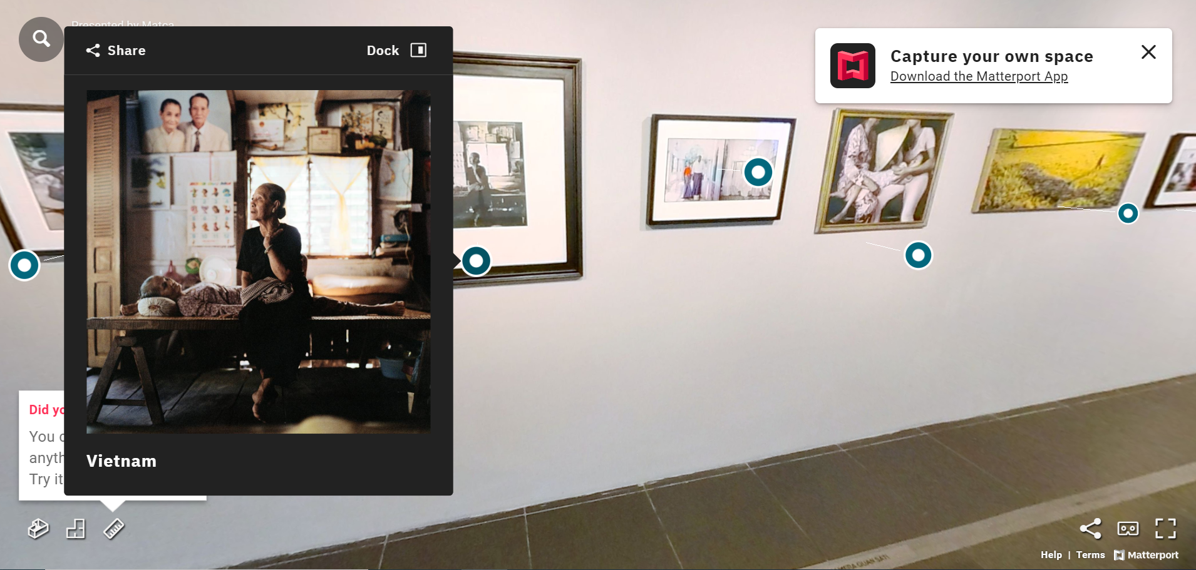
The importance of digital museums
Vietnam can create its own image of Vietnamese culture
An accessible digital culture can give people, globally, a more comprehensive understanding of what is Vietnamese culture

Slide 4
Introduction to
the project
Project Team:
Ms Michal Teague (Design, Vietnam)
Dr Jonathan Crellin (Technology, Vietnam)
Mr Ondris Pui (Design, Vietnam)
Dr Tammy Hulbert (Curation, Melbourne)
Ms Thoa Tran (Research Assistant)
Ms Le Minh Phuong (Research Assistant)
External Museum Partners:
Vietnamese Women’s Museum
Vietnam National Museum of History
Vietnam National Museum of Fine Arts
Project carried out in Vietnam, 2020-2023
At RMIT University Vietnam
‘Futureproofing Museums: The Digitization of Art and Culture in Vietnam’

Slide 5
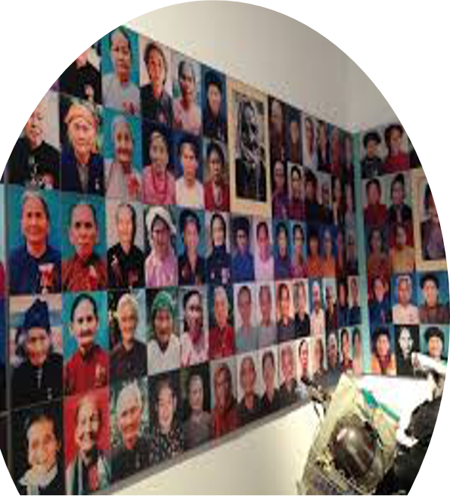
Methodology
50 interviews with artists and cultural professionals in Hanoi, capital of Vietnam.
Digitization project – co-designed action research with museum partners, including consultations with museum partners, and using photogrammetry and 3D scanning technique to digitize cultural artefacts.
Systematic review of government policies on culture development, digitization, and copyright.
Events, for upskilling and capacity building, and bringing the sector together as well as enforcing links between art and IT sector. Part of the action research.
Surveys to audience.
Notes:
Case Study on Matca Space for Photography
(the case study approach provided an in-depth and detailed understanding of Matca’s current state of digitization and how they are digitally displaying this work. The case study approach provided a way of understanding the developments and challenges Matca is currently facing in the process of digitization. This highlights a politics of digitization that is specific to Vietnam. Matca was chosen for the case study because it is an art space that is far ahead in terms of digitzation and use of innovative methods to digitally display content and interact with the audience. )
Three methods for the case study –
Secondary data analysis – Secondary data and publications on Matca were collected and analysed from June until August 2020, including newspaper articles, art and culture magazine articles, past interviews published online with the co-founders and content from their website.
semi-structured Interviews with the two co-founders of Matca in Jan, June and July 2020. Three interviews wwere conducted. As well as 20 semi-strucutred interviews with cultural professionals – May-October 2020.
Dig ethnog of Matca’s Facebook page from January to April 2020. Posts were selected in relation to three themes: (1) emotion/connection, (2) increased digitization and (3) international connection. These Facebook posts were then analysed in terms of how they digitized and displayed art as well as how they used their Facebook page to communicate to local and international audiences.
50 semi-structured interviews were carried out with cultural professionals between May 2020 and May 2021. 20 interviewees were museum professionals. Initial interviewees were recruited based on RMIT University’s existing industry connections. Subsequent interviewees were recruited through snowball sampling. The aim of the interviews was to find out the nature of digital transition occurring in the culture sector in Vietnam, what opportunities and challenges professionals were facing, how they were using digital technologies, and what Vietnamese museum professionals wanted and needed for further dig developments.
Researchers conducted a systematic review that involved the collection, sorting, and filtering of relevant government laws and policies in relation to the keywords: digitization, culture, museums, digital technology, and digital content. Researchers searched and collected legal documents via public documents published on Vietnam Government online portals, including laws and decrees as well as government strategy documents (including the most recent time period for 2021-2030), analysed to find out what kinds of government provision and legal guidelines are in place to support museum digitization.
An audience survey was carried out between July and October 2021. There were 169 survey responses with 46 valid responses. The survey was created, administered, and collected using Qualtrics. Respondents could answer in English or Vietnamese. The purpose of the audience survey was to address the needs of Vietnamese museums to connect with their target audiences. Survey questions were designed to find out what they want from dig content and dig experiences, suggestions for improvements for digital content curation at Vietnamese museums, and suggestions on how to curate online digital content or in-person experiences to attract target audiences. Audience analytics were used to identify locally-based national Vietnamese and international expat visitors to Vietnamese museums. Respondents are from across Vietnam. Participants were recruited based on having already visited Vietnamese museums. The audience survey was divided into two groups of visitors to Vietnamese museums: 1. Vietnamese nationals and 2. international expats currently living in Vietnam. Two groups were included in the survey because the audience-base of Vietnamese museums’ (at that time just after covid) included Vietnamese nationals and international expats living in Vietnam. These two groups were kept separate in the administration, collection, data storage. Analysis combined both groups to highlight the similarities and differences between the two groups. Respondents were provided with information about the survey and research topic before entering the survey online. Respondents were also provided with keywords and definitions to ensure the questions were clear. Respondents gave inferred consent by ticking a box that automatically took them to the survey. All respondents from both groups were asked to answer the same questions. Respondents took slightly different paths through the survey depending on their answers. There were a combination of multiple choice, Likert scale, and open-ended questions.
Cultural professionals included museum staff from various departments such as communications, collections, education, along with museum directors, gallery directors, heads of Vietnam Institute of Arts & Culture Studies, professors at art academies, artists, commercial art galleries, and art auction house workers.
According to the Law (https://thuvienphapluat.vn/van-ban/Bo-may-hanh-chinh/Luat-ban-hanh-van-ban-quy-pham-phap-luat-2015-282382.aspx): In terms of legality, Decree ranks higher than Decision of Government.

Slide 6
Literature
Museum digitization across Asia
Global digitization divides
Ethical digitization
Sustainable digitization
Notes:
Developments in museum digitization across Asia are being led by China, Japan and South Korea with many large-scale, state-funded digitization projects to preserve cultural heritage (Lang, Wang, and Li 2020; Lo et al. 2019; Zhou, Sun, and Huang 2019). For example, China is investing state funding and personnel into digitization projects in a country-wide initiative for the digitization of cultural heritage at state institutions (Zhou, Sun, and Huang 2019; Wanyan and Hu 2020). There have also been digital developments at museums across Japan to create a common archive and standardized procedures for archival data that shares collective memories of national disasters (Togiya 2013). Governments in South East Asia are also supporting digital transformation through the creation of national-level policies to promote the integration of culture and digital technology, creating digital platforms to digitize and display cultural heritage and updating copyright laws for the digital environment. The priorities of digital cultural policies in this region are to ensure the sustainability of digitization projects and to promote ways of using digital culture for developing international connections and economies (Manaf and Ismail 2010; Barker and Adrian 2017). For example, the Malaysian Government manage digital resources, standardize procedures and identify areas that need addressing to ensure sustainable and successful implementation of digitization projects (Manaf and Ismail 2010). Also, the Cambodian Government has set out a new national policy framework, titled ‘Cambodia Digital Economy and Society Policy Framework 2021-2035’. The aim of this framework is to “build a vibrant digital economy and society by laying the foundations for promoting digital adoption and transformation to promote new economic growth and improve social welfare” (Cambodia Government 2021). However, Cambodia's ability to take up digital technologies is challenging due to limited digital infrastructure, digital skills, and digital leadership (SET 2020). Similarly to Vietnam, this local context does not allow for advanced digital technologies like AI, NFT and Blockchain to be used in digital developments at museums currently.
Even though many museums may seem to be ‘within’ this global digital transformation process, many challenges and limitations are overlooked at a global level. As Benhamou et al. (2021) argue, there are current disparities in museums between the Global North and Global South regarding the conditions of use of works contained in their collections, which may impact museums’ abilities to become and remain relevant in the global digital environment. Others also argue that digitization has exacerbated colonial biases and North/South inequalities, despite practical changes made at museums to decolonize collections and practices (Tolia-Kelly and Raymond 2020; Prianti and Suyadnya 2022; Abungu 2019; Vawda 2019). As Pickover (2017) argues, the selection of content for digitization reflects unequalness and creates a new colonialism, stating that digitization projects in the Global South “are fundamentally located in uneven power relations and perspectives which compromise national heritage; do not represent the views and interests of the developing nations; bolster inequities in globalization; and exacerbate historic North/South imbalances. In response, Pickover (2017) argues “digitization projects need to be aligned to local and regional discussions”. As Clerken and Taylor (2021, 170) notice, the issue is that only artefacts with more complete digital profiles will be used at the expense of “unphotographed objects”. This may also apply to artefacts that are digitized at lower quality, slower pace, or without the latest digital technologies. This could, as Clerkin and Taylor (2021: 170) argue, “reinforce problematic canons by making works already engaged in traditional, exclusionary hierarchies of value most accessible”.
This relates to discussion on ethical digitization (Džikić and Radin 2019; Pawelec et al. 2019; Boumans 2021), capabilities of museums in the Global South to digitize cultural heritage (Domingo 2021; Salazar 2006), and the ethical and appropriate digitization of artefacts for indigenous communities and intangible cultural heritage (Pawelec et al. 2019; Boumans 2021). One focal point is the risk of misrepresentation and the need to establish frameworks to mitigate risk. For example, Manzuch (2017) discusses the concern of manipulation, copying and repurposing of digital surrogates that may misrepresent local culture and jeopardize objects’ authenticity. Domingo (2021, 111) presents concerns about digitizing heritage sites in the Philippines as the increasing popularity of VR in cultural heritage representation needs to be accompanied by measures to mitigate misrepresentation, such as giving false impressions of heritage sites and distorting historical records. Additionally, there is discussion on ‘ethical challenges’ and ‘ethical questions’ inherent in digitization (Manzuch 2017; Pickover 2017; Schopp et al. 2019; Domingo 2021). For example, Manzuch (2017) argues that digitization practices create ethical challenges, including biases in selection, interpretation and control. Particularly, Pickover (2014) notices a selection bias towards a Western approach. To overcome such concerns, Anderson (2017) argues that important ethical questions need to be included in digitisation projects, including who will do the work, which digital tools will be utilized and where will it be digitally displayed.
The term ‘Global South’ is used sparingly here with the acknowledgment of its connotations and limitations. The term is used here as a shorthand expression that refers to world regions outside Europe, North America and Australia. This paper adopts this term to refer to the cultural, economic, and geopolitical hierarchies that structure the world and imbue international cultural relations and cultural policies. Researchers acknowledge that there is a bias inherent in the term as it was generally used in the past to suggest underdevelopment. Researchers also acknowledge its contested character due to the way cultural and economic power balances are shifting globally. For instance, the BRICS countries (Brazil, Russia, India, China, South Africa, Iran, Egypt, Ethiopia and the United Arab Emirates) are emerging as important players internationally.
There are cultural agencies in the Philippines that have partnered with VR development companies to adopt VR technology in their exhibits as well as to digitize important built heritage in the country, such as the National Museum, National Historical Commission of the Philippines (NHCP) and Ayala Museum.
Sustainability is a term which is often used when discussing the future of the museum industry. It is a critical principle with a great value which museums are striving for. A lot of literature talks about how digitization can enhance museums’ sustainability – not only talking about collections but also about the digitization of business operations. Based on this research findings a new trend of ‘digital sustainable museum experience’ is trending among museums internationally. While it may have less income on the museums businesses it has for sure maintained the industry during the pandemic situation faced by the entire world. Virtual tourism can also be coined with virtual museum experiences to sustain interest and edutainment experience museums promote.
It is therefore advisable for museums to adopt to the current situation and to integrate digital platforms and tools to enhance it sustainable level through two main factors, which are: digitalization helped museum to keep working during pandemic, and furthermore, digitalizing museum as proven in literature has a big impact on increasing visitor’s interaction level.

Slide 7
Overview of digitization at Vietnamese museums
Digitization projects at Vietnamese museums have been taking place across Vietnam since the early 2010s, predominantly in the larger cities.
The purpose of digitization projects has been for the preservation of cultural heritage and storage in closed digital archives.
Government priority areas include folk arts and intangible cultural heritage. - As you can see in the top image here, with examples of digitized woodblock carvings and musical performances.

Slide 8
Vietnam may be different to where you are from due to lack of tech, financial, and human resources.
Due to being a middle-income country – there is less technical equipment for digitization, less money available for museums, less staff and less staff skilled in digital technologies and digital communication.
There are differences in internet infrastructure as well – so animations, AI , games are not as possible in Vietnam. Because the audience cannot access the content due to load times. And the museums cannot host them on their websites which are not heavy enough for such content.

Slide 9
In Vietnam, museums predominantly use 4 types of in-person digital technologies:
audio guides
iMuseum apps
headsets for audio, video, or VR
video display screens.
Museums predominantly use 3 digitization routes to display content online:
3D images of artefacts
online exhibitions
360 virtual tours.
These adoptions are feasible in Vietnam currently. However, immersive exhibition environments, heavy gaming environments, and AI are not possible as yet in Vietnam – due to internet speed and technical infrastructure.

Slide 10
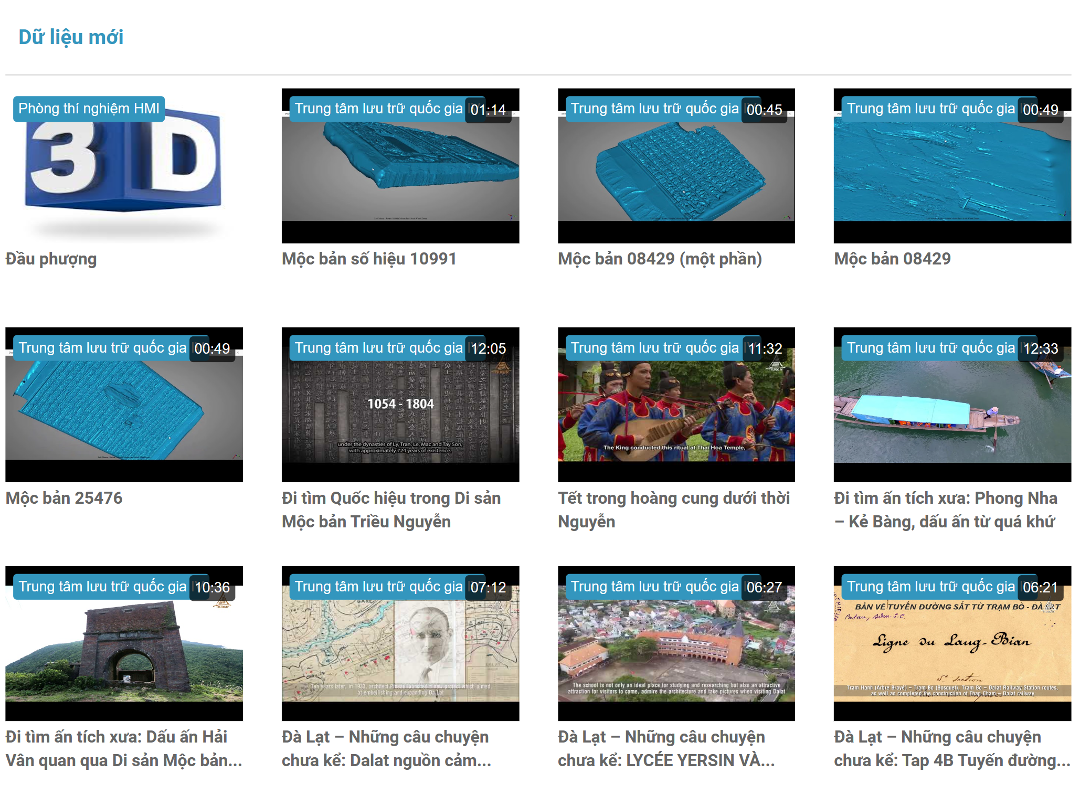
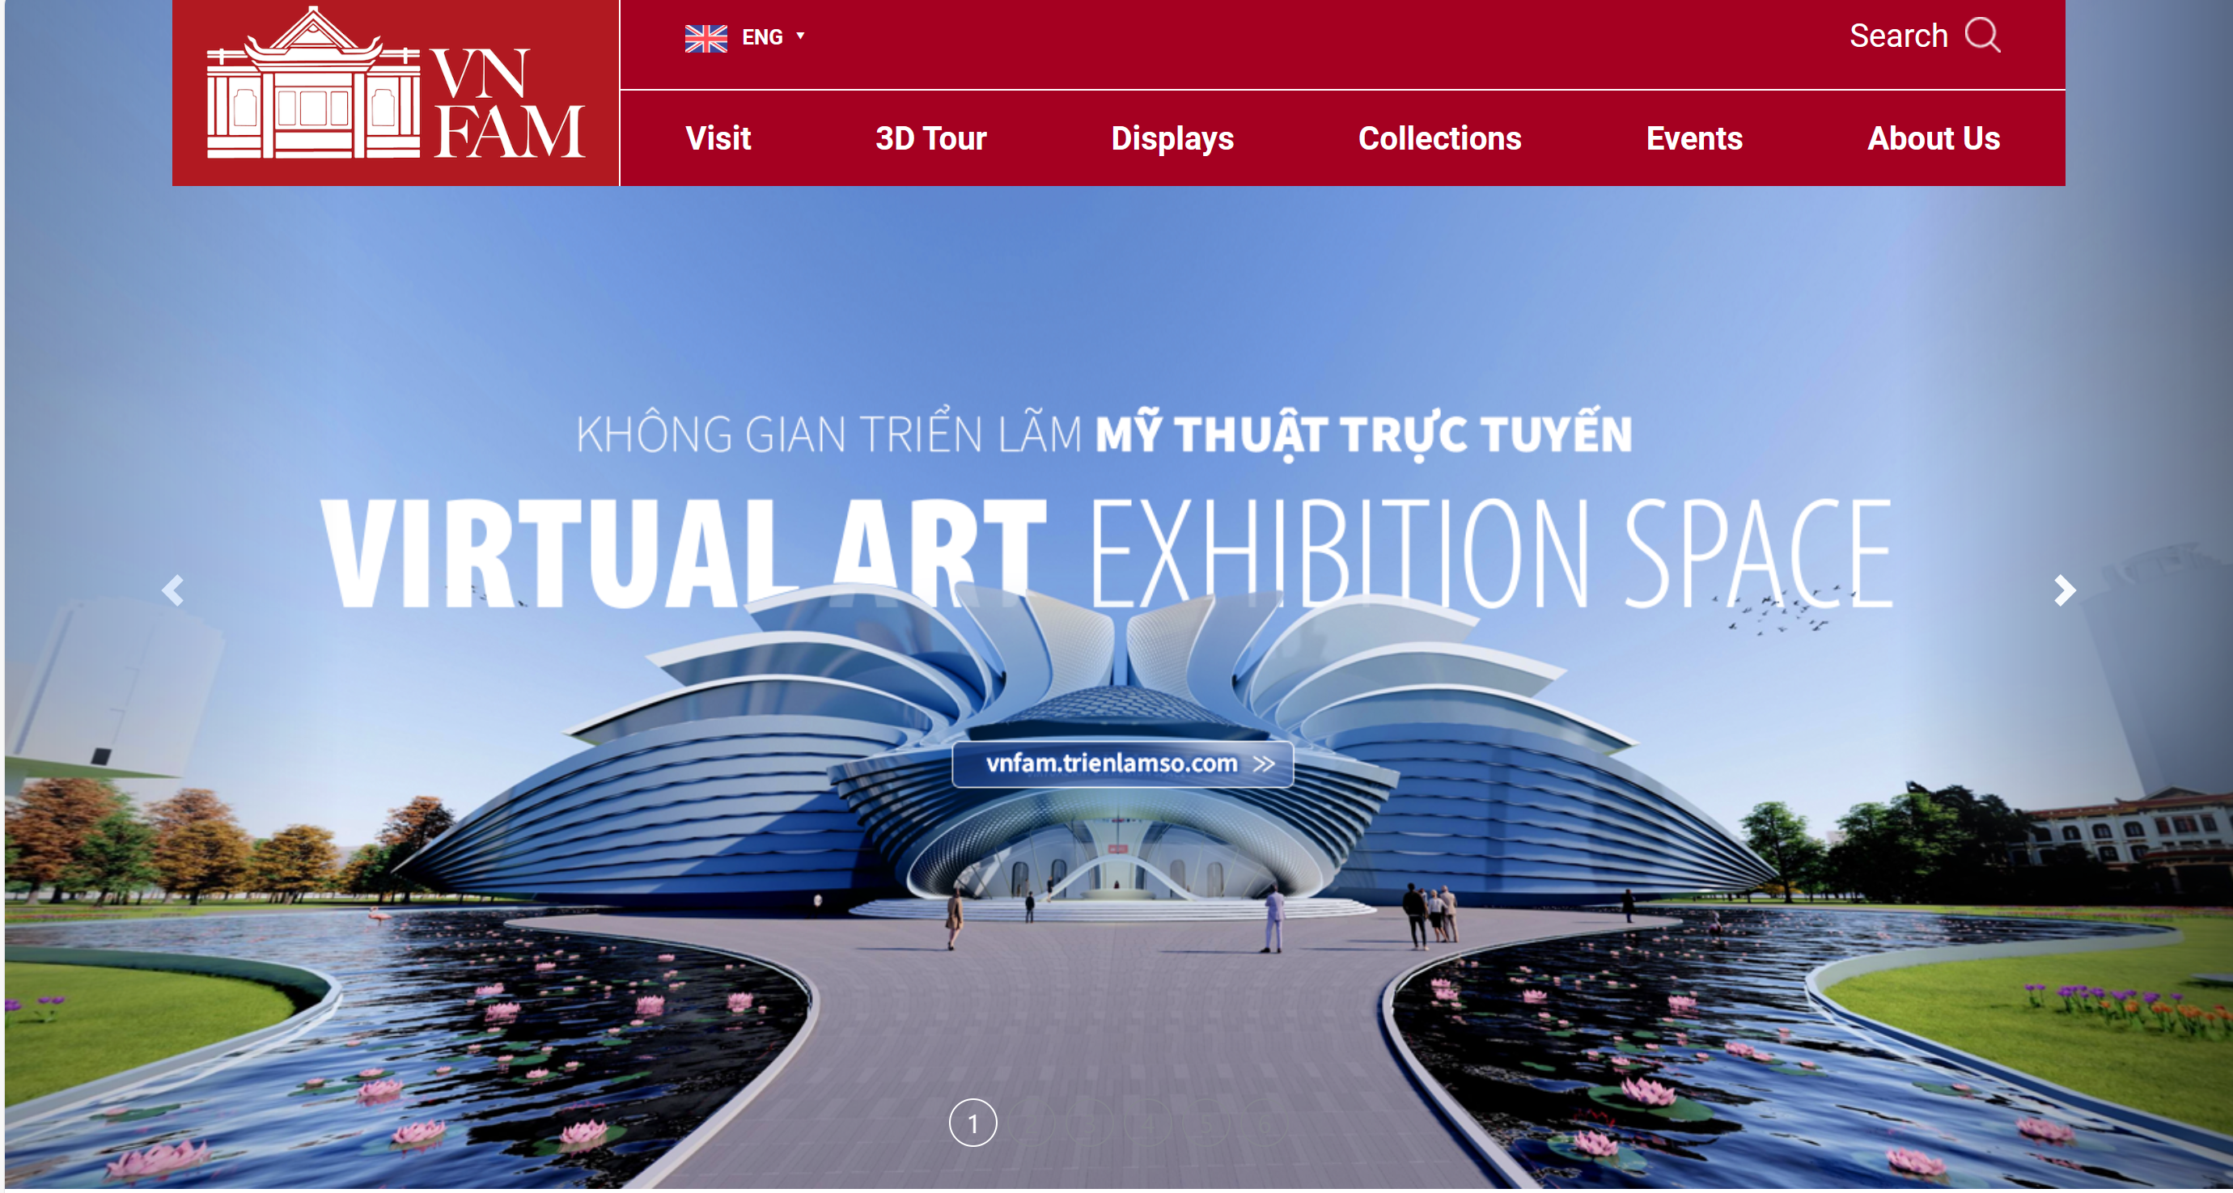
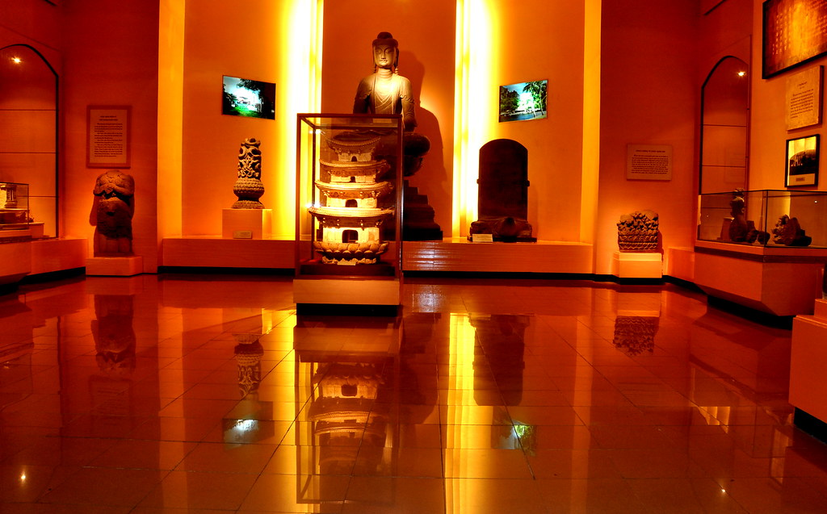
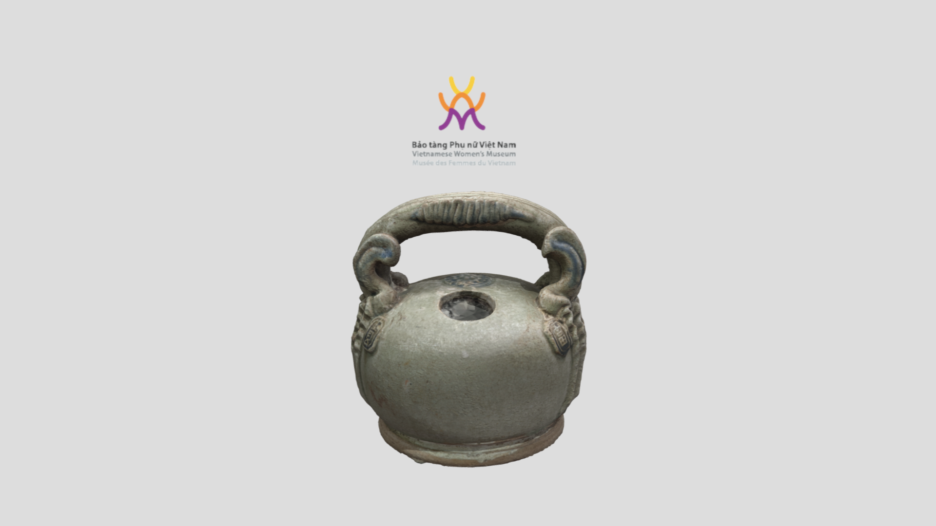
What does digital culture look like in Vietnam?
Notes:
Digitization projects at Vietnamese museums have been taking place across Vietnam since the early 2010s, predominantly in the larger cities of Hanoi, Ho Chi Minh City, Da Nang, and Hue. The purpose of digitization projects has been for the preservation of cultural heritage and storage in closed digital archives. Government priority areas include folk arts and intangible cultural heritage funded by the Ministry of Culture, Sport, and Tourism (MoCST). As you can see in the top image here, with examples of digitized woodblock carvings and musical performances.
Museums predominantly use 4 types of in-person digital technologies: audio guides; iMuseum apps; headsets for audio, video, or VR; video display screens. Museums predominantly use 3 digitization routes to display content online: 3D images of artefacts; online exhibitions; 360 virtual tours. These adoptions are feasible in Vietnam currently. Immersive exhibition environments are often too heavy for websites. However, Vietnamese museums want robust websites for attracting international audiences and to engage audiences with content that is comparable to international standards. Mobile devices are the main way of accessing online content and for some in-person content like audio guide apps.

Slide 11
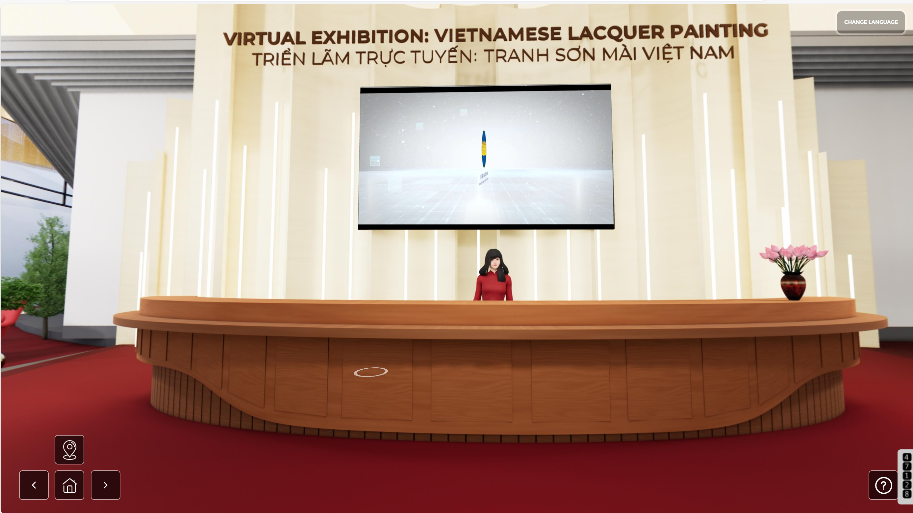
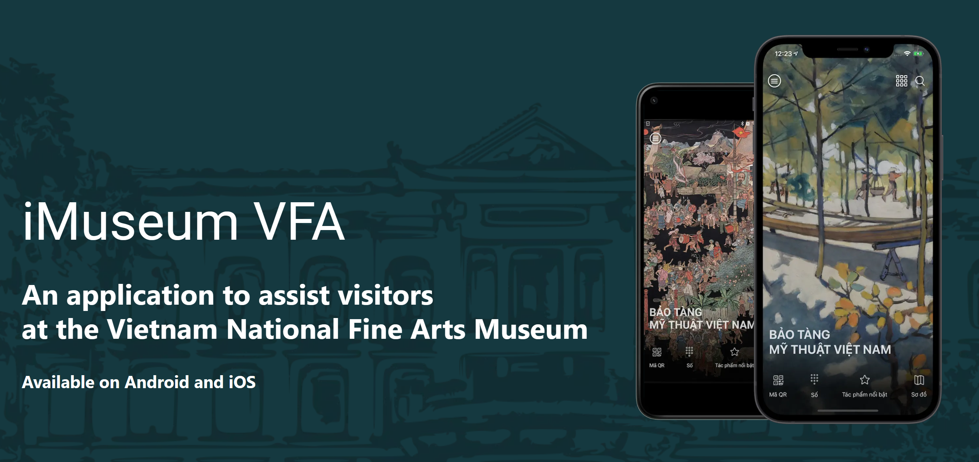
Vietnam National Museum of Fine Arts
Between 2015-2020, VNMFA carried out several activities using digital technologies:
It diversified its activities and attracted more types of audiences.
They researched other museums’ websites internationally and, subsequently, upgraded their website.
They digitized and published approximately 400 images of artworks on their website. They also developed a multimedia guide app called iMuseumVFA in English, Vietnamese, and French for in-person visits.

Slide 12
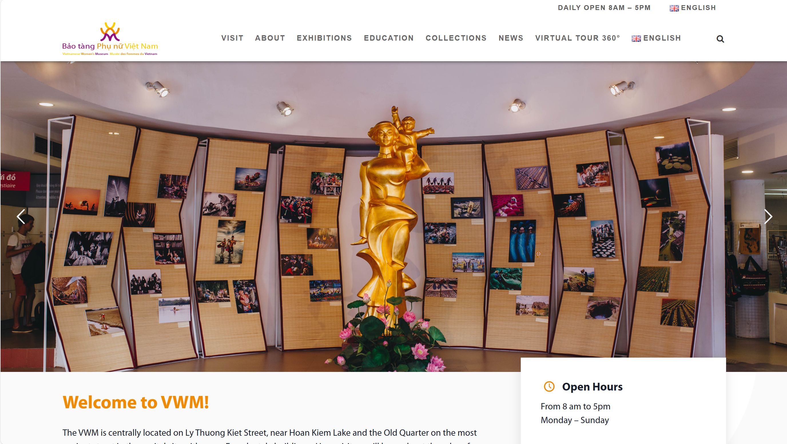
Vietnamese Women’s Museum
Between 2015-2020, VWM carried out several activities using digital technologies:
They digitized and coded museum artifacts for archival and communication purposes.
They introduced a ‘museum artifact story’ on YouTube, Facebook, Twitter, Instagram, and the museum website.
They upgraded their website with a new interface.

Slide 13
What the museums needed and desired?
Overall Needs – technical, financial, and human resources.
Particular needs - technical equipment, digitally trained staff, internet infrastructure, robust websites, finances and how to attract audiences. they needed to connect more with young, family, and international audiences. They particularly wanted to know how to connect with these audiences using dig tech. and didn’t know what these audiences wanted.
Overall desires – to do more digitization and to do it comprehensively and systematically.
Particular desires - further developing digitization projects even though the above challenges. They want to showcase Vietnamese culture and history properly via digital technologies and they also want to have more digital literacy to know how to attract audiences, how to create engaging content, and produce digital stories. Teams dedicated to digital content creation, publication, and maintenance.

Slide 14
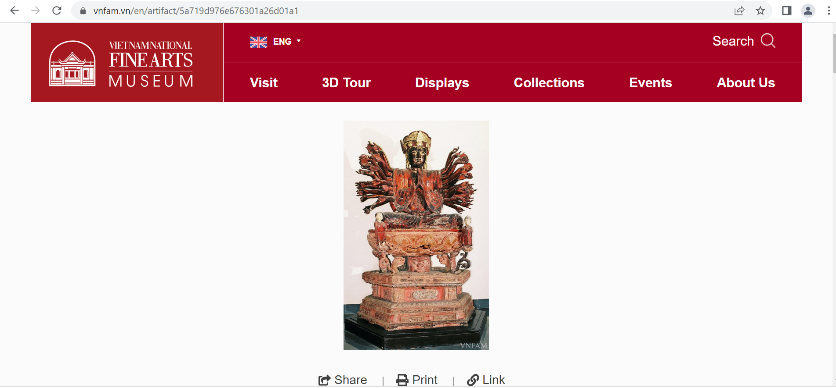
Findings show many Challenges in digitizing museum collections
Lack of human, technical and financial resources.
“digitization is a big job, there is lack of funding and lack of resources.” (Participant 15 from Song Hong)
“the challenge is a lack of human resources, and so a lack of time to spend developing platforms.” (Participant 2 from Phò Dày)
“there are difficulties in getting the best technical equipment for scanning.” (Participant 6 from Luc Nam)

Slide 15
Challenges preventing Vietnam from developing digital museums
“we cannot develop digital platforms due to challenges in human resources and budget, so platforms are limited and there is a challenge in resources which means we cannot exploit international
connections.” (Participant 5 from Ba Thin)​
​
“We do things on the basis of availability of people and/or money. If there is no personnel, or volunteer or money, we would not do anything… home-grown style, depending on the availability of personnel and platforms.” (Participant 31 from Thuy Khoi)

Slide 16
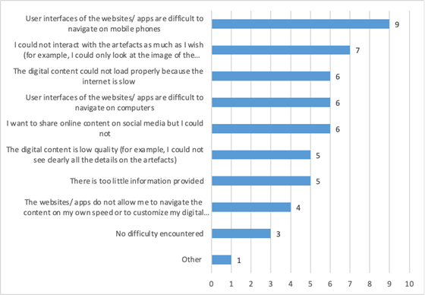
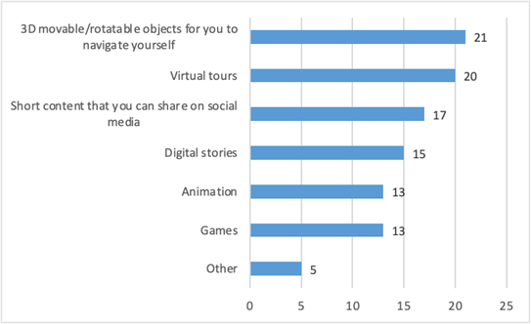
What the audience needs and wants

Slide 17
Local audiences’ suggestions to develop uses of digital technologies and digital experiences for in-person visits
There are 3 main suggestions to develop uses of digital technologies and digital experiences for in-person visits were: 1. the physical and digital should be more closely, logically, and clearly connected. Respondents said "we didn’t understand the story being told [with digital technologies]" and "not easy to follow the path [in the physical space], so it’s difficult to follow the story [via digital technologies]". 2. digital experiences should be realistic rather than sensational or detached from reality. “I enjoy mundane things so much more as it feels more genuine. Videos of city walks or even just personal exchanges of culture via digital technologies could really provide a chance for these museums to grow.” 3. digital storytelling could be more clearly related to the physical. Survey respondents want Vietnamese museum collection displays to connect to the local culture, customs, and area. For instance, respondents said “I liked how it connected with the local area” and “artefacts related to the local area that has significance when you're in situ, even if you come from across the globe”.
Respondents like digital technologies to be used to tell a story to enhance the physical or reveal more information, context, and history than solely the physical object. For example, respondents said they liked the digital to provide an "enrichment of the physical experience" and “deeper immersion than the physical alone”. For instance, some respondents were surprised to be able to analyse objects in more detail than before by being able to see behind, beneath, or inside the object with the 3D model, or when seeing the artifact come ‘alive’ with AR, VR, or animation. Respondents enjoy the use of digital screens in the exhibition to ‘touch’, zoom in/out, and manipulate digital artefacts. Respondents said they like "manipulating objects that you can’t otherwise touch, seeing them from all sides" and "seeing them [artefacts] put into context, which you wouldn’t otherwise be able to grasp easily".
For online digital content, respondents’ main complaints are: 1. the user interface of the websites/apps are difficult to navigate on mobile phones, 2. the internet is too slow for content to load properly, and 3. they could not interact with the artefacts as much as they had wished.
85% of respondents were Vietnamese while 15% were expats living in Vietnam. The majority of respondents were from the younger age group, with 88% aged between 18-29. This reflects the young average population in Vietnam, which was 33 in 2024. For 15% of respondents who were expats, the majority were from the older age groups of 36-45 and 46-55. 90% of respondents did not have any children or dependents. This was important in understanding the answers to the questions. For example, the most common answer to the question of ‘who do you visit the museum with?’ was ‘with friends’ for 70% of respondents. 95% of respondents had been to a museum in person before. 20% of respondents had visited a museum in Vietnam in-person ‘once every few years’ or ‘a couple of times a year’. 60% had visited museum online content internationally. However, only 40% had visited Vietnamese museum content online before. Hence, more had accessed museums online from abroad and less of Vietnamese museums online.
While some of these issues are related to museums specifically, others are about Vietnam’s internet infrastructure overall. For example, these are concerns in Vietnam, broadly, as the internet is unstable and cannot cope with heavy content. This is a challenge for Vietnam, broadly, with low web and mobile internet speed. Vietnam’s average internet speed is 111.89 Mbps, which is ranked 61 worldwide. Vietnam’s mobile internet speed is 5.72 Mbps, which is ranked 65 worldwide. (Wisevoter, 2022). By comparison, Singapore’s internet speed is 300.83 Mbps and its mobile internet speed is 6.59 Mbps, ranked 2 worldwide. Also, Switzerland’s internet speed is 279.8 Mbps and its mobile internet speed is 7.24 Mbps, which makes it ranked 6 worldwide. This is important to identify because mobile devices are the main way of accessing digital content in Vietnam. As Nguyen (2022) notes, internet usage in Vietnam is predominantly mobile-based due to the high smartphone penetration rate. The Ministry of Information and Communications (2022) reported that mobile broadband infrastructure has reached 99.73 percent of villages nationwide. Viet Nam also has 94.2 million smartphone users and 82.2 million mobile broadband subscribers, accounting for 74.3 percent of the national population. This creates challenges when audiences load and view these digital environments that include large amounts of 3D digital objects on one platform such as Mozilla Hubs.

Slide 18
Using local audiences’ suggestions on how to attract audiences – for a more ethical and sustainable solution
To attract young audiences, respondents suggest tailoring exhibition design with age-appropriate content, interactivity, and stylized graphics. Respondents said “exhibitions must be entertaining and exciting beside educational” and “provide age-tailored content”. 5 suggested “more interactivity” and “design interactive activities, connect the information to global issues that require young's participation, like environment and clean food”. 3 respondents suggest more connections to social media sites and options to share content. 2 respondents suggested creating highly-stylized graphics for in-person and online content. To attract families, respondents suggest enhancing interactivity, including “interactive games” (R10), “organize tours and workshops where children can learn through playing” (R22), “include interactive elements the whole family could be involved with, also maybe photograph element to create engagement because families love to take pictures as keepsakes.” There is an emphasis on creating content that the whole family can discuss together, continue, or take away after their visit. Respondents suggested “questions that families can discuss as a group or take away from the museum for further thinking.” To attract international audiences, respondents suggest increasing the amount of content online and creating a separate version with globally-relatable topics. Respondents said “develop an adequate database”, “content must be diversified”, “provide a distance version of some aspects”, and “they should work on the interface to make international tourists feel included in activities.”

Slide 19
Applying local museums’ needs and local audiences’ desires and suggestions in a digitization project – the quest to create more ethical and sustainable digitization projects

Slide 20
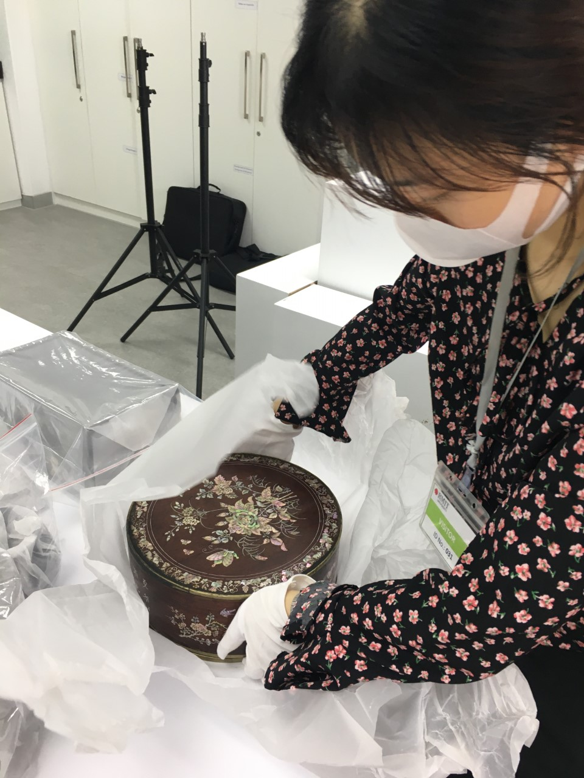
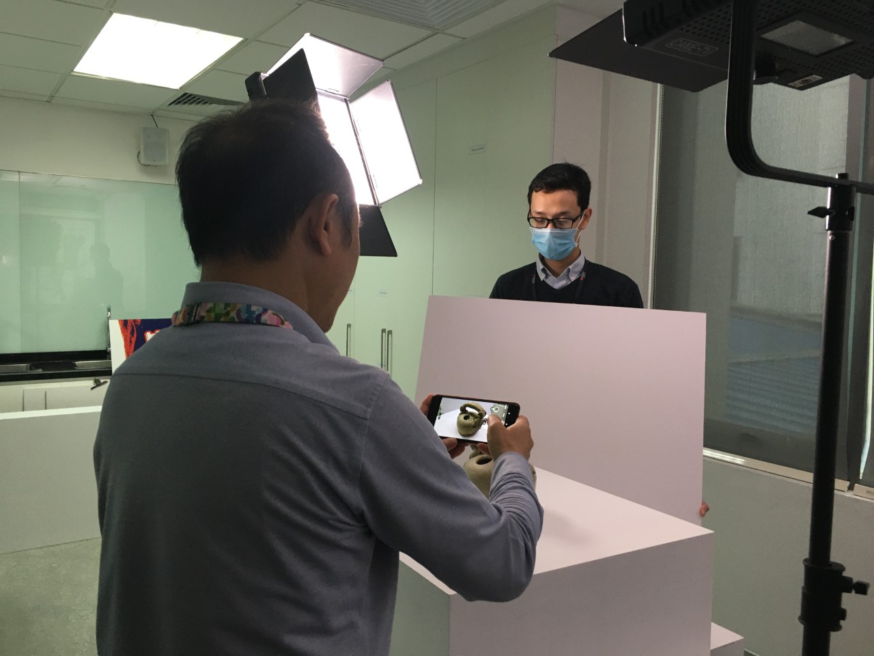
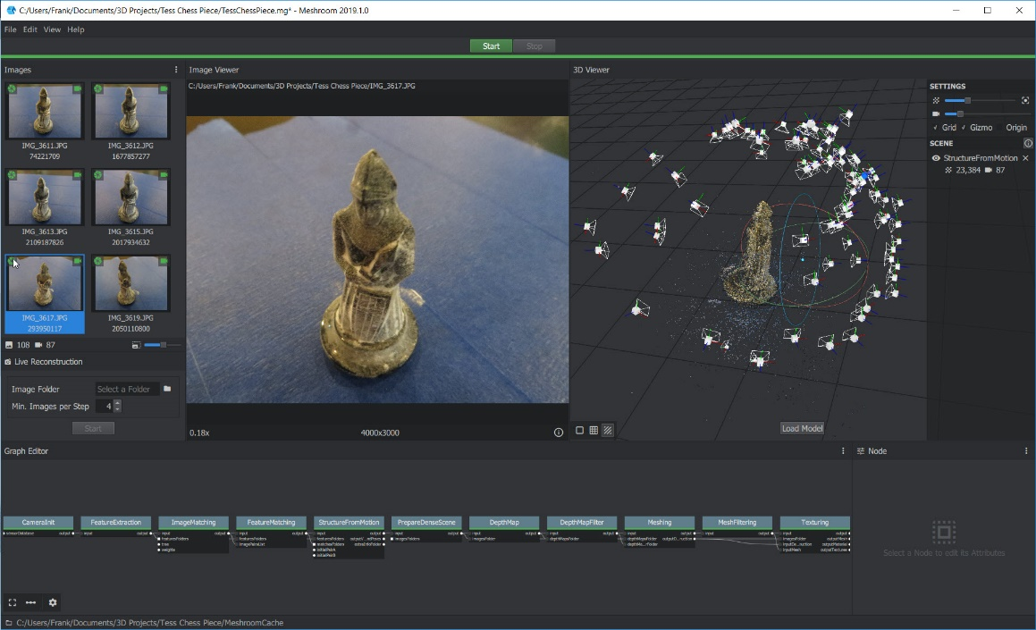
Photogrammetry Process
Smartphone photography, Meshroom, and Blender​

Slide 21
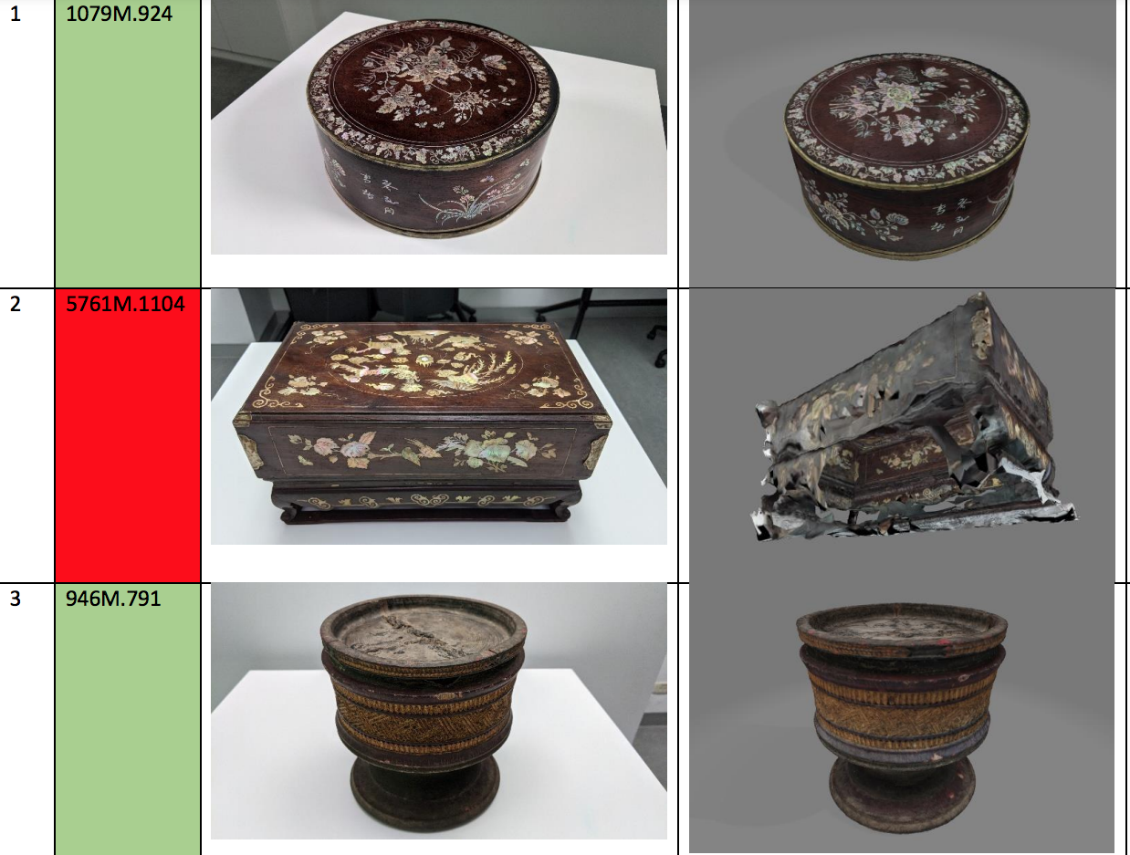
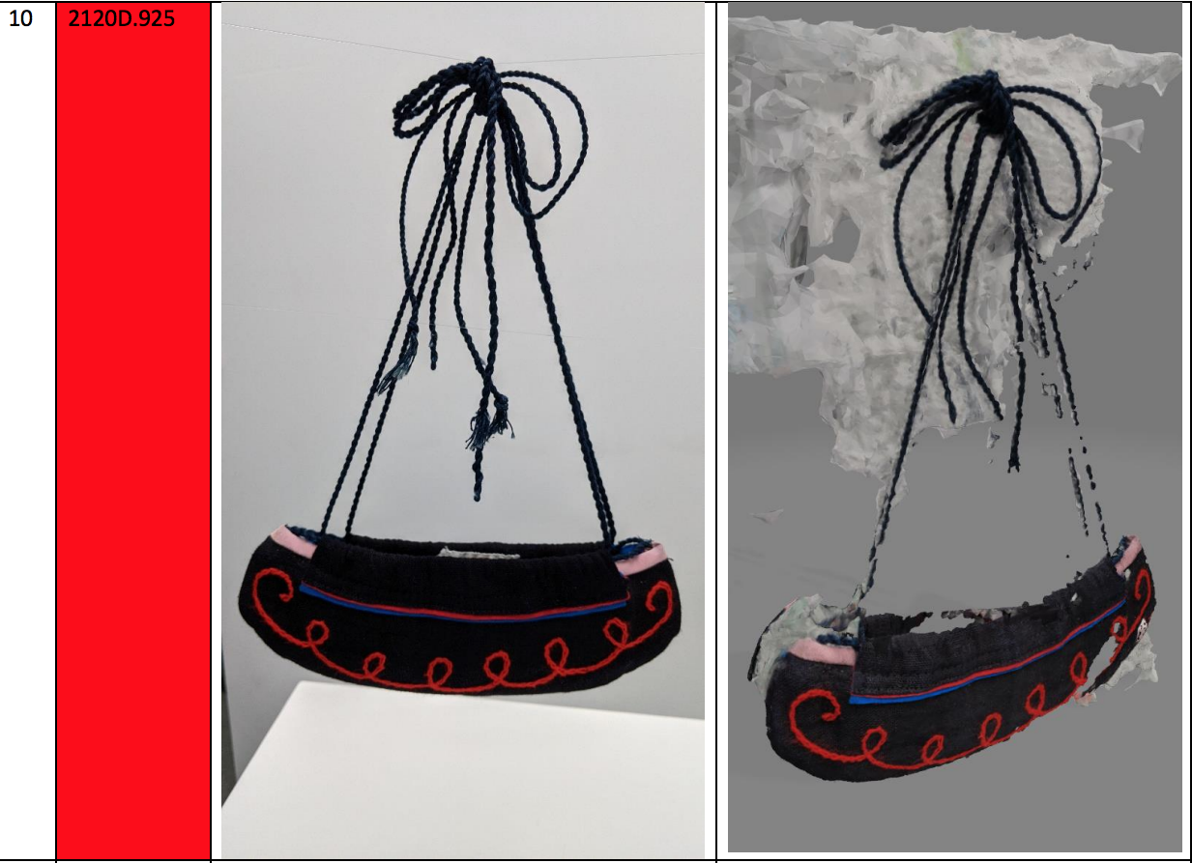
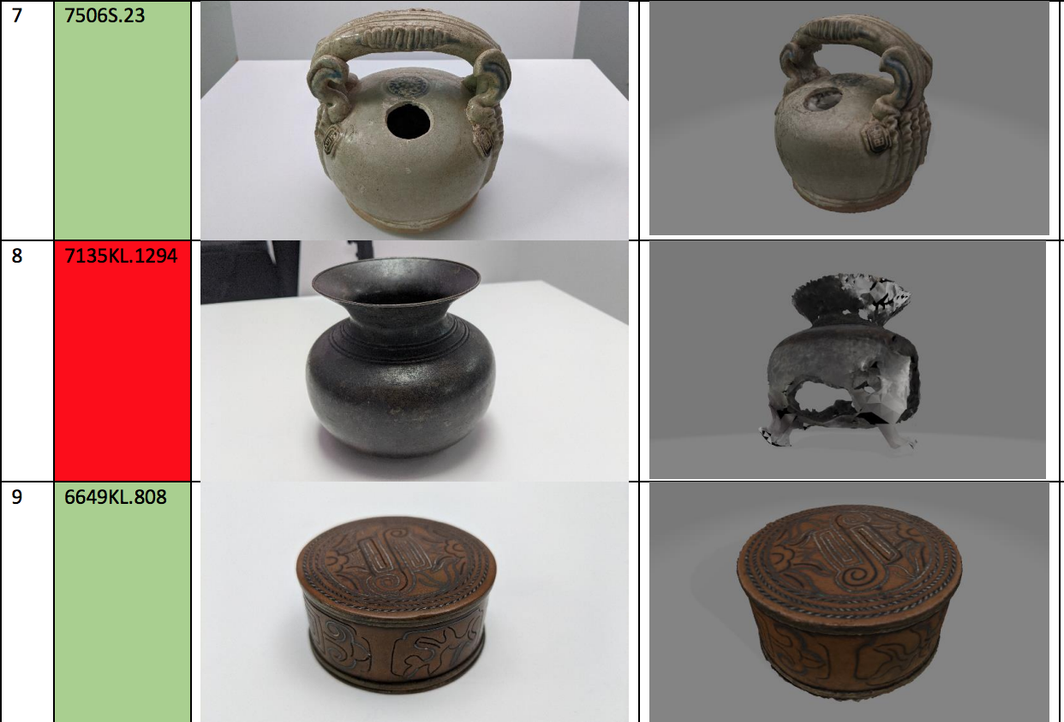
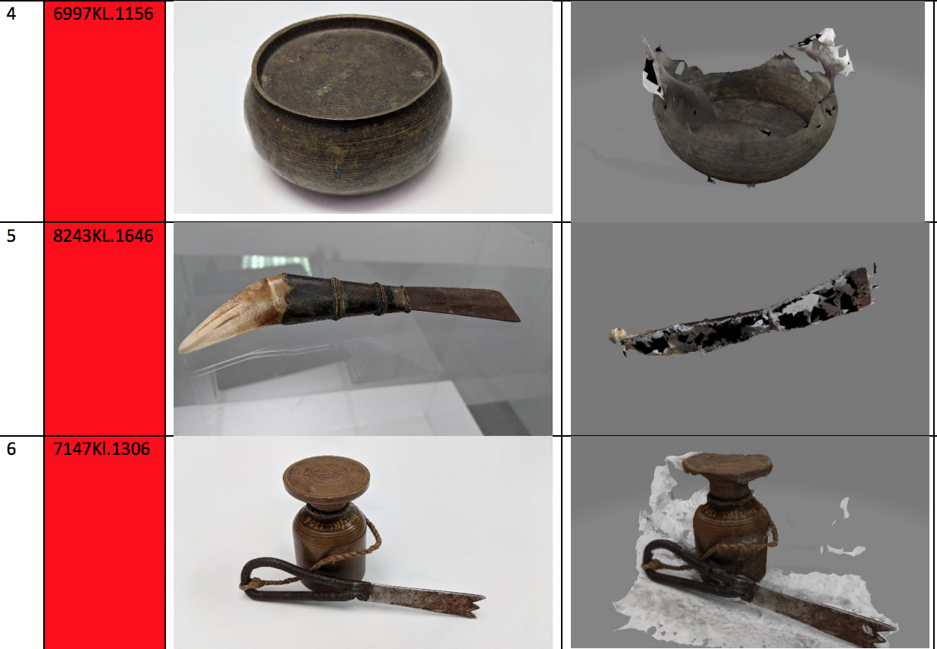
Photogrammetry did not work with more complex artefacts

Slide 22
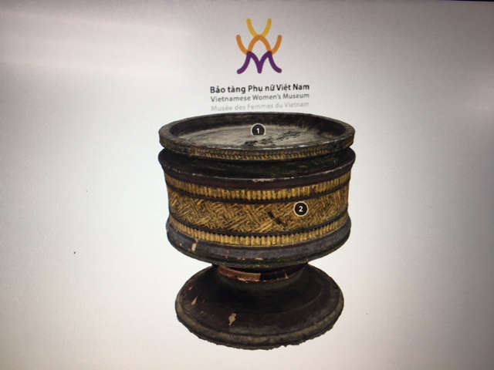
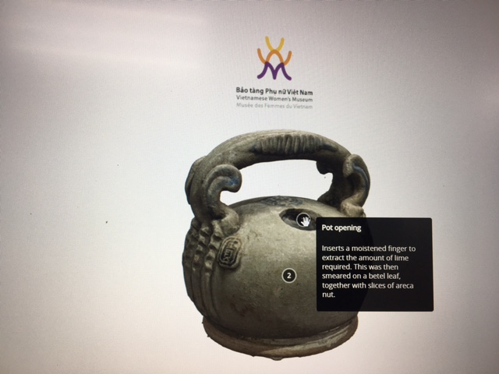
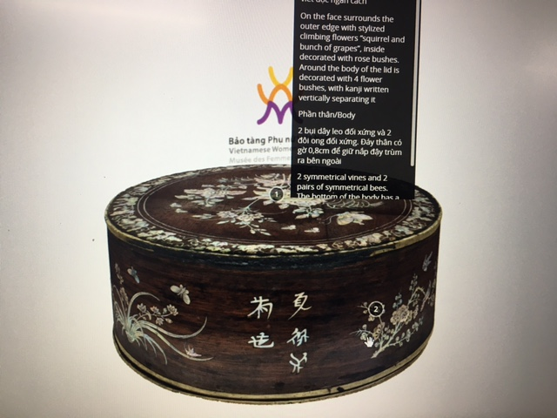
—
Betel Nut Models hosted on Women’s Museum Sketchfab
Vietnamese Women's Museum (@vietnamesewomensmuseum) - Sketchfab

Slide 23
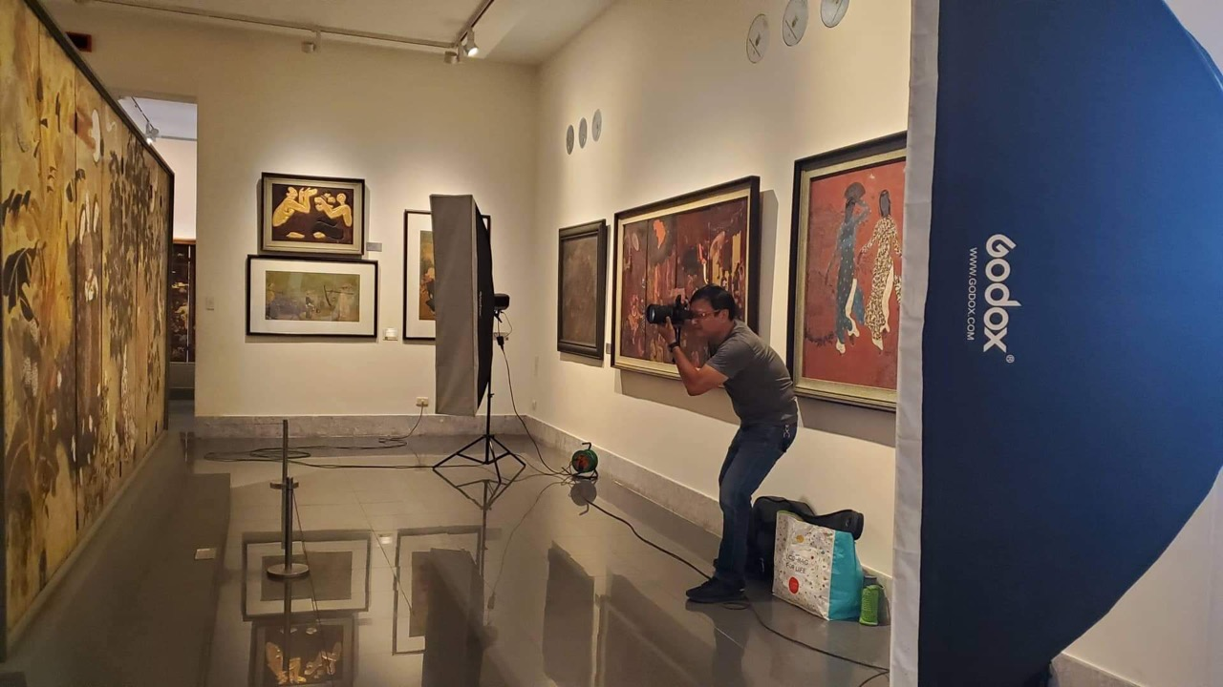
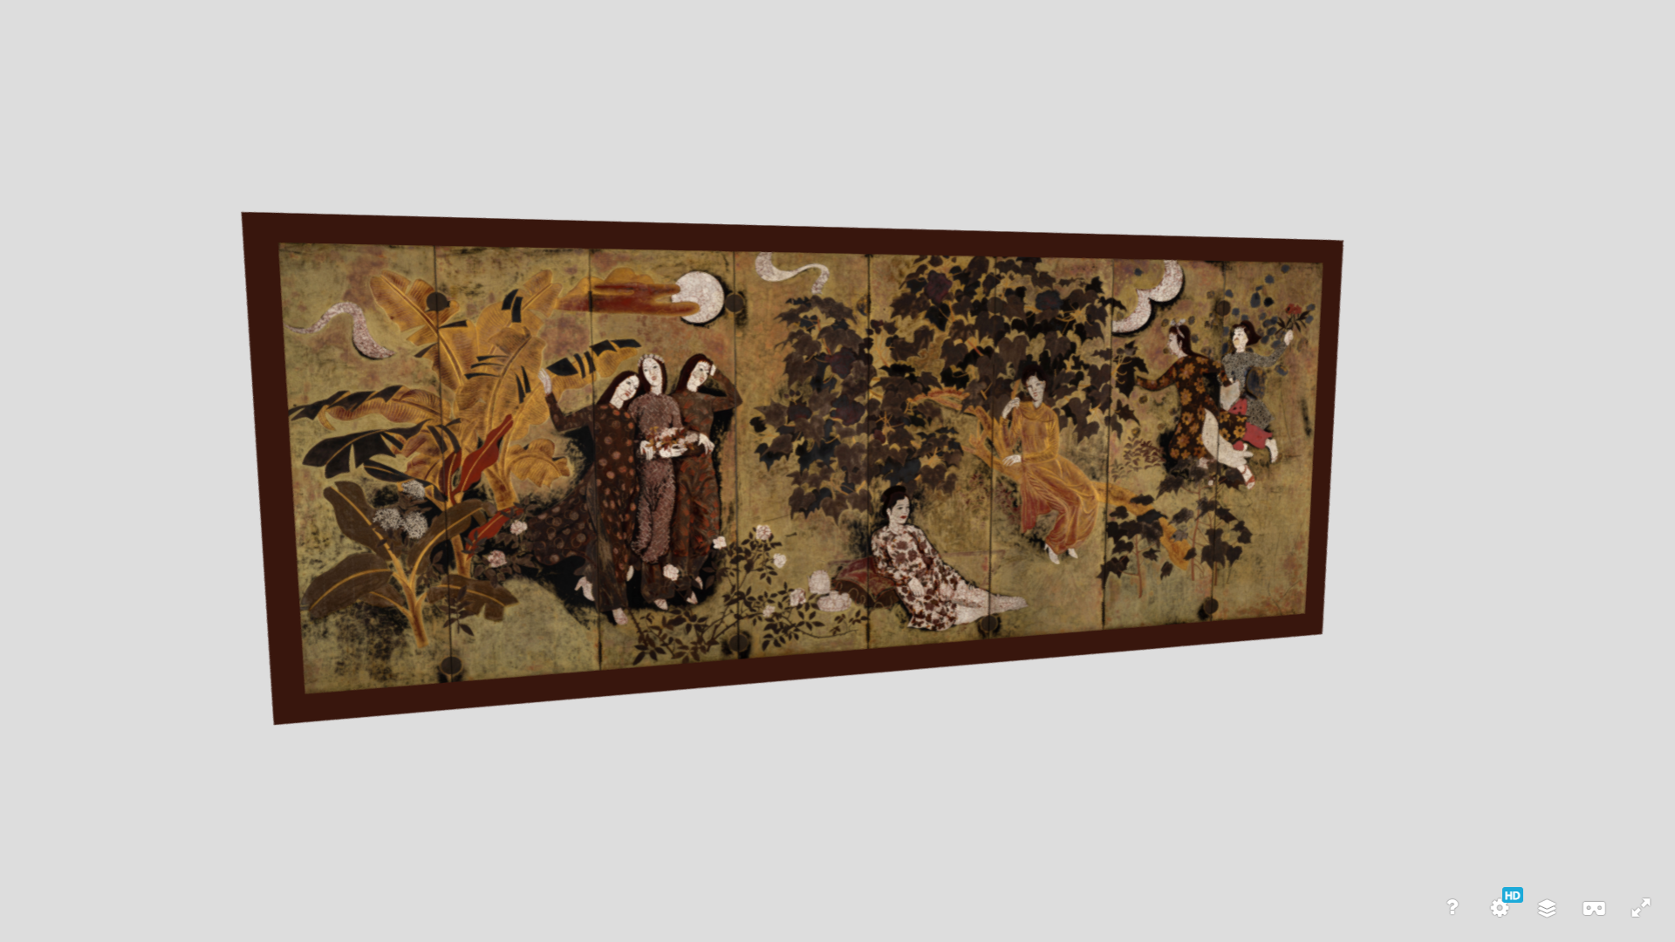
Digitization of a Lacquer Painting
vnfam.vn – Sketchfab
Artist Nguyen The Son photographed the painting using the photogrammetry method, and he then pieced together the photographs using photoshop.

Slide 24
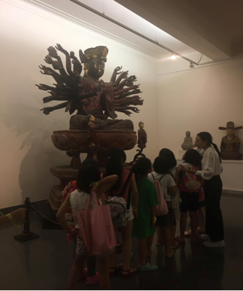
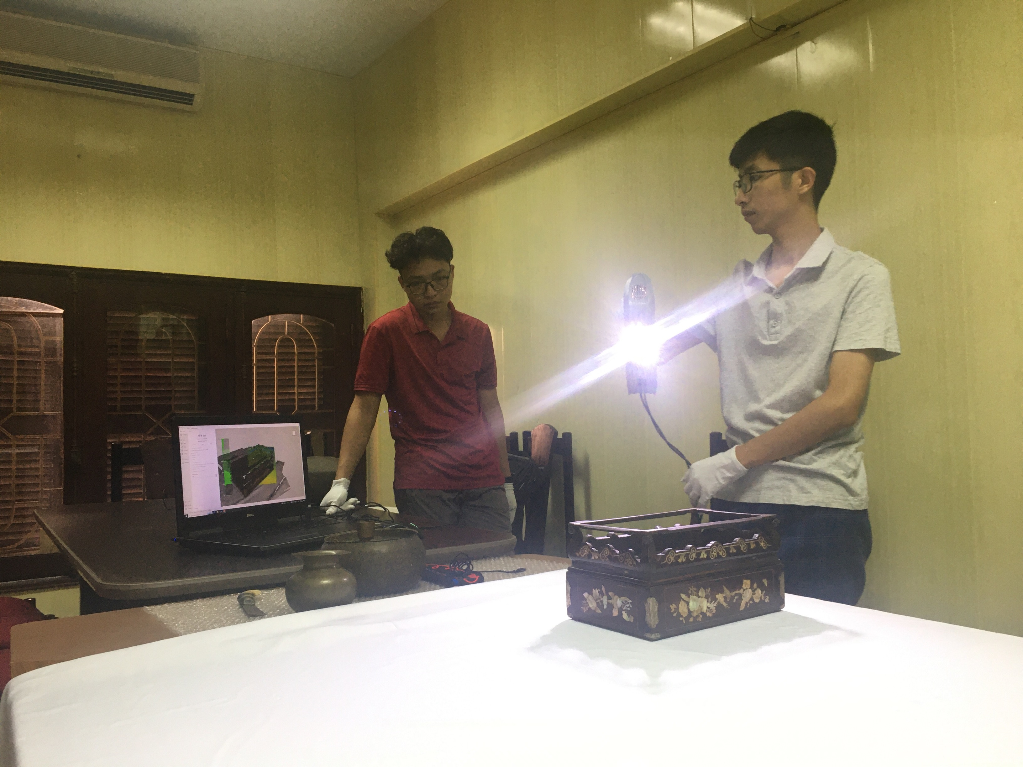
The process of digitizing cultural artefacts using 3D scanner

Slide 25
Statue of the Bodhisattva Avalokisteshvara
3.14m tall (10.3 ft)
Lacquered wood
16th Century
National Treasure
vnfam.vn - Sketchfab

Slide 26
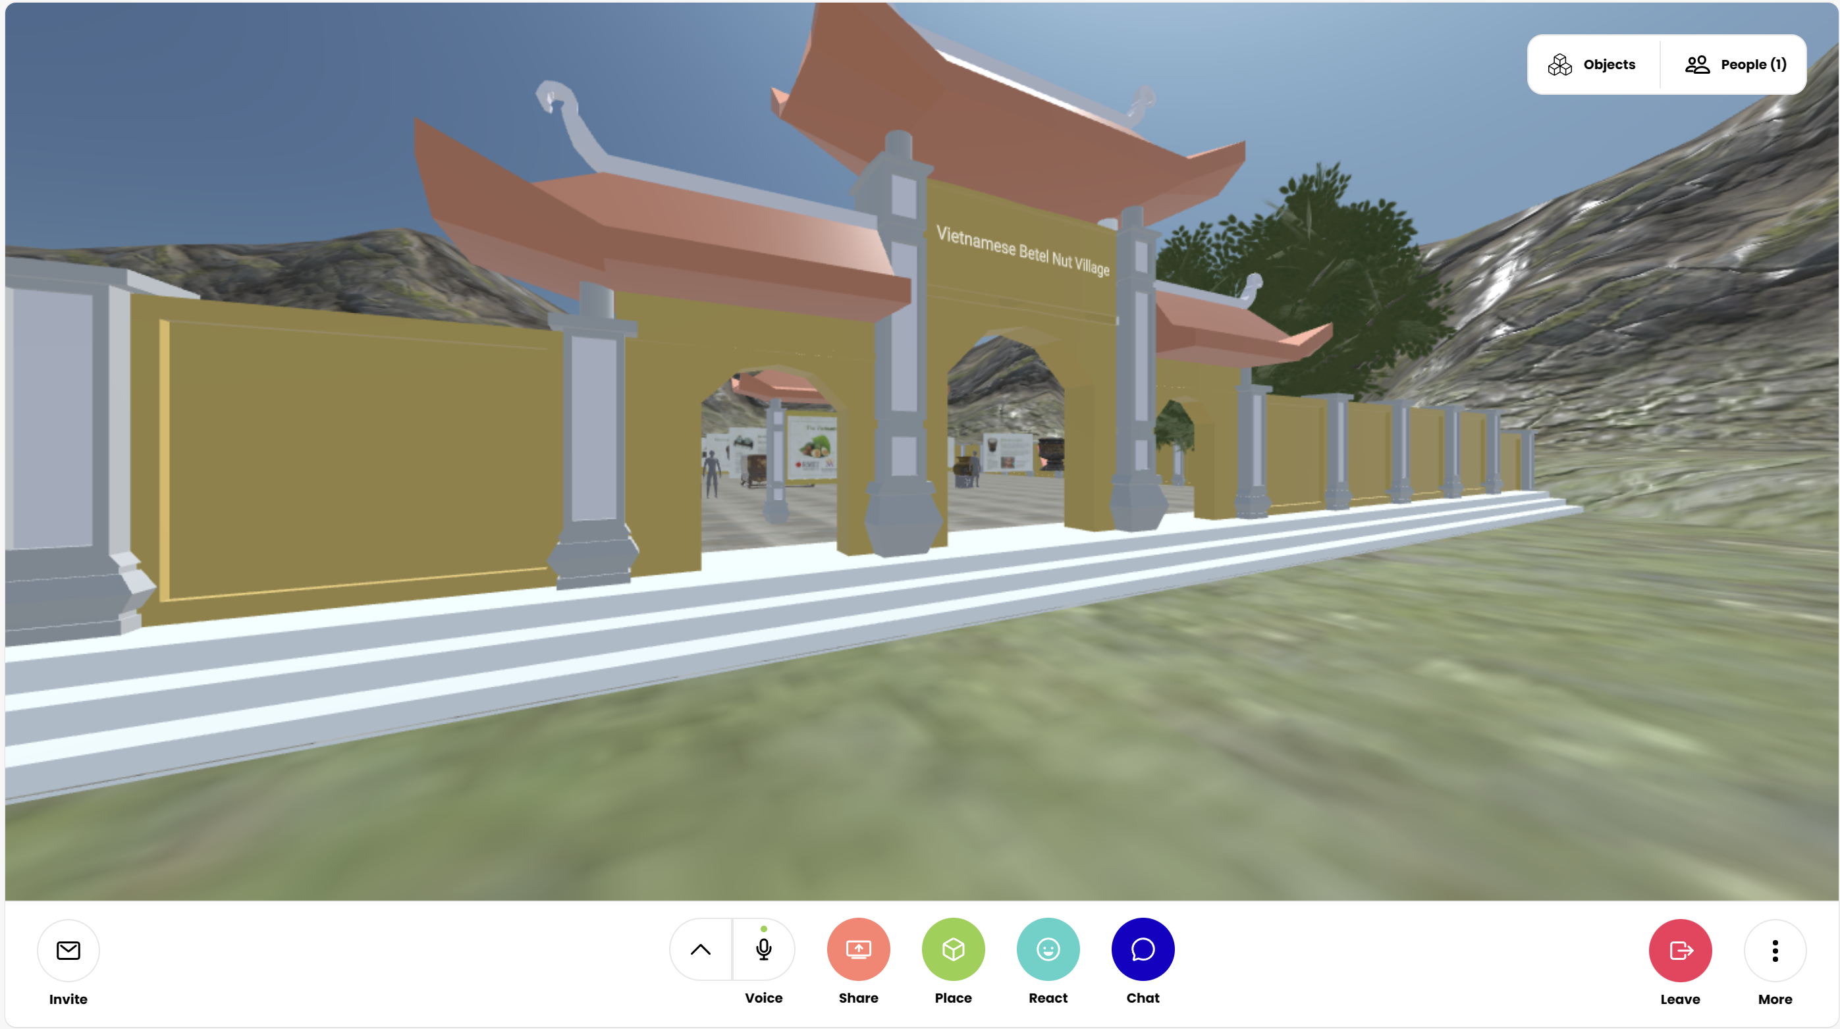
https://hubs.mozilla.com/5groW5K/bold-euphoric-camp

Slide 27
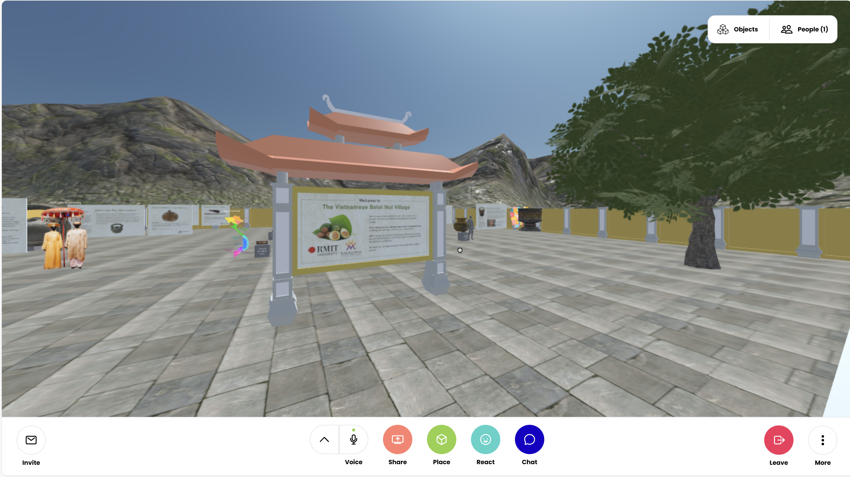

Slide 28
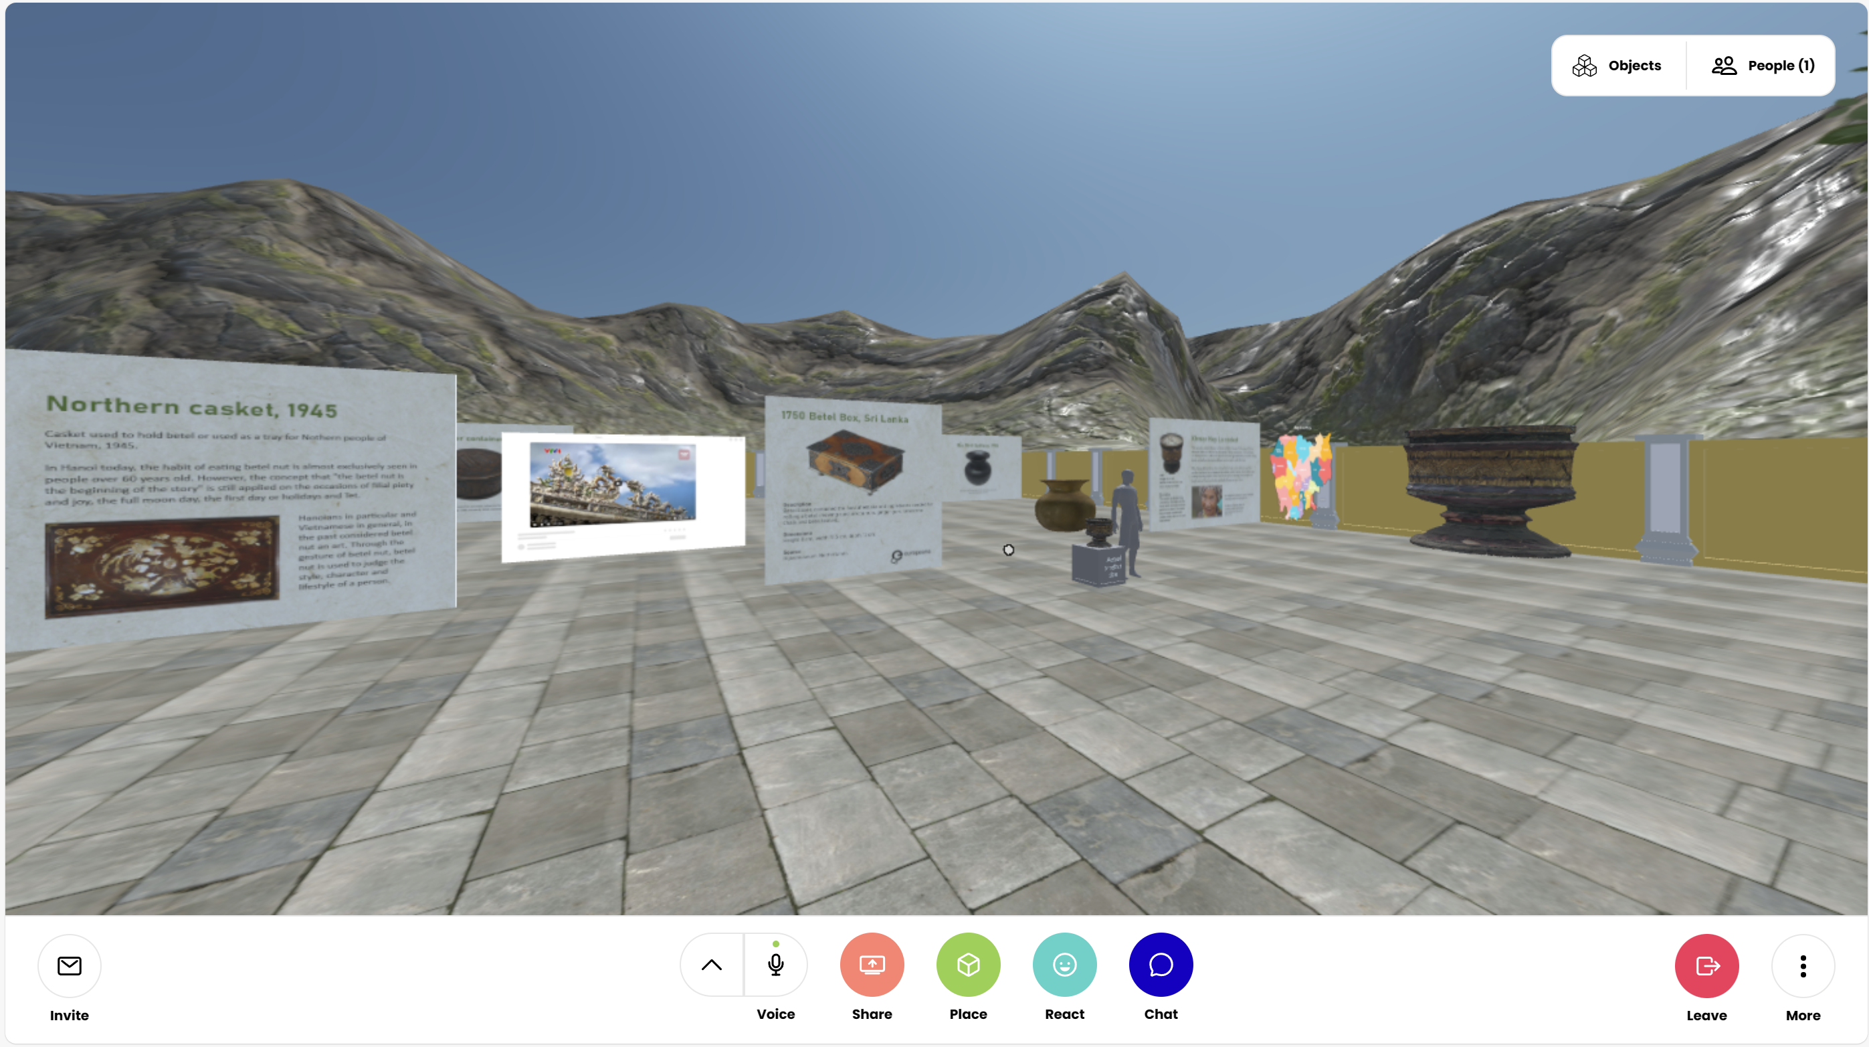

Slide 29
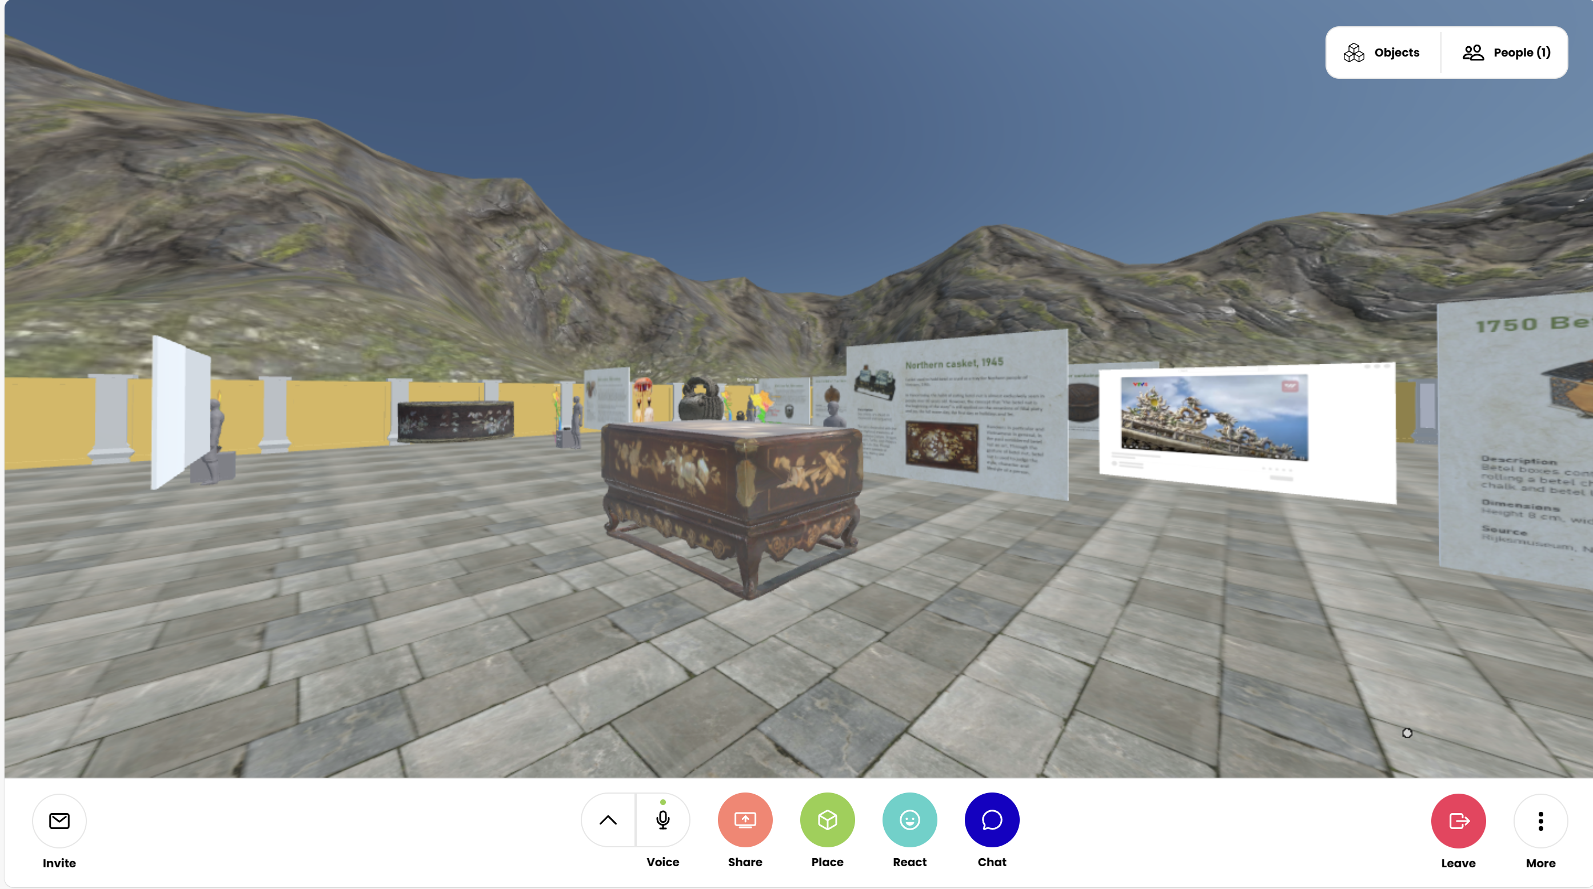

Slide 30
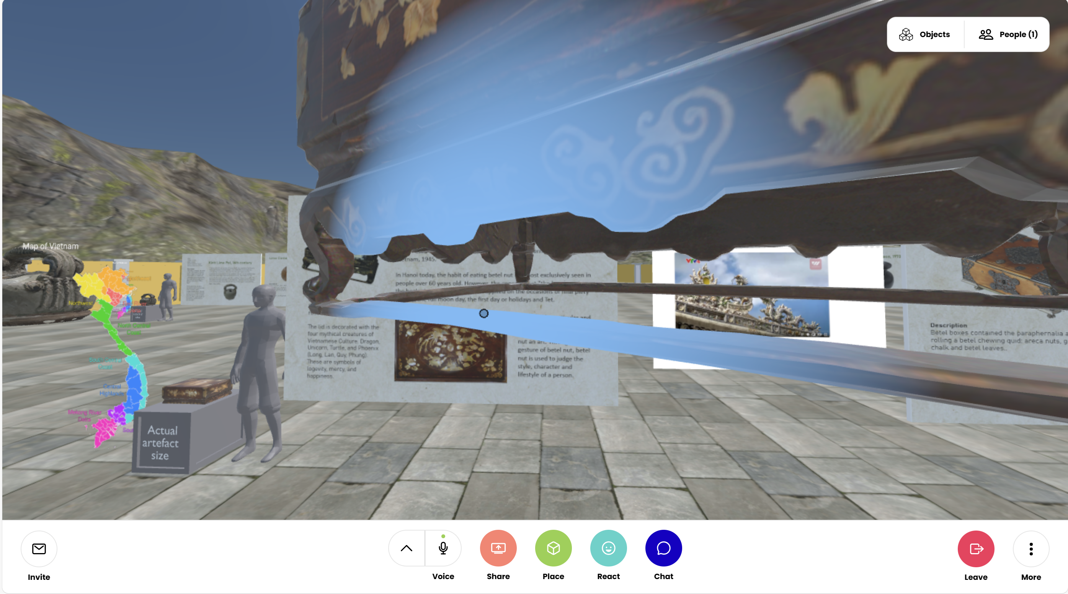

Slide 31
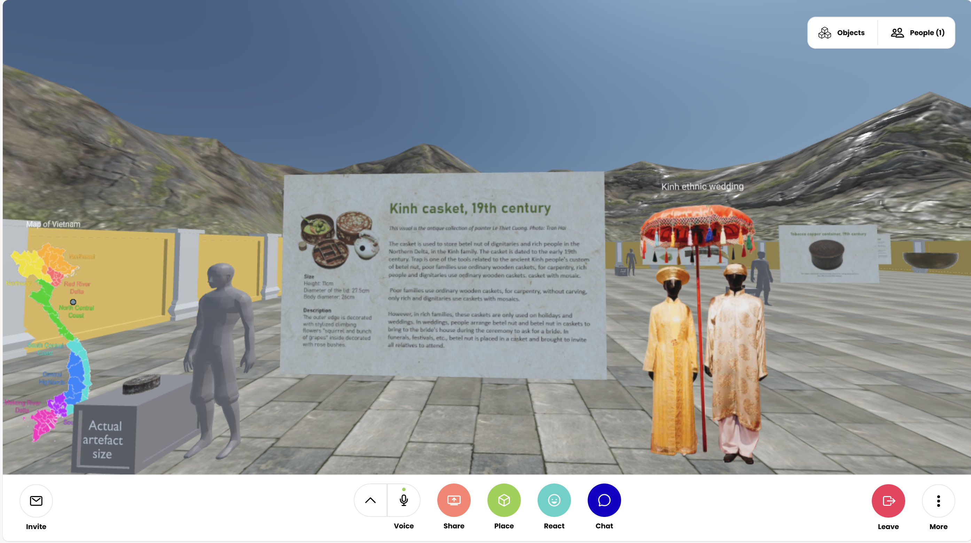

Slide 32
Conclusion
Ethical digitization projects should include consideration of local values, customs and cultures.
Local ‘stakeholders’, including local communities and museum staff, should be in-charge of decisions about what, when, and how artefacts are digitized and where and how they are presented digitally.
It is necessary to find sustainable digital solutions that are technically feasible and possible for museum professionals or local communities to maintain long-term.
This requires an understanding of local technical context, the local cost and maintenance of digital platforms, and amount of financial, technical and skilled human resources.

Slide 33
However, there are limitations regarding long-term sustainability of digitization projects. For example, there are concerns about museum professionals being able to maintain and update digitized content amid lack of technical resources, financial resources and skilled human resources. There are also concerns about the longevity of digital platforms and loss of cultural nuances that might occur if the digital representations are not regularly reviewed and updated. There is also a need to incorporate ongoing feedback from museum professionals, universities and audiences to help refine and improve digitization projects and to ensure they remain relevant and effective long-term.
This digitization project has helped to increase online interactivity and include more digital experiences for in-person visits. This project has also helped communities in rural areas of Vietnam to virtually visit museum collections and see a ‘digital’ view of their own cultural heritage. There is now a steady increase in visitors to the VWM and VNMFA’s online content and physical spaces, according to data from these two museums. Other digitization projects are being carried out across Vietnam by museums, government, private companies and universities, which is helping to broaden the representation of Vietnamese culture. Younger generations are now much more inclined to visit museums and engage with the digital content while international audiences are more able to access Vietnamese paintings, sculpture and antiques remotely.

Slide 34
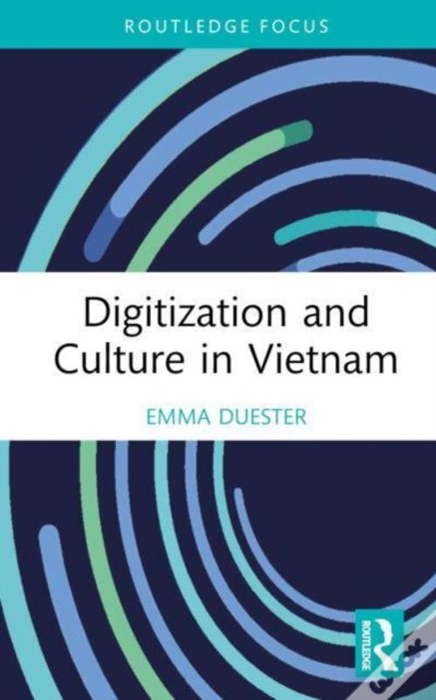
Thank you!
Any questions? emmaduester@sjtu.edu.cn

