Slide 1
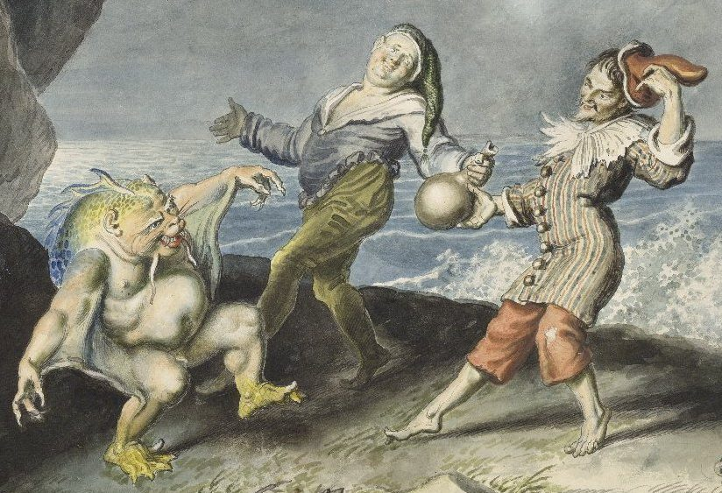
“Shipwrecks, Islands, Magic, and Marvel: Renaissance Responses to the New World Project” Mary Watt University of Florida
Mary Watt, University of Florida
Notes:
Johann Heinrich Ramberg, 1763-1840
Stephano (centre), Trinculo and Caliban dancing on the seashore,

Slide 2
“Now the Lord God had planted a garden in the east, in Eden; and there he put the man he had formed.” (Genesis 1:8)

Slide 3
Prester John from HARTMANN SCHEDELS’s NUREMBERG CHRONICLE 1493

Slide 4
Modern conjectural depiction of the lost western section of the Tabula Peutingeriana, showing a representation of the Pillars of Hercules (Columne Ercole)

Slide 5
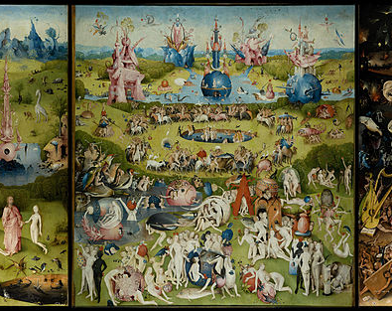
The Garden of Earthly Delights, Hieronymous Bosch, 1503–1504

Slide 6
Woodcut form Sebastian Münster, Cosmographiae universalis lib. VI (Basel: Heinsrich Petri, 1550; print; 1100).

Slide 7
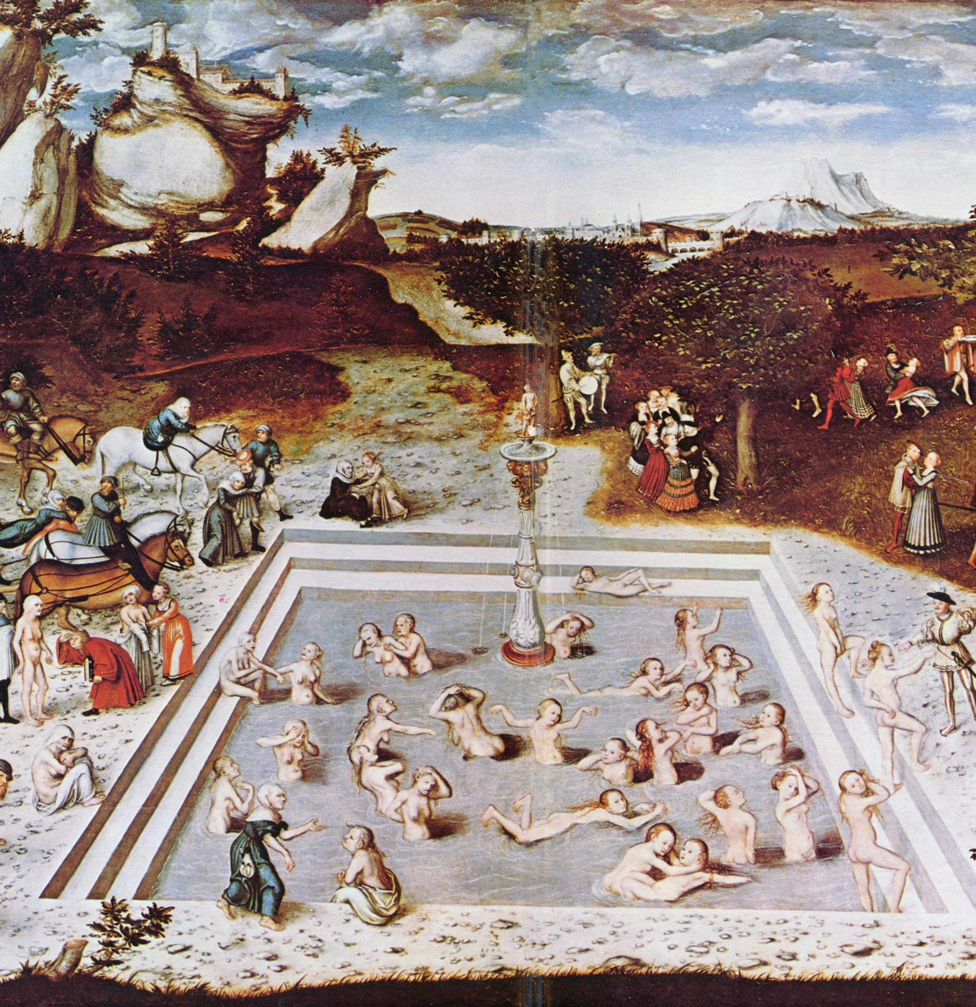
Lukas Cranach Fountain of Youth,1546

Slide 8
"Preste" as the Emperor of Ethiopia, enthroned on a map of East Africa in an atlas prepared by the Portuguese for Queen Mary, 1558. (British Library)

Slide 9
Thank YOU
… for your attention

