Slide 1
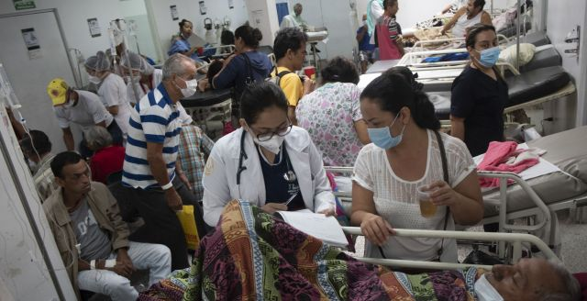
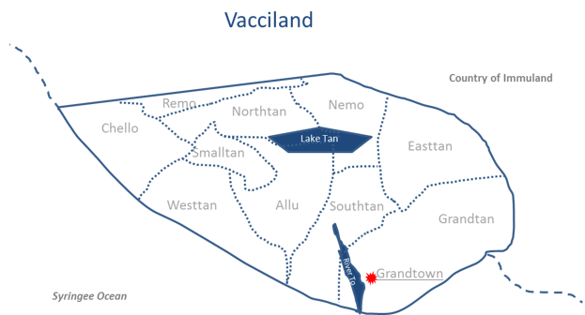
Measles outbreak
Vacciland 2018

Slide 2
Vaccine coverage (1)
Local, HMIS data
coverage, numerator, denominator issues
Coverage overestimates

Slide 3
Vaccine coverage HMIS/DHS (2)

Slide 4
Measles cases
Suceptibles
Most cases in grandtown (> 50%)
Last outbreak + SIA in 2011
AGE
11 % <1 cohort,
37 % cases < 5,
50% <9
80% cases Not vaccinated or no data
Hesitancy is growing
10% access services through private provider

Slide 5
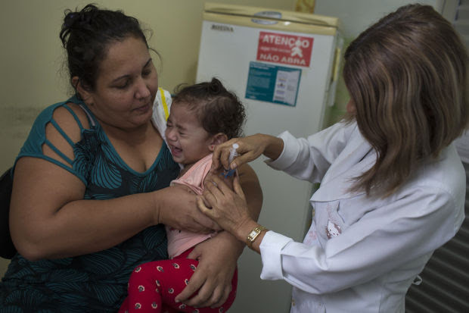
Outbreak response
MR vaccination AT 6 months during the outbreak
Increase access, extend hours, outreach sessions
Consider MR sia
Focus groups on acceptability of vaccine
Social mobilization to increase demand for vaccination

Slide 6
Recommendations data for action
Activate the EOC
Increase granularity of data analysis
Improve numerator/denominator
Provide age specific data > 10 years old cases
Case Mapping, cluster and cohort analysis of cases
Field visits, session observations
Qualitative data
Private providers

