Slide 1
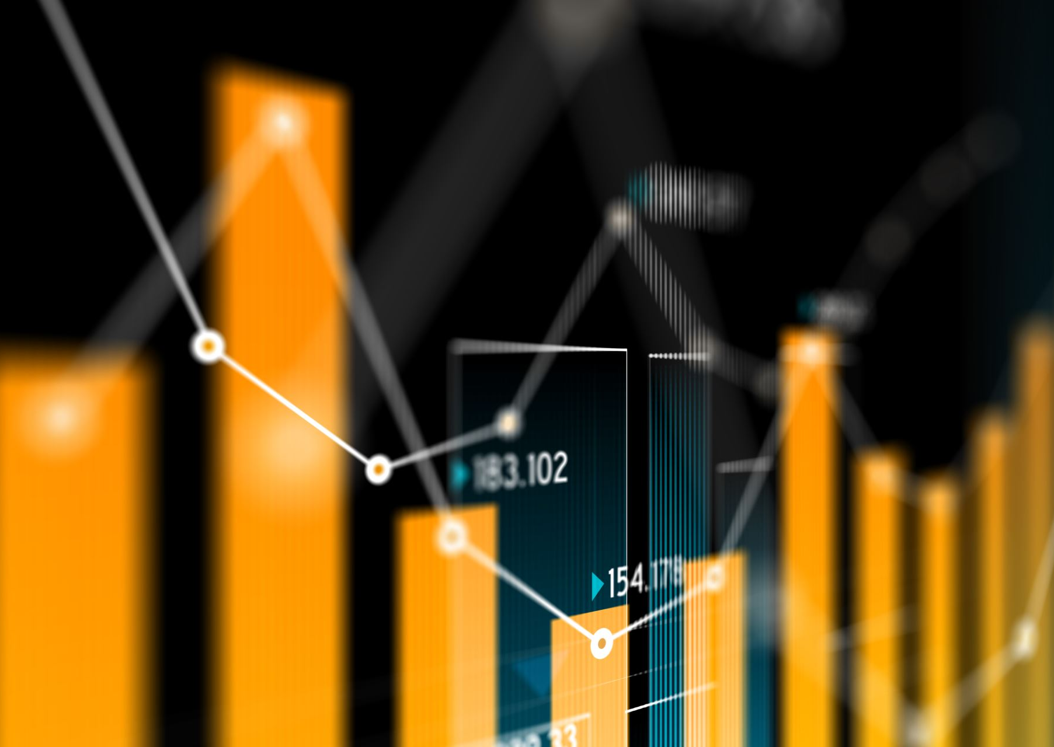
Week 2
When the Price Mechanism Fails: Externalities
Context: With exorbitant prices in many markets, along with environmental and health degradations, the price mechanism may be creating more problems than solving them.
What are externalities and how are they usually corrected?
Why are externalities not being accounted?

Slide 2
Cigarette Commerical (before they were banned in 1971)
YouTube. (2008, July 23). Winston Airplane AD. YouTube. https://www.youtube.com/watch?v=ORTAp8PlQ0k

Slide 3
Externalities are spillover costs borne by 3rd party who are not involved in the economic transaction (ie. buying and selling of a good or service).
Note: Externalities can be negative (external cost) or positive (external benefit)

Slide 4
How does Economics seek to correct this market failure ? (by using the price mechanism)
Market Failure:
when the market fails to
allocate resources efficiently.
Externalities always cause market failures
Market for Cigarettes
Price
Quantity of cigarettes
With the use of a Pigouvian Tax

Slide 5
Externalities are spillover costs borne by 3rd party who are not involved in the economic transaction.
What are some externalities that we are 3rd party to?

Slide 6
But consider a few things… a. is this a supply or demand side intervention? b. why are cigarette taxes so successful? c. which externalities are corrected for? which are not? why?

Slide 7
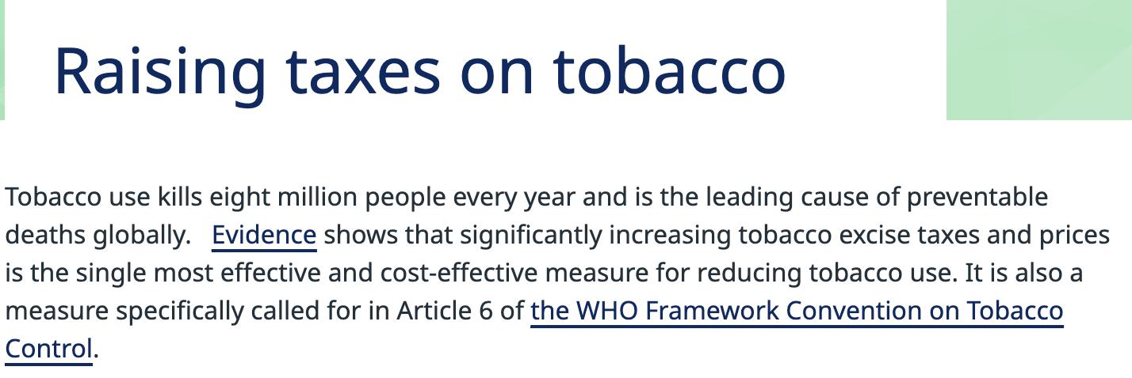
Source: WHO, n.d.
The verdict on Pigouvian Tax on cigarettes
Notes:
Source: Raising taxes on tobacco (who.int)

Slide 8
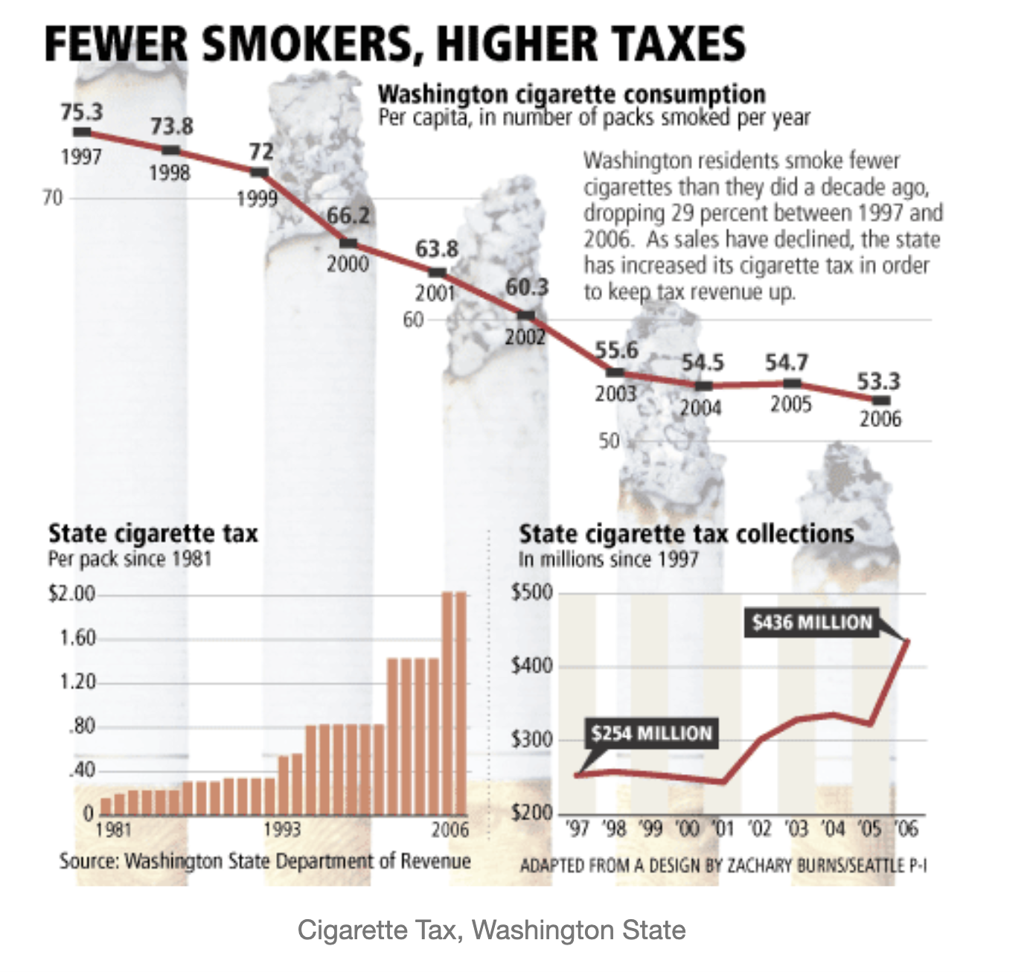
Do Pigouvian taxes work all the time?
(Noren, 2009)
Notes:
Noren, L. (2009, April 8). Cigarette tax, smoking rates. Graphic Sociology. https://thesocietypages.org/graphicsociology/2009/04/08/cigarette-tax-smoking-rates/

Slide 9
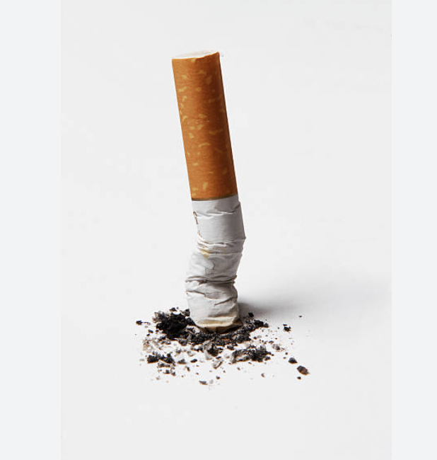
Who are all the stakeholders to make cigarette tax effective?
CEL: optimal outcomes require a composite approach
(involving both demand and supply factors)

Slide 10
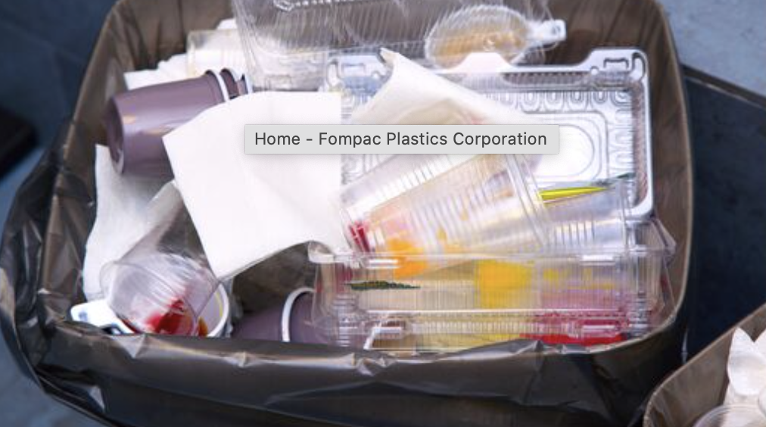
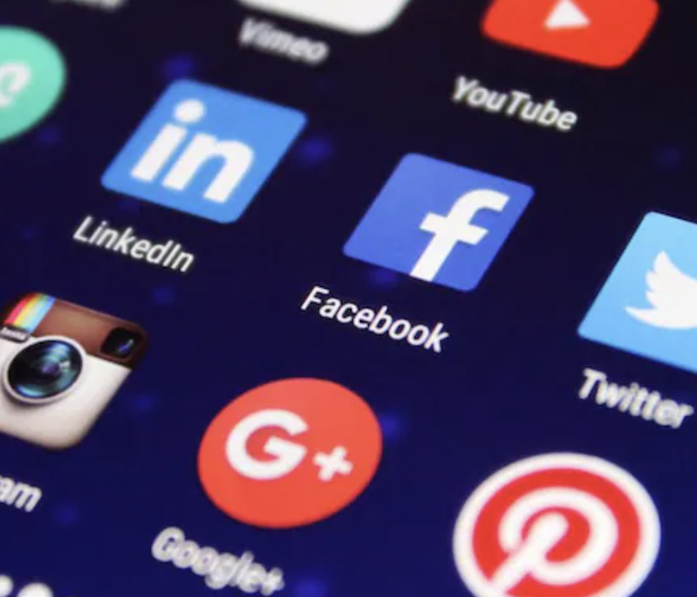
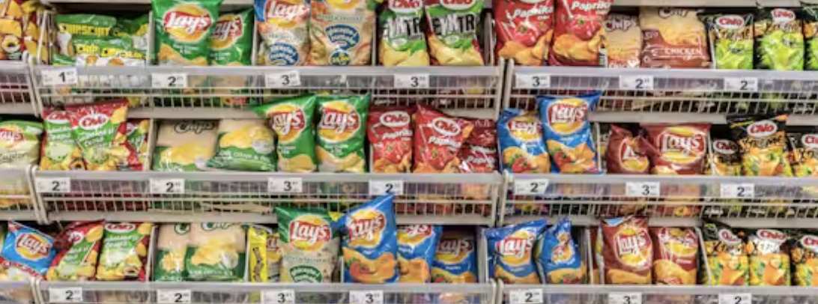
Which externalities are being corrected for? What is being done about them?
CEL: Economics is not value-free (AKA positive versus normative; neither is education – we will turn to this in Week 4)

Slide 11
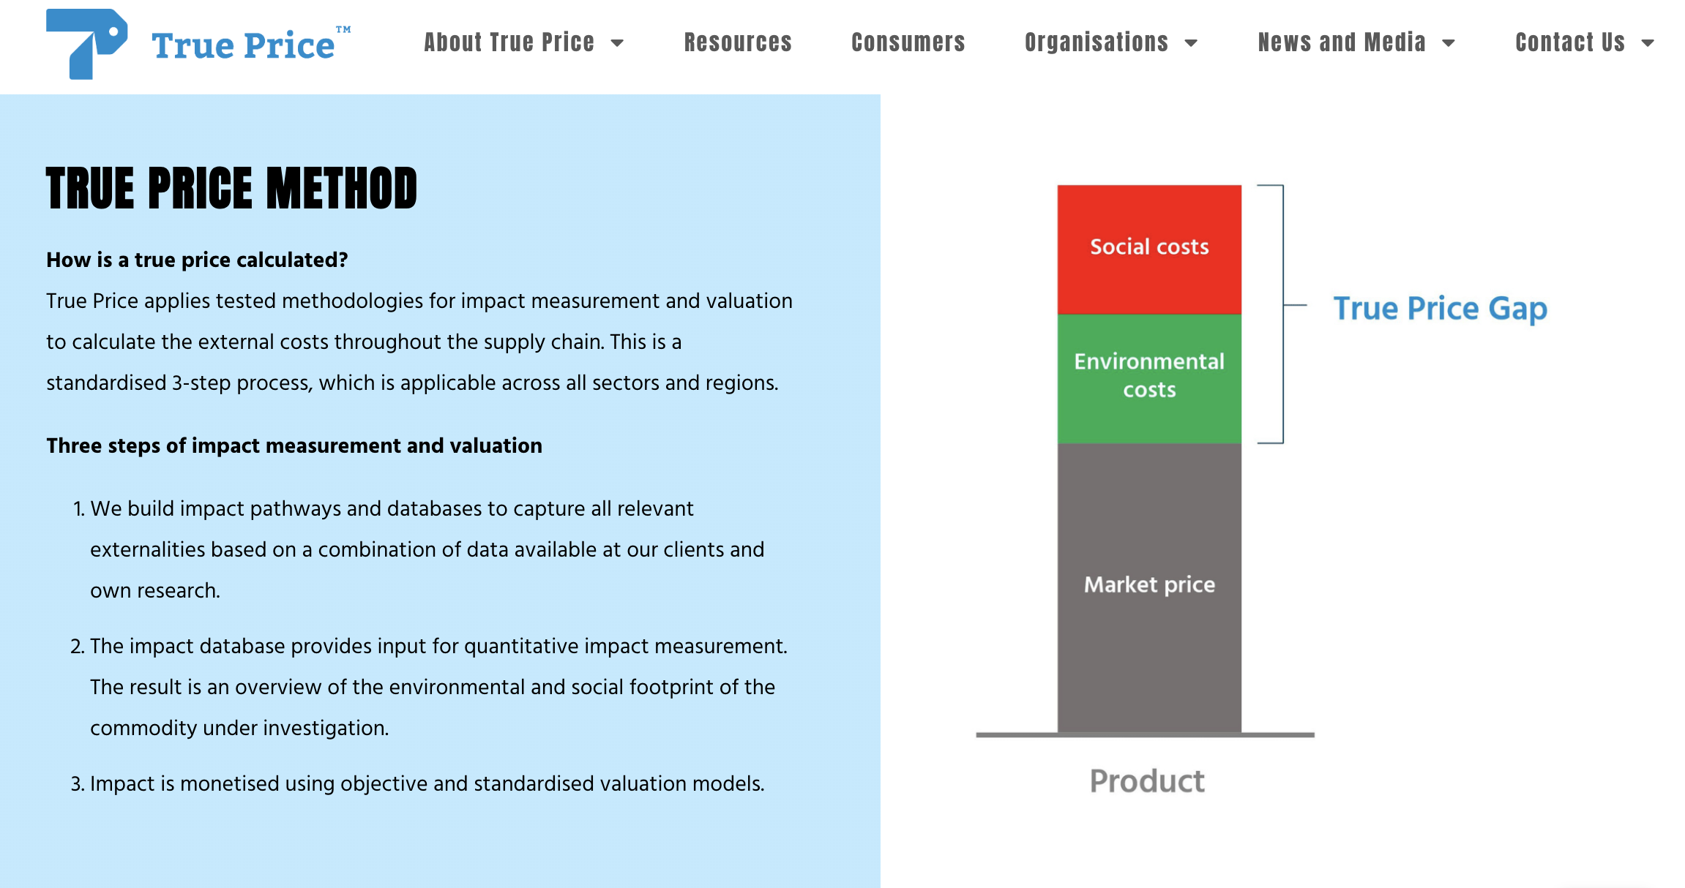
Netherlands: True Price Initiative
Source: (About Us - True Price, 2022)
Notes:
True Price manifesto - True Price

Slide 12
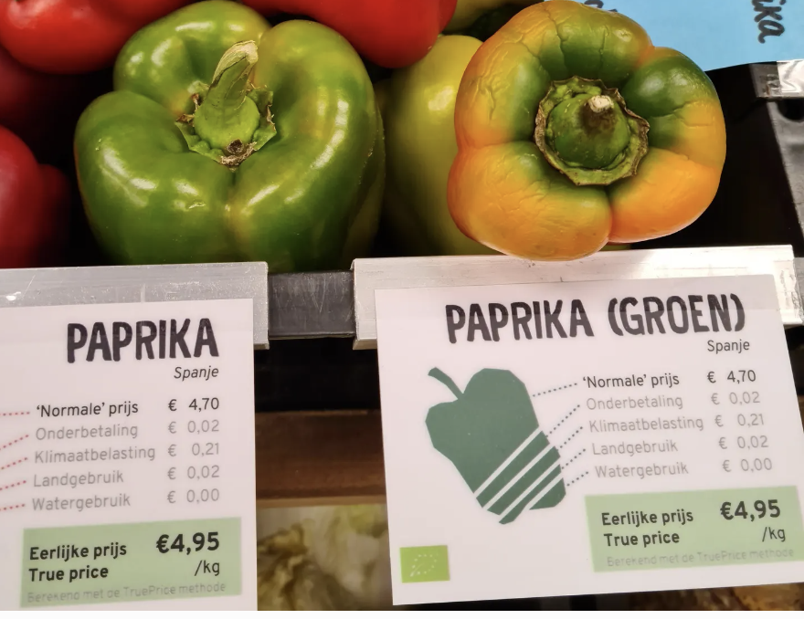
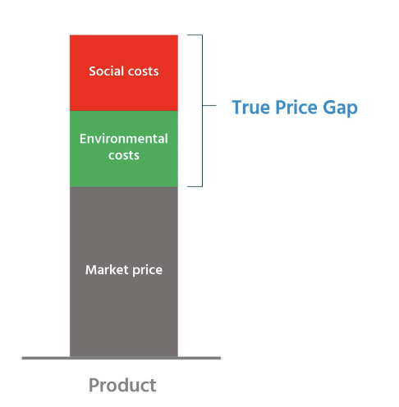
Netherlands: True Price Initiative
Notes:
True Price manifesto - True Price Read Forbes interview - What’s The True Cost Of Your Food? True Price Incorporates Social And Environmental Impact (forbes.com)

Slide 13
CEL: Understand what a price tag means (it reveals and hides information)

Slide 14
If the question of negative externalities had been posed decades ago whether the current ecological and environmental crisis we are facing today could have been reduced as the result?
How does a government consider the externalities when agreeing on certain policies? Are there areas of government intervention that are concerned with negative externalities more than the others?
How would you respond to manufacturers argument that 'this might just be another tax on the group that can least afford to pay it'?
How to effectively incorporate social cost into business practices, robust mechanisms must incentivize companies to recognize and mitigate negative impacts?
Does the change of policy change the habit/amount of sugar consumed by the community, is there a benefit to this Pigouvian tax?
Why haven't cigarettes been priced out of the market, taxed to the point where people no longer smoke. Why are cigarettes still affordable?
How many market models are there? If social surplus is afforded by the cost to bystanders how is the cost to bystanders calculated? How can social surplus be used more constructively rather than introducing taxes?
Is market failure purely failing to adhere to a model ? Are 'market failures' ever used as opportunities?
Your Wonderings…

Slide 15
Week 2 Update/Reflection Prompt:
“What are the consequences of not paying the true price on goods and services we buy?” (150-200 words)
CEL PAR: Next Step (Tuesday night)

Slide 16
Week 2 When Price Mechanism Fails: Externalities
Context: With exorbitant prices in many markets, along with environmental and health degradations, the price mechanism may be creating more problems than solving them.
What are externalities and how are they usually corrected?
Why are externalities not being accounted?

Slide 17
Woohooo, views last week! Keep up the good work and engagement! You get a value point

