Slide 1
Week 1 Economics and The Price Mechanism
Context: Many people equate Economics with money. Is that true?
Who invented Economics and what problems is it trying to solve?
How have I been impacted by price mechanism?

Slide 2
Experiencing the Economic Problem
What is the Economic Problem?

Slide 3
Economic problem is Scarcity Therefore, every society has to ask 3 economic questions
Scarcity = unlimited wants + limited resources

Slide 4
3 Economic Questions: What to produce How to produce For whom to produce
Adam Smith’s answer (1776)?

Slide 5
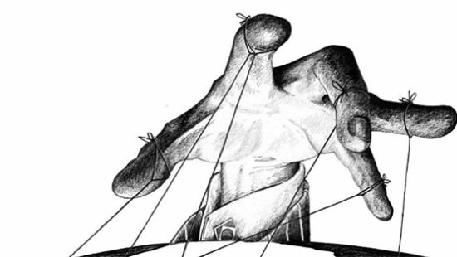
How will the price mechanism work for our market for chairs?
The Invisible Hand
Price Mechanism
Market for Chairs in 320
Price
Quantity of chairs

Slide 6
What does Market Equilibrium Mean? What does “laissez-faire” Mean?
The Invisible Hand
Price Mechanism
Market for Chairs in 320
Price
Quantity of chairs

Slide 7
But consider a few things… a. definition of demand b. assumption of supply c. assumption of model
So does invisible hand/ price mechanism work?

Slide 8
Demand: the ability and willingness of consumers to buy a good or service at different price levels.
CEL: What is problematic about the definition of demand?

Slide 9
Supply: the willingness and ability of firms to produce a good or service at various price levels.
CEL: what must be true about firms?

Slide 10
invisible Hand/ Price Mechanism What other assumptions needs to be true?
CEL: Economic models all hold assumptions (some hidden in ceteris paribus)

Slide 11
What are the implications of “laissez-faire”?
Governments should not intervene in the functioning of markets/ economy

Slide 12
Why are we not incentivised to solve the issues of our times to take action and make decisions that balance our world in a way that is equitable? What are the mechanisms of capitalism and how do countries operating as a businesses prevent a global population from thriving? Who is benefitting from poverty?
How can government interventions be better designed and implemented to ensure that markets do end up producing the socially desirable outcomes we need?
Has the general use of economics changed over the time since Adam Smith published his works?
How can we re-imagine the ways resources are allocated so that all parties' interest or benefits are taken care of?
Your Wonderings…

Slide 13
The Problem of Practice:
How do we teach for change?
SSI
Critical not just Soft GCE
Global Crises
Growing inequity
Privileged Young People
Teacher PD
Our CEL PAR Journey

Slide 14
Socially Sanctioned Ignorance (SSI)
“bound to the pleasures of this uneven global imaginary and its by-products (nationalism, exceptionalism, consumerism, materialism and individualism) as we enjoy the (false) sense of stability, fulfilment and satisfaction that they provide (belonging, community, togetherness, prestige, heroism and pride)….the result is a modern subject who uncritically celebrates the progress and evolution that they represent, and who believes and affirms their own neutrality and innocence in the face of injustice.” (Andreotti, The Educational Challenges of Imagining the World Differently, p.105)
“社会认可的无知”
我们被这个不平等的全球想象及其副产品（民族主义、例外主义、消费主义、物质主义和个人主义）的愉悦所束缚，因为我们享受着它们所提供的（虚假的）稳定感、成就感和满足感，及由此产生的（归属感、社区感、团结感、威望、英雄主义和自豪感）……其结果是，现代人在面对不公正时，毫无批判地庆祝它们所代表的进步和演变，相信并肯定自己在其中的中立性和无辜。”（Andreotti，第105页）
Our CEL PAR Journey

Slide 15
SDG Target 4.7 Education for SD and Global Citizenship
By 2030, ensure that all learners acquire the knowledge and skills needed to promote sustainable development, including, among others, through education for sustainable development and sustainable lifestyles, human rights, gender equality, promotion of a culture of peace and non-violence, global citizenship and appreciation of cultural diversity and of culture’s contribution to sustainable development
Our CEL PAR Journey

Slide 16
We cannot teach as if it is “business as usual”.
To explore how to teach for transformative change
Question Socially Sanctioned Ignorance
Pursue fairness and social justice
Pursue more equitable outcomes
Promote flourishing for all (all species)
CEL PAR: Purpose

Slide 17
Research Questions (provisional)
What do non-Economics teachers say about the impacts of an 8-week participatory action research on Critical Economic Literacy on their personal and professional life?
What is the relationship between non-Economics teachers’ development of Critical Economic Literacy and their understanding of Critical Global Citizenship?
How do non-Economics teachers apply newly acquired Critical Economic Literacy to the teaching of Critical Global Citizenship in their unit plans?
CEL Participatory Action Research

Slide 18
Weekly:
Pre f2f - Preview and comment/raise wondering
f2f – Respond to Weekly Update Prompt
Explore Economics/CEL/ Update/Reflection by Wed
Post f2f – Comment on 2 peer’s update and respond to peers’ comments (@person)
This week’s weekly update/reflection prompt:
How have I benefited from the price mechanism?
CEL PAR: Process

Slide 19
Week 5
Pre f2f - submit Unit Plan version 1 to version 2
Week 7
Pre f2f- implement feedback
Week 8
f2f – present unit plans
Post Week 8
1 on 1 interviews; digital storytelling
CEL PAR: Process

Slide 20
Week 1 Update/Reflection Prompt:
“How have I benefited from the price mechanism?”
CEL PAR: Next Step (originally during f2f, by Tuesday night, ideally)

Slide 21
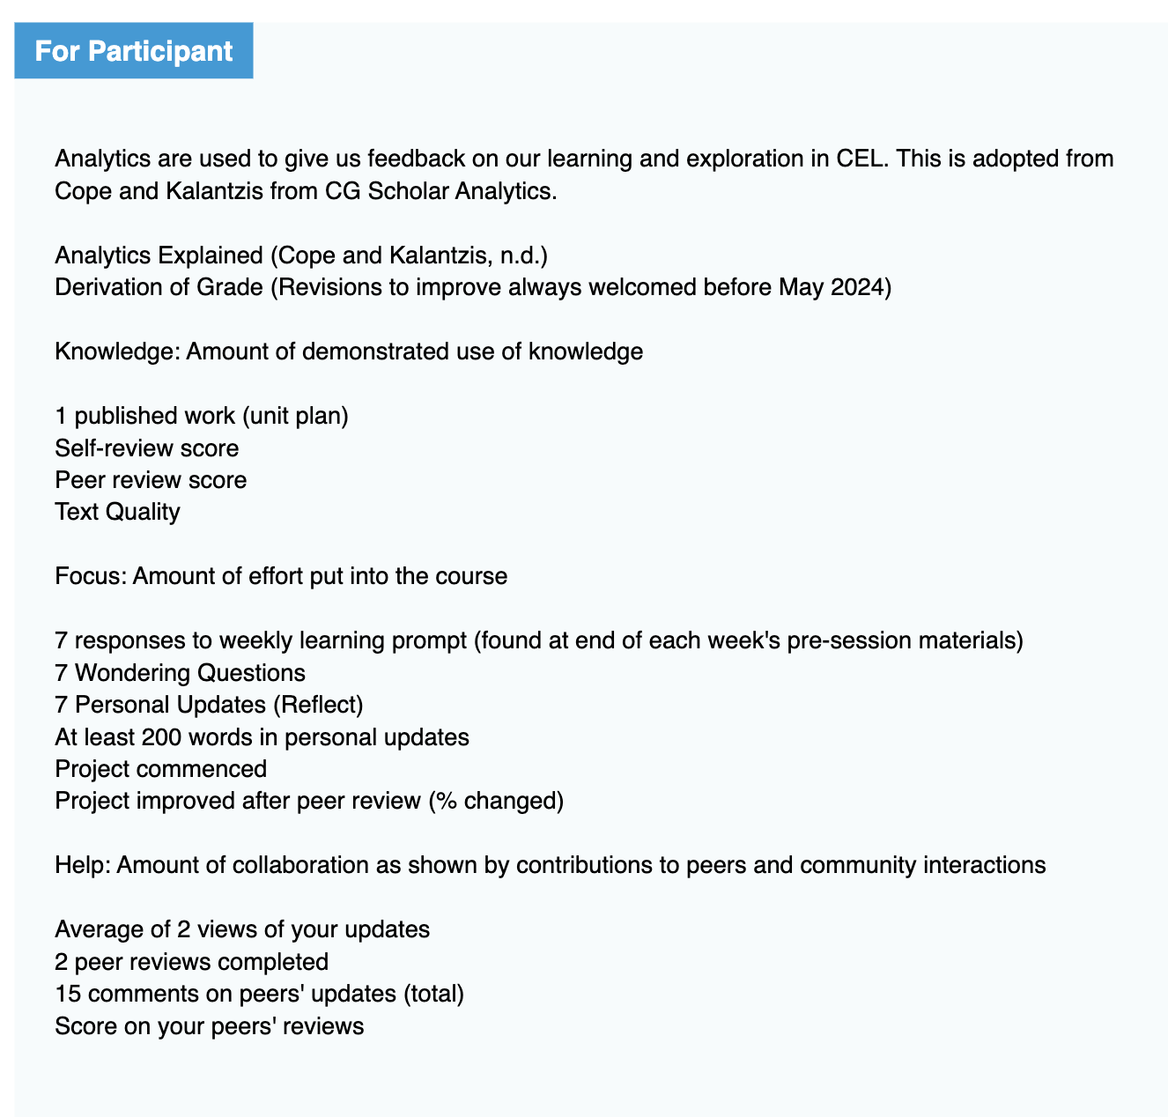
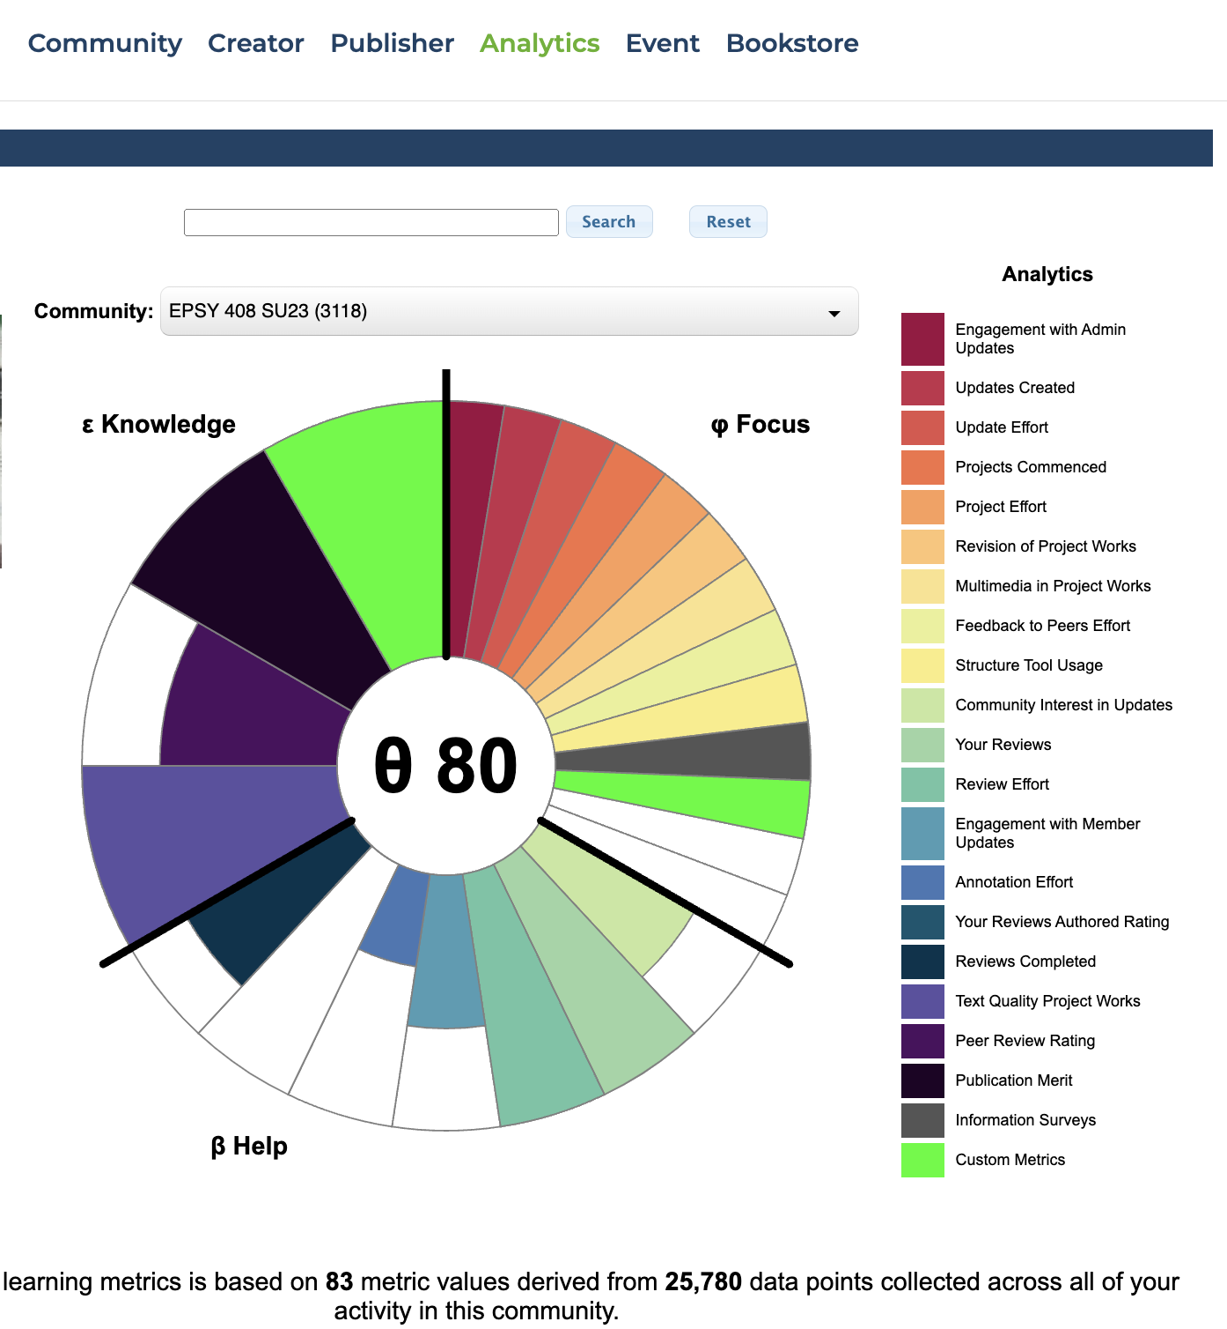
CG Scholar Analytics
(7 Digital Affordances)

Slide 22
Week 1 Economics and The Price Mechanism
Context: Many people equate Economics with money. Is that true?
Who invented Economics and what problems is it trying to solve?
How have I been impacted by price mechanism?

Slide 23
Thank you for being risk-takers and change makers!

