Slide 1
Week 6
Economics over the Ages
Context: Economics has been around for more than 250 years. During this period, many influential Economists and thinkers with their different theories have come and gone. This is the concept of Refutation.
Economics, like any other Social Science, is seeking to describe and explain reality, often with an over-simplification in the use of Economic models. But reality and contexts do change, which warrants a re-thinking of Economic theory.

Slide 2
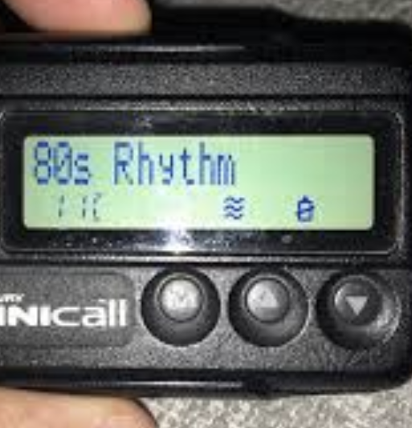
What has changed in our world?

Slide 3
How are we shaped by these changes? (structure)
How are we shaping the changes? (agency)

Slide 4
What should we keep in light of the changes?
What should we discard?

Slide 5
The act of saying or proving that a person, statement, opinion, etc. is wrong or false
Cambridge Dictionary
What is Refutation?

Slide 6
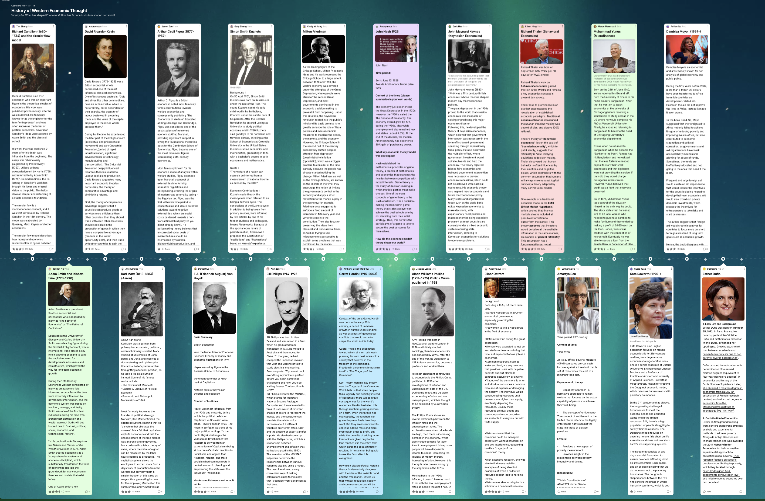
How has Economic Ideas changed over time? What were the contexts?
Before Adam Smith 14 – 16th C
Mercantalism
Government intervention; build up reserves of gold through trade; limit imports; thrift.
Ricardo’s theory of Comparative Advantage vs. Mercantalism
During Great Depression:
Keynesian Economics (Government Interventions) overturning
Neoclassical Economics
Hardin’s Tragedy of the Commons
Ostrom’s Collective Governance

Slide 7
How has Economic Ideas changed over time? What were the contexts?
Advancement in data collection and psychology
Smith and Neoclassical
Rational Economics versus
Thaler’s Behavioral Economics
Random Control Trials
Yunnus’ Micro-credit and Duflio’s Conditional Cash Transfers

Slide 8
It is not from the benevolence of the butcher, the brewer, or the baker that we expect our dinner, but from their regard to their own interest.
Adam Smith

Slide 9
Rational Economic Man?
Economic Man vs Humanity: a Puppet Rap Battle (youtube.com)

Slide 10
The act of saying or proving that a person, statement, opinion, etc. is wrong or false
Cambridge Dictionary
What areas of Refutation exist in your subject fields?

Slide 12
How did Neoliberalism become the Dominant Story?

Slide 13
a. Investigate the definition b. Question assumptions that lie behind economic model c. Consider what problem was being solved d. Consider what unintended consequences can arise e. Consider if there a “silver bullet” (uncomplicated solution) or composite approach f. Question if the economic policy is truly ”positive” or value-free g. Scrutinize for internal incoherence h. Refute economic theories that are no longer relevant to changed contexts…adopt new ones that are more appropriate
CEL Means…

Slide 14
Who is the Father of Capitalism? Is it Adam Smith? Is free market always strongly linked to capitalism?
Does being an economist mean having most popular model at the time?
Is our world de-globalizing?
Your Wonderings…

Slide 15
Week 6 Update/Reflection Prompt:
Identify a policy that has impacted you (or your family or country) - trace its economic underpinnings and describe the impacts it has/had created (150 – 200 words).

Slide 16
Unit Plan includes:
1. Learning objectives
2. At least 3 Learning activities over a week (consider different modality - text, video, audio, image)
3. At least 1 piece of evidence of learning/ understanding created by students (singly or collaboratively)
4. Contrasted with unit plan version 1
5. Commentary on how CEL is being embedded in the unit to help promote Critical Global Citizenship Education
Next Week – Unit Plan Feedback by 30th May

Slide 17
Wonderings
Weekly Updates
Revision of Unit Plans
Feedback on Unit Plans
Post-PAR Survey
Interview
Data Collation and Analysis – Discourse Analysis

Slide 18
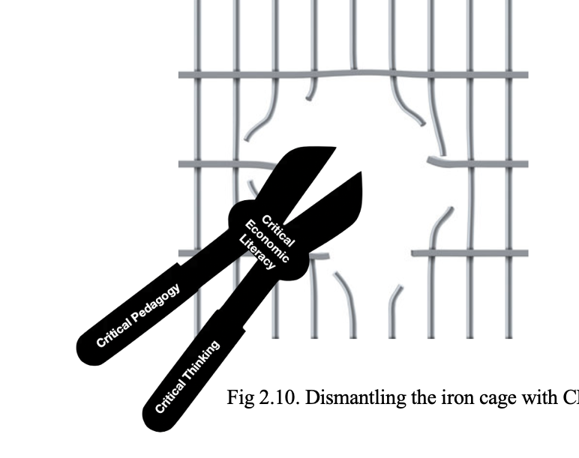
Following Week –
What is Alternate Criticality?

