Slide 1
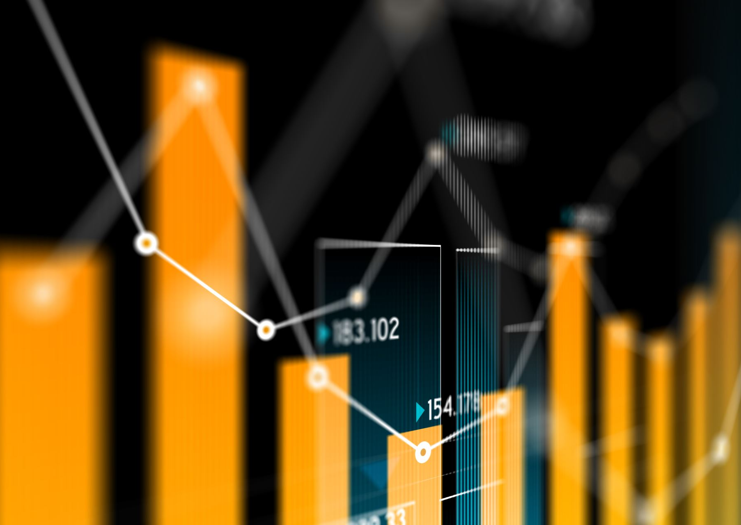
Week 4
The GDP
Context: What is the history to the invention of this indicator and why does the GDP have such power in our social reality?
How is this phenomenon linked to the concept of Banking Education that was developed by Freire?

Slide 2
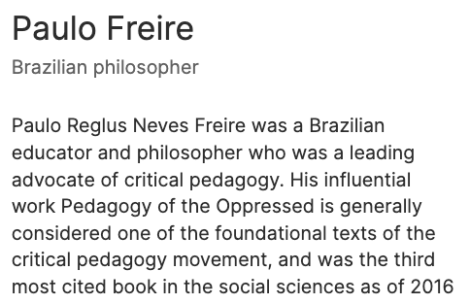
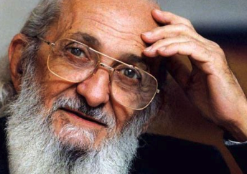
(Wikipedia)

Slide 3
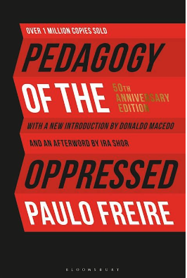
Did you have a favorite quote from Chapter 2, Why did it resonate with you?
Share an example of Banking Education

Slide 4
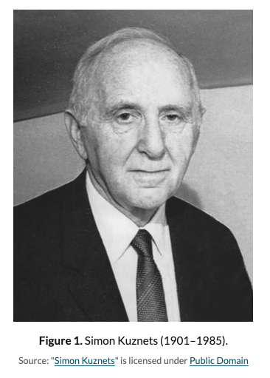
The first basic concept of GDP was invented at by Richard Cantillon in 1755.
The modern concept was developed by the American economist Simon Kuznets in 1934 and adopted as the main measure of a country's economy at the Bretton Woods conference in 1944.
The History of the GDP

Slide 5
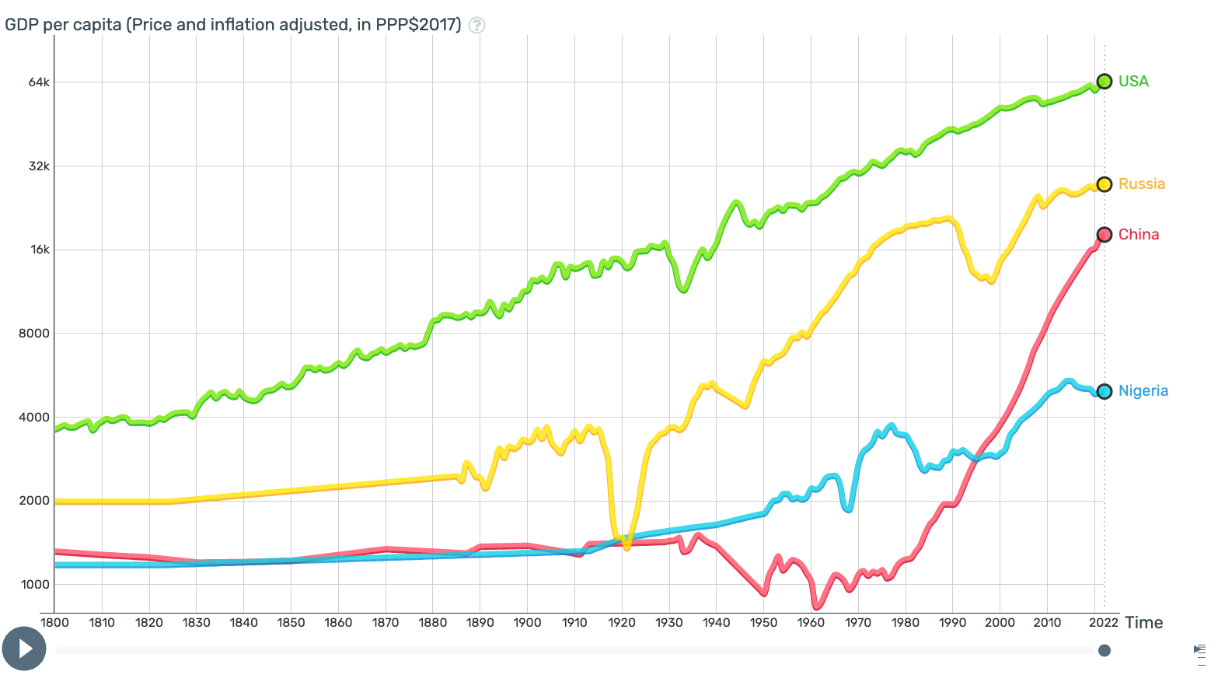
How does GDP look like across countries?
Gapminder Tools

Slide 6
How does the GDP make you feel? Think?

Slide 7
Based on the Circular Flow Model
How is the GDP derived? What problem was it trying to solve?

Slide 8
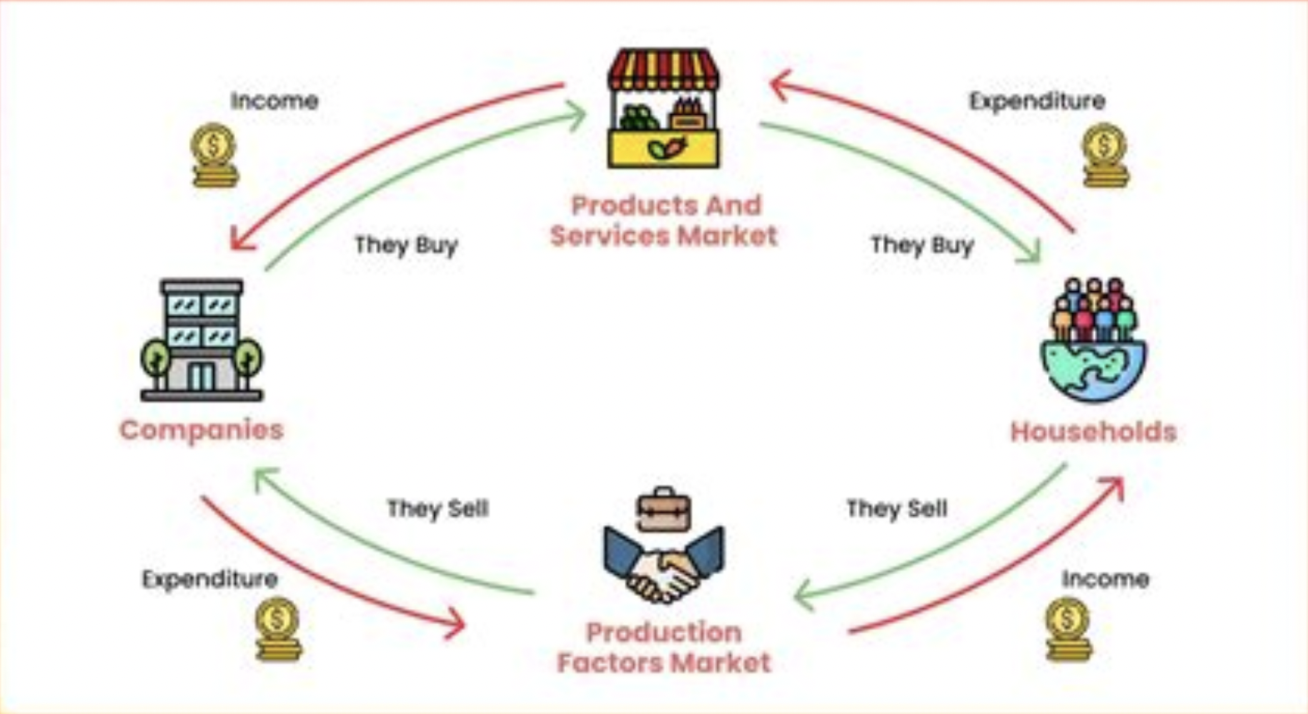
Source: circular flow model - Ecosia - Images
The Economic Theory: Draw The Circular Flow Model

Slide 9
'The gross national product ... measures everything ... except that which makes life worthwhile.’
- Robert Kennedy 1968
Source: Diane Coyle, Time to Fix the GDP?

Slide 10
'The gross national product ... measures everything ... except that which makes life worthwhile.’
- Robert Kennedy 1968
Source: Kate Raworth, Design to Distribute
Issues with the GDP:
Sustainability, inequality/inequity,
not accounting for important work (eg. caring for family)

Slide 11
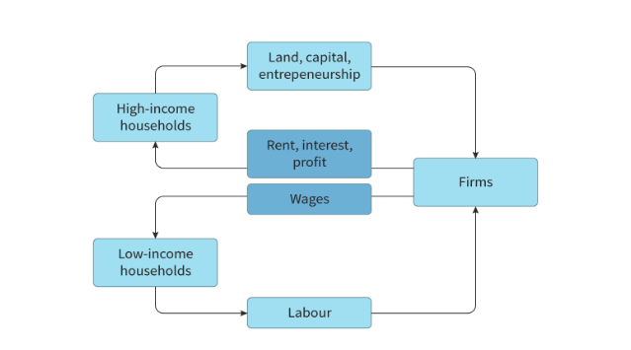
Source: Kognity
A Modified Circular Flow Model.
What problems does GDP create?

Slide 12
a. What are some glaring problems with the GDP? b. To what extent is inequity inevitable in our current economic model/theory?
Some Economics to Consider

Slide 13
What has Banking Education Got to Do With the GDP?

Slide 14
There’s no such thing as neutral education. Education either functions as an instrument to bring about conformity or freedom.
Freire

Slide 15
a. Investigate the definition b. Question assumptions that lie behind economic model c. Consider what problem was being solved? d. Consider what unintended consequences are created? e. Consider if there a “silver bullet” (uncomplicated solution) or composite approach? f. Question if the economic policy is purely ”positive” or value-free? (Who has the power to decides?)
CEL Means…

Slide 16
What does a government policy that blends GDP, Gross National Happiness (GNH), Genuine Progress Indicator (GPI), and Social Progress Index (SPI) as key metrics and part of the research phase would look like?
How effectively can economists include digital goods / services into their calculations?
Do countries relying on more cash-exchange generate higher GDP than what the GDP formula can calculate? Can buying and exchange goods/services where there is no net cash flow contribute to overall GDP?
Is our current economy an outcome of the industrial revolution like schools are? Will alternate systems like Bitcoin ever become mainstream if they are regulated by governments that have been banked What will it take to roll out a new economic order ?
Your Wonderings…
Aren’t informal economies which are not typically reflected in GDP statistics, particularly in developing countries, are tied to areas linked to waste or production for the benefit of developed countries?

Slide 17
Week 4 Update/Reflection Prompt:
“What are the ways I have been “banked” in my education that creates a sense of unbridled faith in the GDP?” (150-200 words)
CEL PAR: Next Week – Getting the Story Wrong

Slide 18
This Week by Friday:
Upload your Unit Plan on CG Scholar
Demonstration in class – accept Work
CEL PAR: Next Week – Getting the Story Wrong

Slide 19
Week 4
The GDP
Context: What is the history to the invention of this indicator and why does the GDP have such power in our social reality?
How is this phenomenon linked to the concept of Banking Education that was developed by Freire?

